Slide 1

Homeowners’ Association
ANNUAL MEETING
October 21, 2023
Notes:
John will welcome everyone and call the meeting to Order

Slide 2

John Cleveland, President
Lavinda Hedman, Vice President
Susan Dewey, Treasurer
Ynette Marx, CC&R Committee
Laura Macbeth, Secretary
Christopher Mitcham
Notes:
John will introduce the Board members and excuse Laura. We have asked Ynette to take minutes for tonight’s business. Note that Christopher was appointed to the board earlier this year.

Slide 3
2022 Annual Meeting Agenda
Call Meeting to Order
Establish Quorum & Proof of Notice
Minutes of 2022 Annual Meeting
Introduction of Board Members
Treasurer’s Report
Audit Report
2023Accomplishments
Penalties & Fines Policy
Website Submissions
2024 Goals
Call for Questions/Input from Homeowners
Introduction of Candidates, Write Candidates & Nominations from the Floor
Election of Board of Directors
Volunteer Recruitment
Election Results
Adjourn Meeting
Introduce Officer to Speak
to HOA concerning recent events and safety precautions.
Notes:
John will summarize what is going to happen and turn the time over to Susan. For convenience everyone received a copy of the agenda in their packet.

Slide 4

Establish Quorum & Proof of Notice
Quorum requires 19 members or proxies
(one member per property)
Notes:
SUSAN will announce that there is a quorum represented either in person or by proxy and confirm that the Notice of Annual Meeting was mailed 30 days prior to the meeting.
Mr. President there are 182 households in Waterford. Ten percent constitutes a quorum. There are _________ represented in person here today. In addition, we have _______ signed proxy assignments that were submitted prior to the meeting. That is a total of ________. We have met the requirement for a quorum.

Slide 5

2022 Annual Meeting Minutes Review & Approval
Notes:
JOHN will announce that minutes from last year have been available on the HOA website and we passed them out as members checked in today. He will ask that the reading of the Minutes from last year’s meeting be waived and ask for a motion to approve. If there are changes then ask for a motion to approve with the indicated changes.

Slide 6
Treasurer’s Report
FISCAL YEAR:
OCTOBER 1, 2022, to SEPTEMBER 30, 2023
Notes:
John will introduce the Susan as the Treasurer. He will explain our fiscal year ends on September 30th of each year so that we can have reports ready for the Annual Meeting.

Slide 7
Income
MEMBERSHIP DUES INCOME | $35,046.00
TRANSFER FEES INCOME | 450.00
INTEREST INCOME | 1,403.02
TOTAL INCOME | $36,899.02
All members are current on their annual dues!
7
Notes:
Susan will present the financial report. For convenience everyone received a copy of the treasurer’s report in their packet.
Note that interest for the previous fiscal year was $12.88.

Slide 8
OPERATING EXPENSES
Membership Expenses
 | Events & Promotions | $ 822.60
 | Holiday Decorations | $ 2,790.02
 | Board Gifts | $ 106.95
Total Membership Expenses |  | $ 3,719.57
Landscaping and Groundskeeping
 | Lawn Care | $ 13,747.00
 | Tree & Shrub Care | $ 460.00
 | Sprinkler Maintenance & Repairs | $ 1,242.98
 | Snow Removal | $ 4,356.00
Total Landscaping and Groundskeeping |  | $ 19,805.98
Monthly Banking Costs
 | Bank Charges | $ 1.00
 | Venmo Fees | $ 38.60
 | Credit Card Processing Fees | $ 193.03
 | ACH Check Processing Fees | $ 6.00
Total Monthly Banking Costs |  | $ 238.63
8
Notes:
Holiday Decorations included Christmas lights and 4th of July Decorations.
Lawn Care was up by $1700, and snow removal was up $1700, sprinkler repair up $400.

Slide 9
Supplies & Services
 | Meeting Expense | $ 117.30
 | Office Supplies | $ 711.94
Total Supplies & Services |  | $ 829.24
Postage and Delivery
 | Postal Box Rent | $ 176.00
 | Stamps | $ 460.00
Total Postage and Delivery |  | $ 636.00
Professional Fees
 | Accounting & Audit Fees | $ 500.00
 | Insurance & Bonding Costs | $ 1,238.00
 | Legal Fees - New Bylaws & CC&R's | $ 718.75
 | Courthouse Filing Fees | $ 454.20
 | Taxes - State of Idaho | $ 30.00
Total Professional Fees |  | $ 2,940.95
9
Notes:
Office Supplies included the purchase of a scanner for the HOA, and the supplies to make our own vinyl signs (Mitcham’s donated the stands)
Legal Fees included preparation of having our attorney review the revisions to the Bylaws and CC&Rs.
Filing fees were $454 to Bonneville County.

Slide 10
Utilities
 | 0340 Napa Drive | $ 312.00
 | 3330 Burgundy Drive | $ 494.24
 | 3561 South 5th West | $ 358.96
 | 3900 Tuscany Drive | $ 330.83
 | 3811 South 5th West (Pump) | $ 427.41
Total Utilities |  | $ 1,923.44
TOTAL OPERATING EXPENSES | $30,093.81
10
Notes:
Utilities are pretty constant each year. Overall total operating expenses came to $30,093.81

Slide 11
INCOME LESS EXPENSES
Gross Income $36,899.02
Operating Expenses (30,093.81)
Net Income $ 6,805.21*
*Moves into Equity Account (Savings) for Capital Expenditures
Notes:
Explain this, see next slide

Slide 12
CAPITAL EXPENSE “EQUITY” ACCOUNT
Beginning Balance on 10/1/22 $56,806.95
2023 Net Income $ 6,805.21
Total Equity Account $63,612.16
12
Notes:
Our extra income of $6805 went into the Equity pot

Slide 13
2023 CAPITAL EXPENDITURES
Capital Improvements
 | Canal Cleanup | $1,800.00
 | Tree Removals | $3,300.00
 | TOTAL CAPITAL IMPROVEMENT EXPENDITURES | $5,100.00
13
Notes:
Susan will Explain the Capital Expenditures.
Canal - Note that the city of Idaho Falls paid $1,800 to help with the cost of the canal cleanup.
Tree Removal - we did put it out to bid.

Slide 14
Total Equity Account $63,612.16
Less 2022-2023 Capital Expenses ($5,100.00)
Remaining Capital Expense Equity $58,512.16
14
Notes:
Last Year’s Equity was at the end of the year was $56,806.96, so there was a overall increase to the
Equity, which is basically our “savings”

Slide 15
Assets
Checking Account $ 574.50
Money Market Savings Account 2.5% APY $ 27,092.64
Certificates of Deposit
One Year 4.25% APY matures 1/24/24 $ 24,694.36
Six months 5.51% APY matures 1/24/24 $ 6,150.66
TOTAL CASH ON DEPOSIT $ 58,512.16
15
Notes:
Review the assets of the Association – The $58,512.16 that we ended the fiscal year with is divided between these accounts. We cannot put it all into certificates and tie it up because we need it for operating expenses until dues start coming in this fall.
Turn it back to John

Slide 16
2023 Audit/Review
Board made a resolution in 2022 that the Association’s records will be Audited every other year and simply reviewed in the alternate years.
The HOA will have the full Audit the end of the Treasurer’s first year in office, and again at the end of the Treasurer’s third year in office, or before a new Treasurer will take office.
The incoming Board will determine the need to have the CPA prepare the taxes each year.
Present the Review Letter from CPA
Notes:
John Ask for a motion to accept the treasurer’s report as presented
Review the points on the slide and then note the Board requested a FULL AUDIT of the Association’s records for the past fiscal year. You will read the portions of the audit report that state the good things we are doing, and point out the things we should work on. (It is not necessary that the entire report be read)

Slide 17
2023 Accomplishments
Notes:
John will present our achievements for the past year

Slide 18
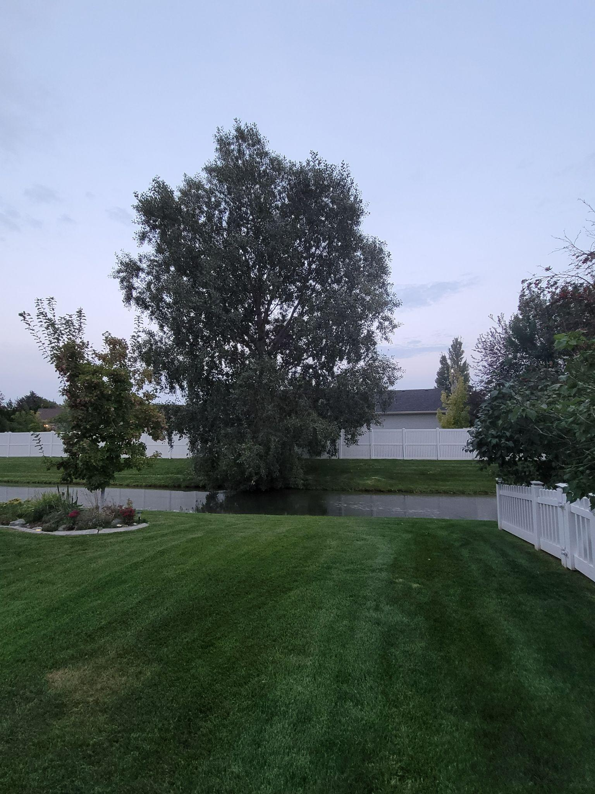
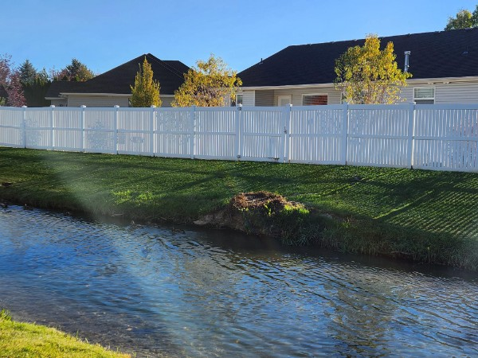
#1 Removed large tree growing in the canal
Notes:
The tree along the east side of Gustafson Canal was removed as the integrity of the root system was compromised. Some HOA members were able to harvest some of the firewood.

Slide 19
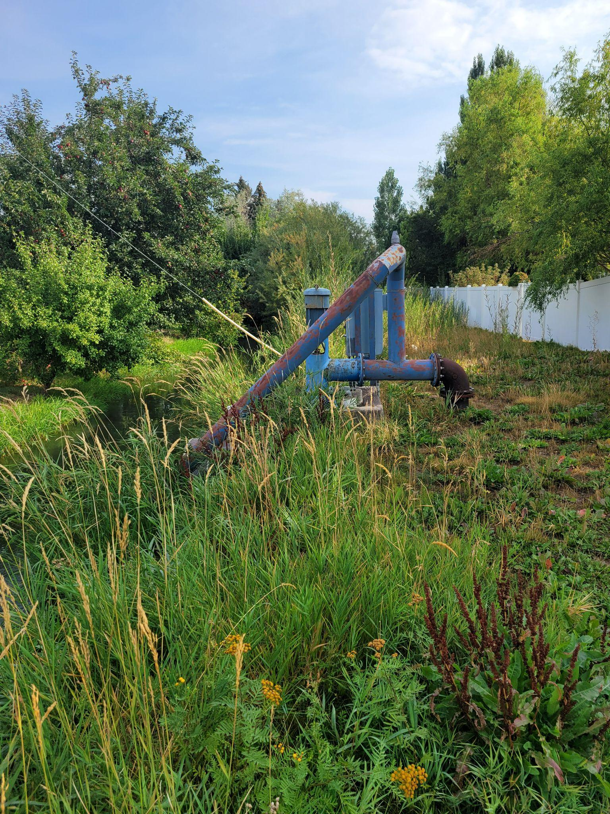
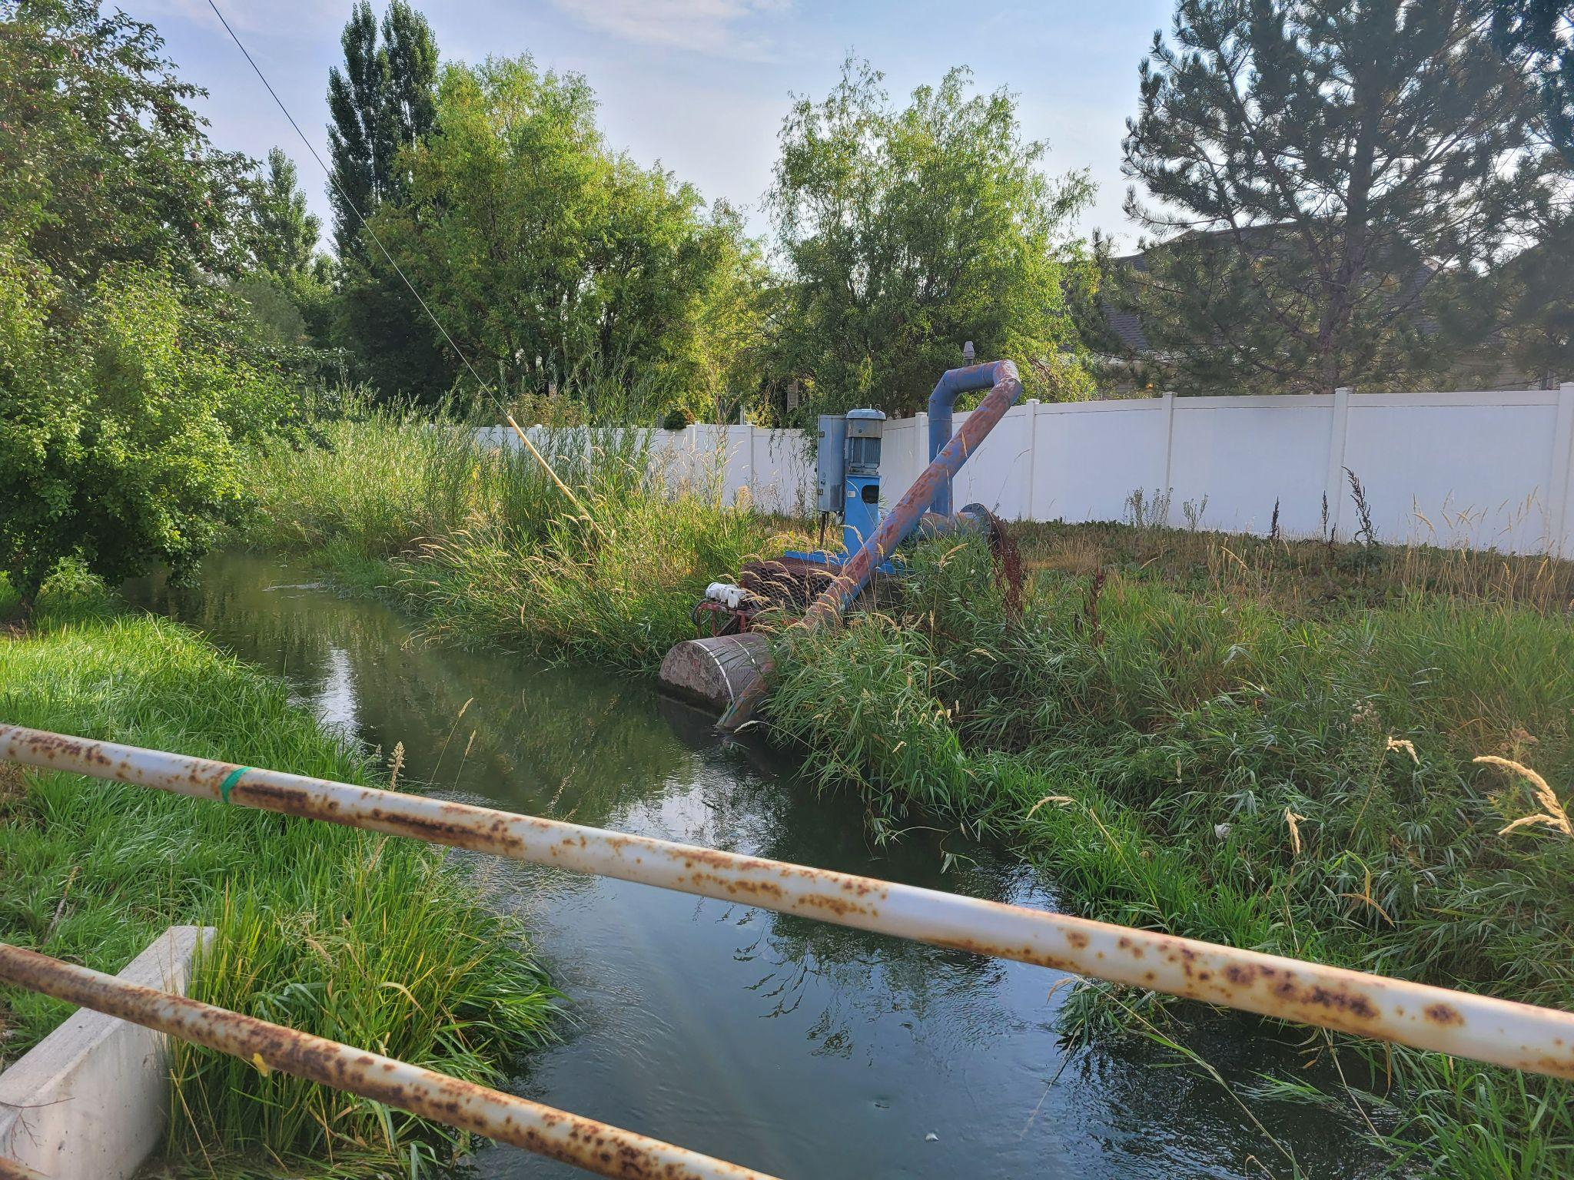
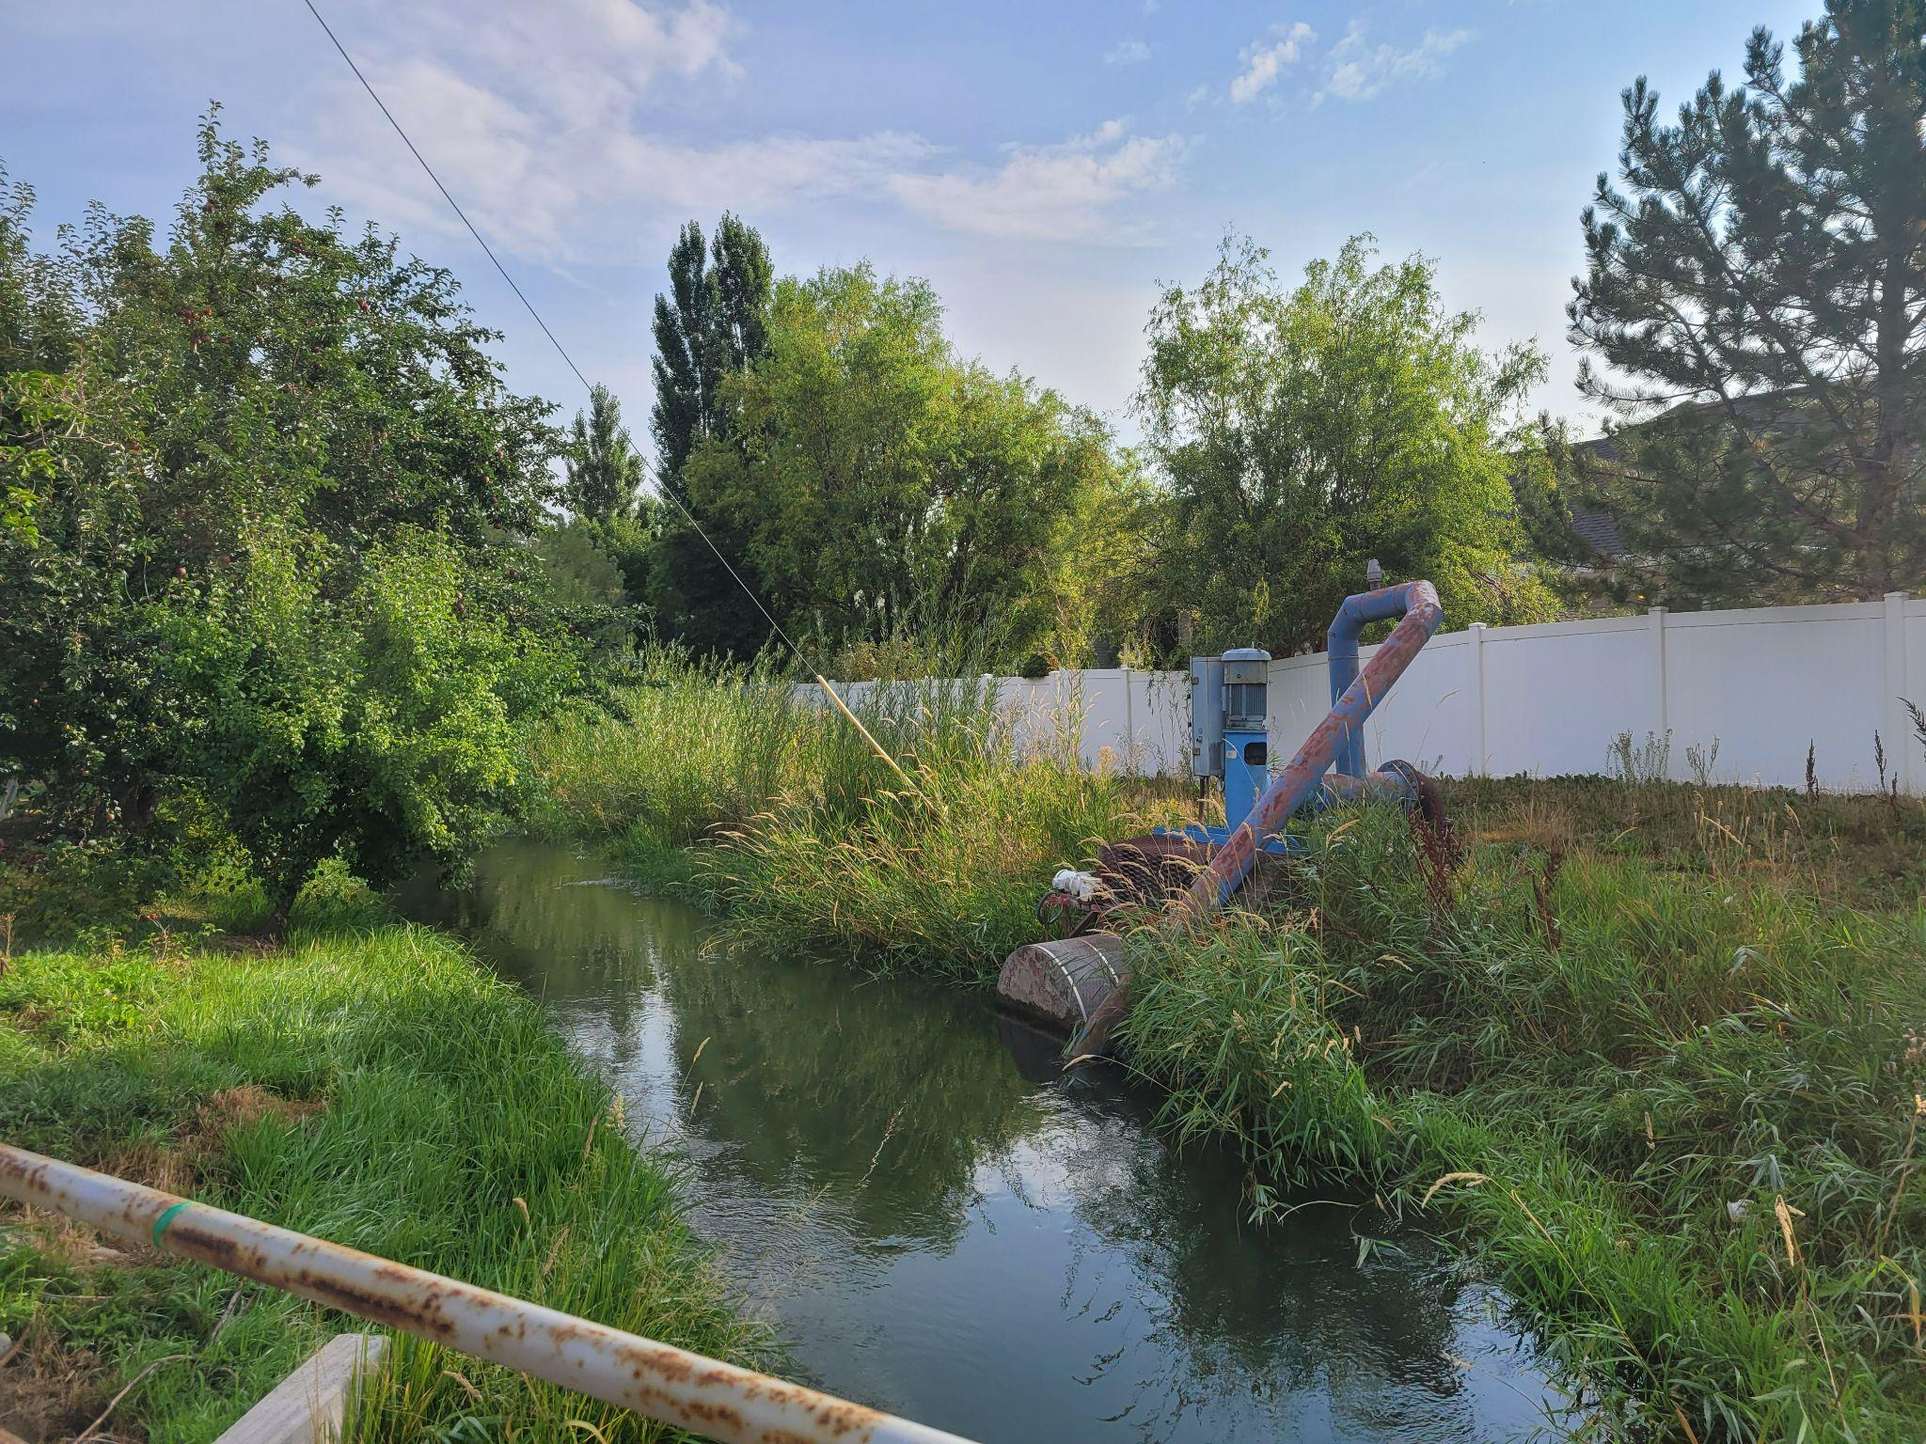
#2
Cleaned up
Pump and
Canal Area
(Before)
Before
Notes:
The pump area is the HOA’s responsibility. We were able to work with the city on this project. They paid ½ of the cost to have T & T clean up the area along the canal.

Slide 20
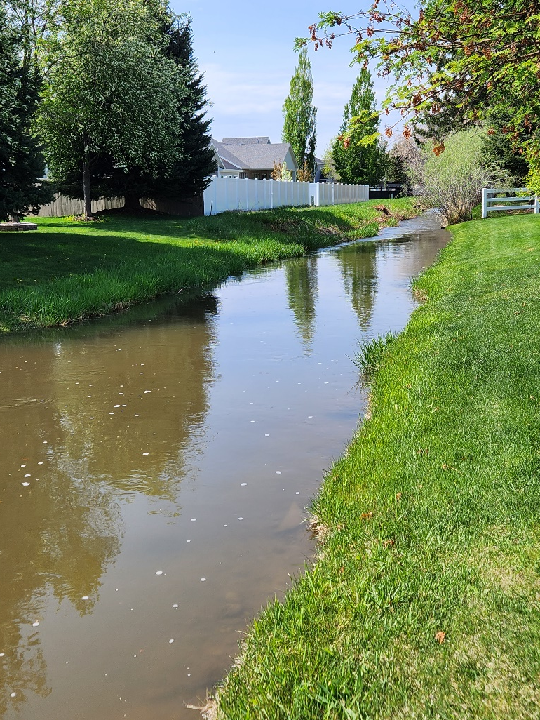
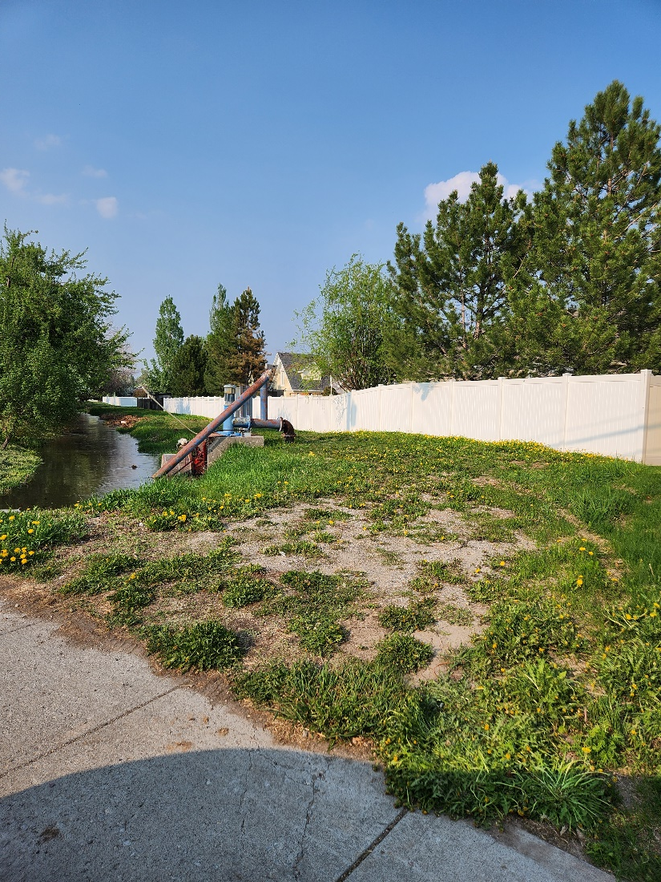
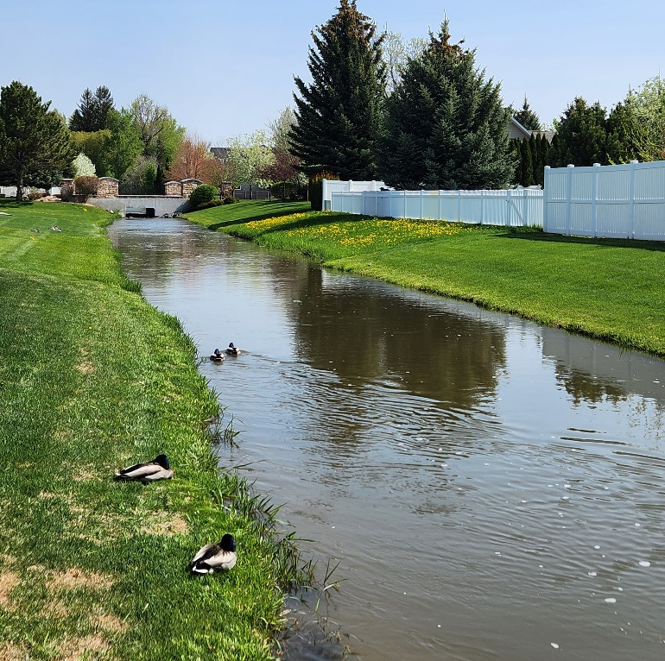
After Cleanup
After
Notes:
The pump area is the HOA’s responsibility. Now that is has been cleaned up, we have informed the homeowners along the canal that it is their responsibility to maintain it. Nothing but grass should be planted between the fence line and the water. Willow especially must be removed or cut down.

Slide 21
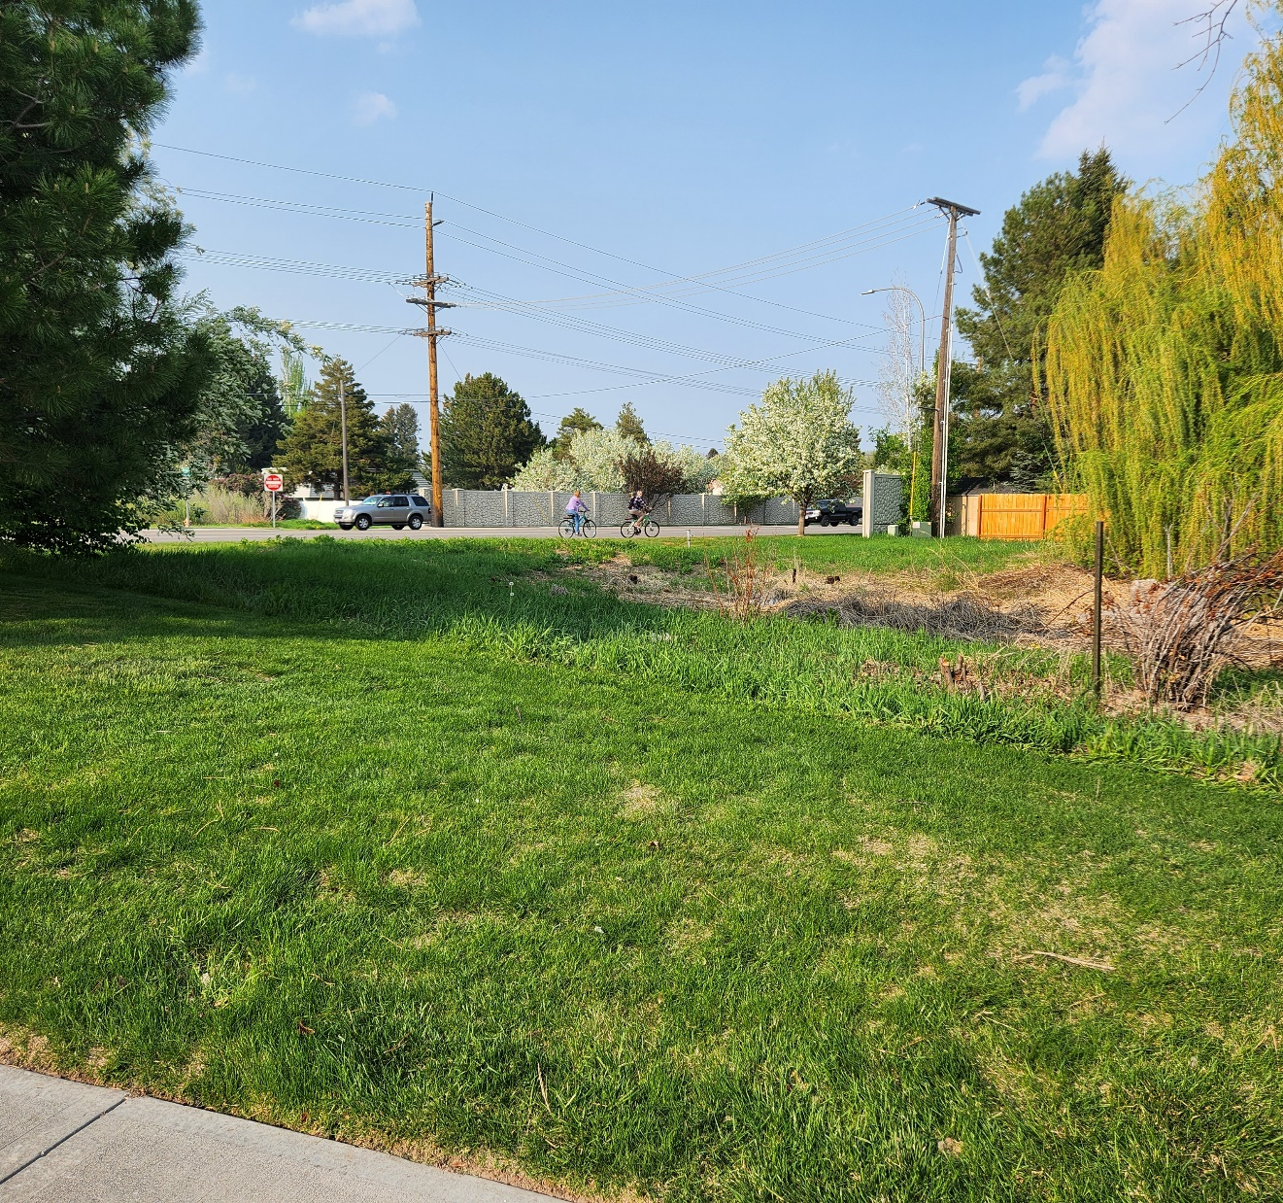
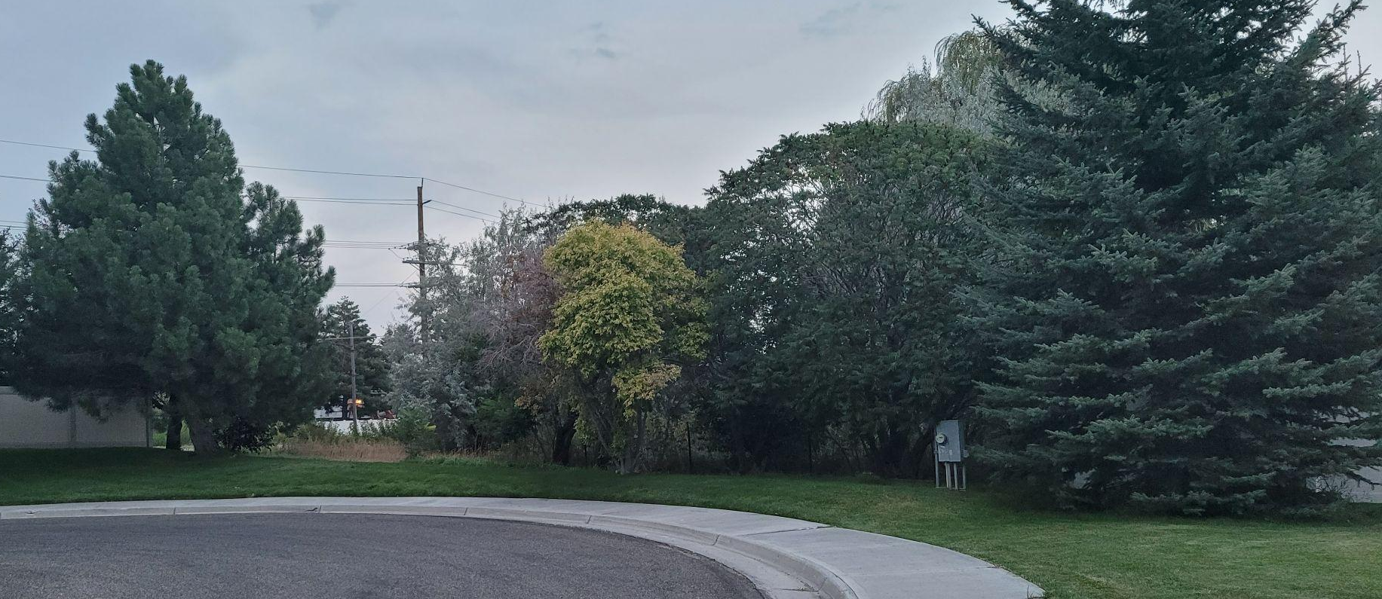
#3 Worked with City to clean up wetland area at the end of Burgundy
Notes:
At the end of Burgundy we worked with the city to get the wetlands cleaned up.

Slide 22
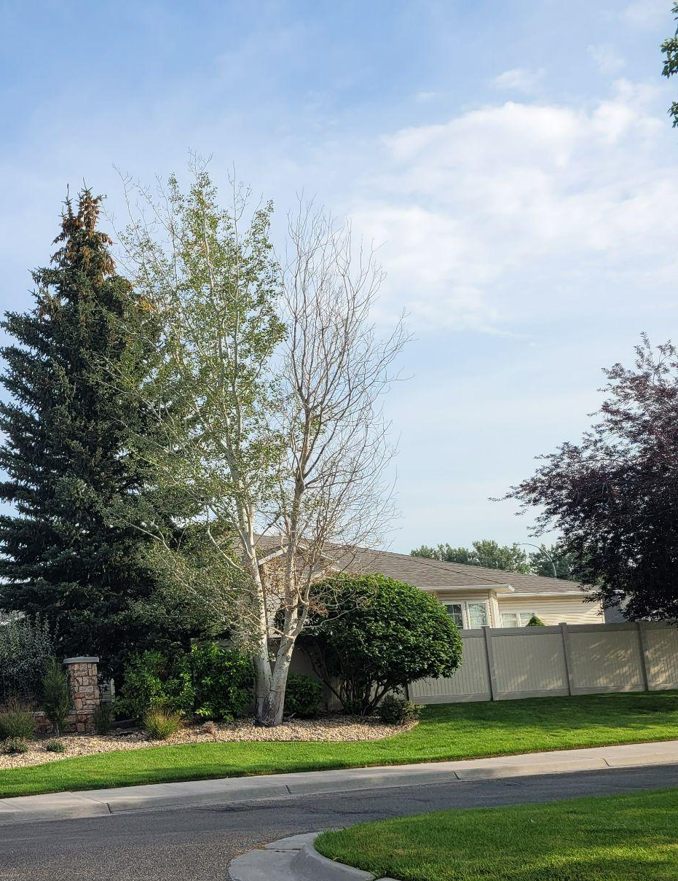
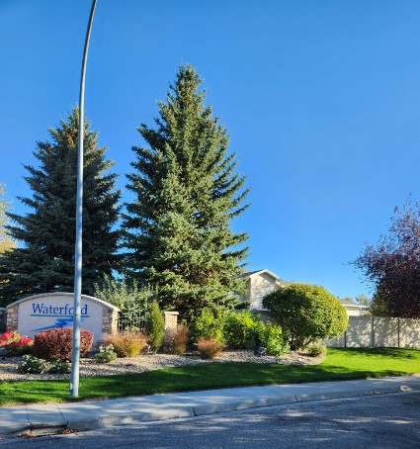
#4 Removed or
Trimmed
Dead Trees Around the Neighborhood
Notes:
There were some dead trees that need to be addressed. They were removed, trimmed, or replaced on a case by case basis.

Slide 23

#5
Developed a financial plan to move association assets to Mountain America Credit Union and keep contingency funds in a money market account and certificates of deposit.
Notes:
The treasurer’s report shows the breakdown of the certificates of deposit and the money market account. The HOA earned over $1400 interest in the last fiscal year.

Slide 24
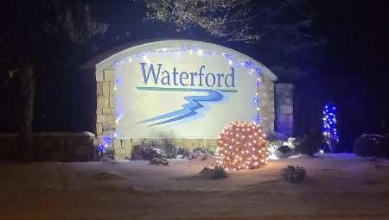
#6 Holiday Lights
Notes:
We were able to get a start on the holiday lighting last year. Our hope is to improve on what that this coming year. Our goal is to get power to the island at the north entrance (possibly solar) and then next add the islands’ trees to the plan.

Slide 25
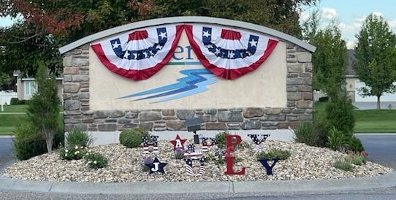
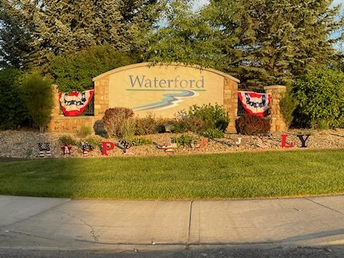
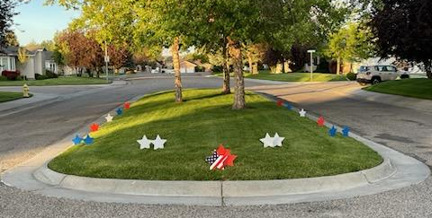
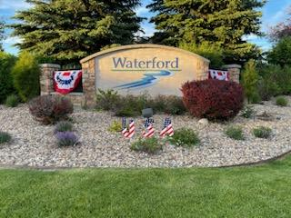
#4 Fourth of July Decorations
#7
Fourth of July Decorations
Notes:
We decorated the HOA entrances for the 4th of July this year. We plan to use the same decorations each year as well as on Veterans Day.

Slide 26
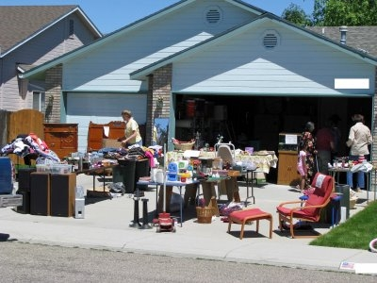

#8 Neighborhood Yard Sale
Notes:
We had the 2nd annual neighborhood yard sale. Those that participated did well.

Slide 27
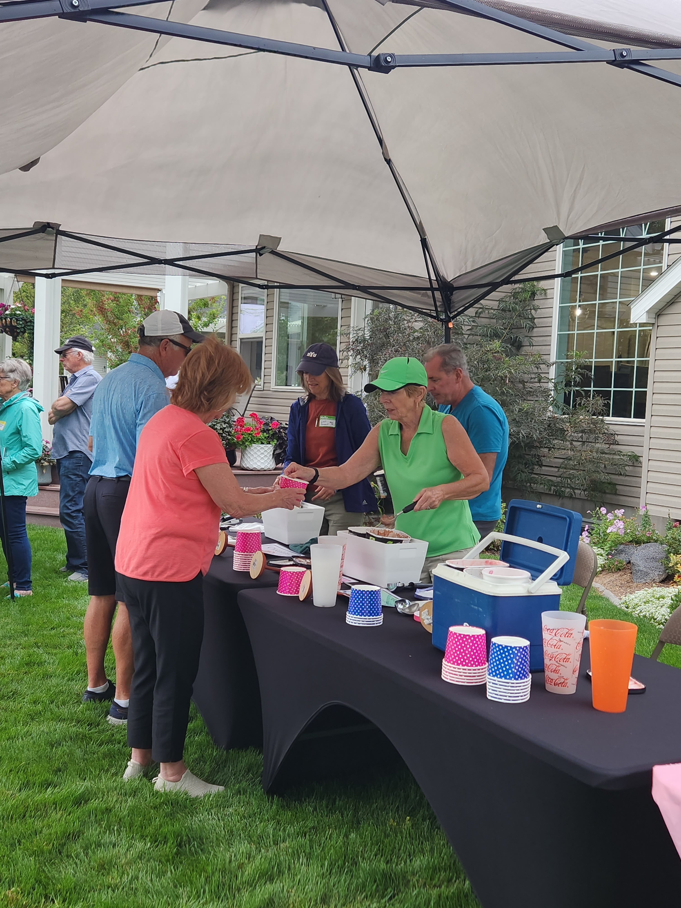
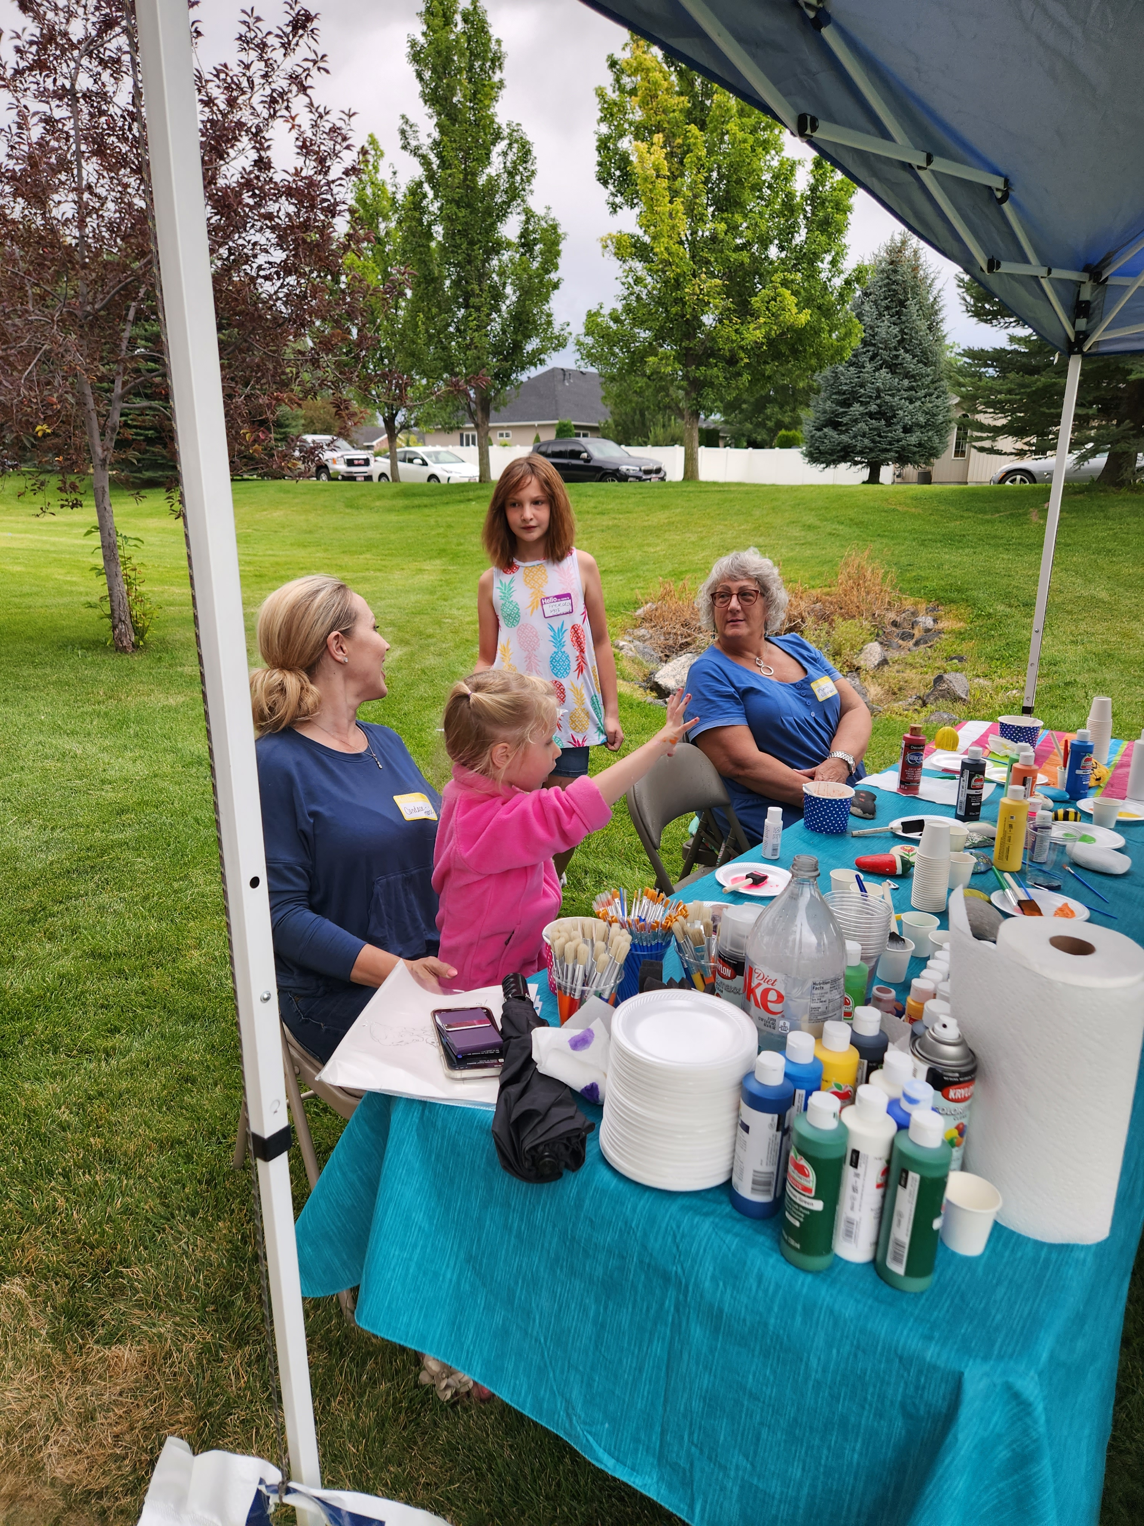
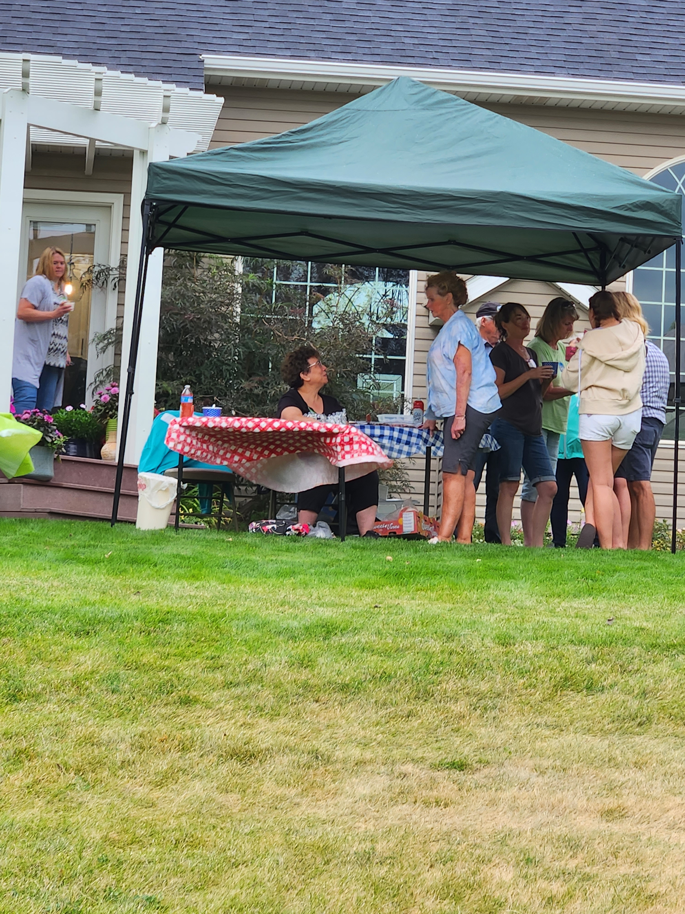
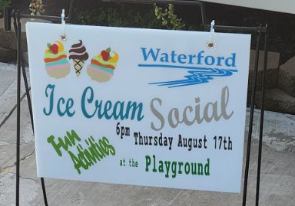
#9 Social Gatherings
Ice Cream Social
Rock Painting
Bocci Ball
Corn Hole
Montana Golf
Notes:
Lavinda will report on the Ice Cream Social. Note all the activities we had at the event.. Approximately 50 people participated.

Slide 28

#10
Board and
Committee Training
Notes:
Ynette will cover the training for the board and ACC that we had and more that we hope will take place soon. She will explain the expansion of the ACC Committee and new Compliance Committee.

Slide 29
#10 Neighborhoods Matter
The stormwater retention areas aka as parks in our neighborhood are not dog parks. Animals should be leashed and cleaned up after according to city ordinances. Complaint concerning animals should be directed to Animal Control, not Board Members.
Speeding cars have become an issue on some of our streets so the City of Idaho Falls has placed electric speed sign near the bridge on Hickory to raise awareness.
It has been suggested that we work with the city to have some kind of walkway to the playground area from the street. That is under consideration.
Ad “DEAD END” sign is going to be place near the end of Burgundy, where it meets up with Tuscany. This will hopefully reduce some of the nuisance traffic in that area.
IF SOMETHING HAPPENS THAT CONCERNS YOU,
CALL THE POLICE OR FIRE DEPARTNMENT.
Notes:
Ynette will discuss these issues.

Slide 30
#11
Established Fines & Penalties Policy
The new Idaho Statute and our new Covenants, Conditions & Restrictions now allow for the implementation of fines and penalties non-compliance.
The Idaho Homeowners’ Association Act went into effect July 2022.
The Policy will keep us compliant with the new statutes
Notes:
The entire Board will explain the fines and penalties which the Compliance Committee developed and which the Board voted to approve. Copies of the Policy were available at the door.

Slide 31
Purpose:
The purpose of this policy is to establish clear fines and penalties for homeowners within the Waterford community who fail to comply with the Article II of Covenants, Conditions, and Restrictions (CC&R) established by the Waterford Homeowners' Association (HOA). These rules are essential for maintaining the aesthetic appeal, safety, and harmony of our neighborhood.
Note: Fines of more than $25.00 imposed by the HOA as outlined in this Policy must have a majority vote of the Board of Directors.
Notes:
SUSAN

Slide 32
1. Visible Parking:
Parking of utility trailers, equipment, disabled vehicles, recreational vehicles (RVs), including but not limited to snowmobiles, ATV's, watercraft, camp trailers and similar vehicles, is strictly prohibited in the front of homeowner’s house or on the street, except under specific circumstances (i.e., construction, moving, etc.) with prior authorization and for a specific timeframe. RV trailers and campers may be parked in front of the property for less than 72 hours when in preparation for travel. Non-compliance with this rule, or if parked for more than 72 hours, will result in the following fines:
First Offense: Written warning and a fine of $25.00 per day.
Second Offense or Failure to Move the Vehicle or Equipment as required in written warning: Fine of $100.00 and a mandatory HOA Review Meeting.
Third Offense: Fine of $200.00, towing at owner's expense, and a mandatory HOA Review Meeting.
Notes:
CHRISTOPHER

Slide 33
2. Garbage Cans:
Garbage and Recycling cans must not be left outside except on designated collection days. Can must not be set out more than 24 hours in advance. Following the collection, garbage cans must be returned to a concealed location within 24 hours. No written notice will be given after the first written warning. Non-compliance will result in the following fines:
First Offense: Written warning.
Second Offense within 12 a month period: Fine of $25.00, with no written notice.
Three or More Offenses within 12 a month period: Fine of $50.00 for each subsequent offense.
Notes:
YNETTE

Slide 34
3. Lawn Maintenance:
Homeowners are responsible for maintaining their lawns in an orderly and well-kept manner. This includes regular mowing, trimming, weeding, and watering, as well as eliminating nuisances such as voles and obnoxious weeds and trash. Egregious failure to do so will result in the following fines:
First Offense: Written warning with a 72-hour deadline to rectify the issue. If the issue is not resolved within 72 hours a fine of $25.00 will be assessed.
Second Offense: Fine of $50.00 and a mandatory HOA Review Meeting.
Third Offense: Fine of $100.00 up to $1,000.00 and possible third-party lawn maintenance at the homeowner's expense.
Notes:
JOHN

Slide 35
4. Homeowners’ Failure to Comply with Article II of the CC&R’s
Homeowners may be notified of failure to comply with sections of Article II not otherwise identified herein. At the discretion of the Compliance Committee a written warning may be issued to the homeowner. Failure to Comply in a timely manner as outlined in the warning may result in the following fines:
First Offense: Written warning with a specific remediation deadline.
Failure to Comply within written timeline: Fine of no less than $25.00 but not more than $1,000.00 and a mandatory HOA Review Meeting.
Failure to Comply with terms agreed upon in Review Meeting: Fine of $1,000.00.
Notes:
SUSAN

Slide 36
5. Failure to Submit Plans for Construction, Hardscaping, Tree Plantings, and Other Improvements:
Homeowners planning construction, hardscaping, tree plantings, or other significant improvements to their property must submit detailed plans to the HOA for review and approval before commencing work. Failure to do so will result in the following fines:
Failure to Submit Plans: Written warning and a fine of $50.00.
Commencement of Work Without Approval: Fine of $100.00 and immediate cessation of work until proper approvals are obtained.
Continued Non-Compliance: Fine of $200.00 and additional fines for each subsequent violation until compliance is met.
Notes:
YNETTE

Slide 37
6. Reconsideration of Fines:
The HOA Board may, at their discretion, waive or adjust fines assessed under this policy upon receipt of a written request for reconsideration from the homeowner. The request must be received within fourteen (14) days and should provide a detailed explanation of the circumstances surrounding the violation, steps taken to rectify the situation, and any other relevant information, including actions needed to be taken by others before your issue can be resolved. The HOA Board will review the request and make a determination based on the merits of the individual case.
Notes:
LAVINDA

Slide 38
7. Lien Placement for Unpaid Fines:
Homeowners with unpaid fines and penalties will have a lien placed on their property. The HOA will initiate the lien process 60 days from the date of the first notification. The lien will include the unpaid fines, associated administrative costs, interest, and legal fees.
Notes:
JOHN

Slide 39
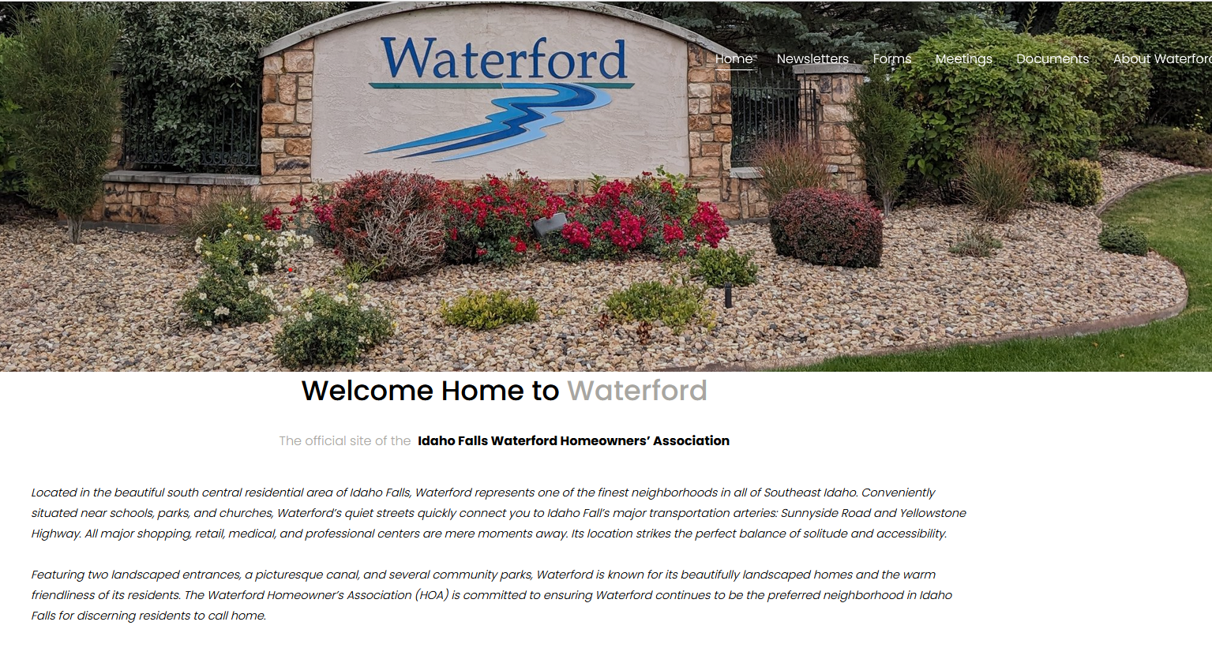
#12
Upgraded the HOA Website to Facilitate Online Complaints or Violation Submission
Waterfordhomeowners.org
Notes:
Susan will detail the upgrade of the HOA website to accommodate submissions for online complaints

Slide 40
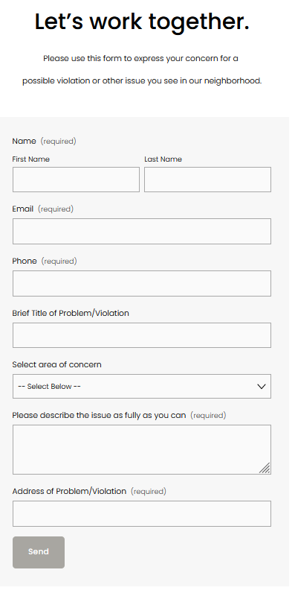
Notes:
SUSAN

Slide 41
2024 Goals & Plans
Notes:
John will present our goals for the coming year

Slide 42

#1
Seek to fill the 7th Position on the Board
Notes:
John will discuss the open position on the Board and the fact that we hope to fill the position with a write in candidate today. We were not able to get representation from every division in the subdivision as recommended in our bylaws, but we will be able to work as a full board going forward.

Slide 43

#2
Continue Board and Committee Training
Notes:
YNETTE The board will work towards more training for the Board and ACC and Compliance Committee.

Slide 44
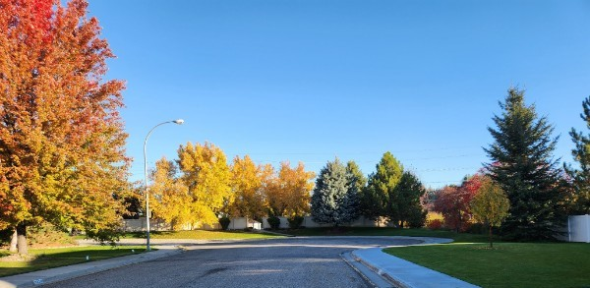
#3
End of Burgundy Area Upgrade and Additional Fencing
Notes:
Ynette will detail the plans for the end of Burgundy. At the end of Burgundy we plan to install a fence on the east, from the Creager’s fence line along our property line and over to the existing fence. Then on the west side we are going to continue the fencing over to the canal area. The canal is partially on our property here as well. We plan to plant some trees that will help with the noise coming from Sunnyside Road. The flower beds will be upgraded to have rocks similar to what is at the entrance and near the bridge.

Slide 45
#4
Continue Efforts to Keep Canal Vegetation under Control by working with adjacent homeowners and the Irrigation District
Notes:
Christopher will talk about the canal land upkeep.

Slide 46
Gustafson Canal
#5
Establish a Governing Policy Concerning Homeowners Along the Canal and their Responsibility to Maintain the Area Between their Property Line and the Water’s Edge
Notes:
John will report that we are working on a policy for the canal upkeep

Slide 47
#6
We plan to have the entrances decorated by Thanksgiving this year.
Notes:
LAVINDA

Slide 48
Online CC&R Requests
#7
Establish an option on the website to facilitate online requests for CC&R Committee Approvals.
Notes:
SUSAN will explain this.

Slide 49
#8
We are working to set up a system where minutes, treasurer’s reports, and newsletters can be quickly upload to the HOA website so members can see them in a timely manner.
Notes:
SUSAN will explain this

Slide 50
Homeowner Input
What’s on your mind?
Notes:
John will ask for comments, questions, and concerns.

Slide 51
Introduction of Candidates
And nominations from the floor
Notes:
JOHN will explain that there are three positions open. Susan and Lavinda have agreed to another term, but that leaves one more position open. First Lavinda will introduce Susan, then Susan will introduce Lavinda and then we will talk about the third position.

Slide 52
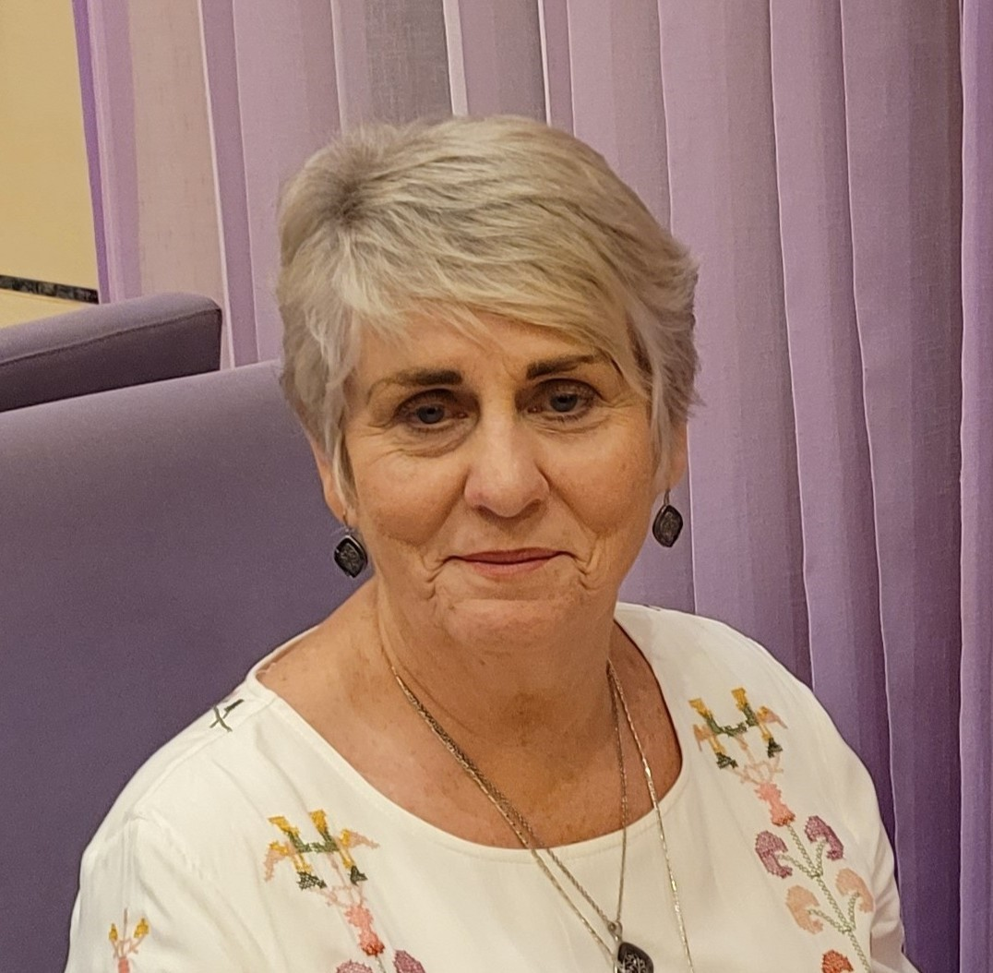
Candidate for Three Year Term
Susan Dewey. I am excited to submit my candidacy for another term on the board, driven by my passion for using my expertise in bookkeeping and computer skills to continue serving our neighborhood effectively. Over the three years, I have had the privilege of contributing my knowledge in bookkeeping to ensure responsible financial management, transparency, and accountability within our organization. I was instrumental in revising the Association’s Bylaws and CC&R’s last year. We now have up to date governing documents that comply with the new Idaho Statutes. Furthermore, my proficiency in various computer skills has allowed me to enhance communications with our members. I firmly believe that with the experience and knowledge I have accumulated during my current tenure, I can contribute even more effectively to our success in the coming years. I am committed to continuing to work diligently and ensuring that our neighborhood thrives. My husband, David, and I have lived in the Waterford Townhouses since 2014.
Notes:
Lavinda will introduce Susan

Slide 53
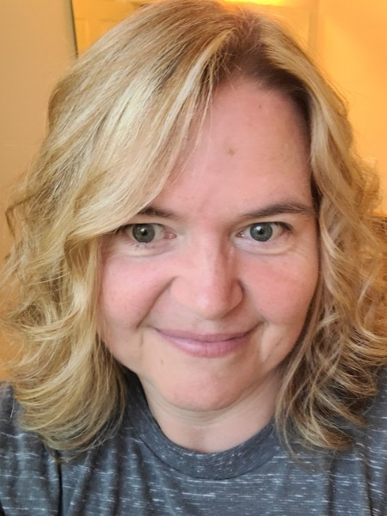
Candidate for Three Year Term
Lavinda Hedman. During my two years on the board, I have worked diligently to update our membership’s contact information, often going door to door to meet new members. This has made communication much easier for the Board. We now get accurate information directly from the title companies at the time of ownership transfers. I have facilitated the holiday decorations this past year, including Christmas and Fourth of July, making our neighborhood entrances pleasant and inviting. Waterford’s Annual Ice Cream Social was a success, in spite of the weather. I enjoyed chairing that event and I’m already thinking about next year’s. I continually seek feedback from members and association leaders to ensure my contributions align with the organization's goals and needs. I believe my knowledge of the neighborhood and our little community has helped me serve the HOA to bring success, along with others on the board, to achieve common objectives. My knowledge can be particularly valuable when working as part of a team, driving positive change, solving problems, tempering discussions, and contributing to the overall success of the association. My husband, Joel, and I have lived on Napa Drive since 2014.
Notes:
Susan will introduce Lavinda

Slide 54
Verl Stuart
Abe Romo
Write-in Candidates
Notes:
Thus far, from mailed in ballots, we have two write in candidates. Verl Stuart and Abe Romo. They were each contacted. Abe and is willing and excited at the prospect of serving on the board. He is unable to be here today because of a family commitment. Verl has expressed to us that he would be willing to serve, if elected.

Slide 55
Voting
Notes:
JOHN will ask for ballots to be turned in. Votes will be added up and the results turned over to John.

Slide 56
Volunteers Needed
We need your help to make our neighborhood strong.
Notes:
While ballots are being counted all of Board can discuss the need for Volunteers
Compliance Committee with Candace-Marie Mitcham

Slide 57
Election Results
Notes:
John will announce voting results and ask for a motion that the ballots be destroyed.
SUSAN The Ballots have been counted. Lavinda and Susan have been reelected for another three years. There were _____ write in candidates. _______________ received the most votes and is therefore elected for a three year term.

Slide 58
Meeting Adjourned
Thank you for your contribution to our neighborhood!
Notes:
John will thank everyone for their participation and adjourn the meeting. “Meeting is Adjourned until Next October”

