Slide 1
2025 Recap
Executive Director’s Review

Slide 2
2025 Bulkhead Repair Synopsis
Completed Work Orders | 117
New Bulkhead Install | 443 Linear Feet
Cap Repairs | 1660 Linear Feet
Manta Ray Tie-Backs | 75 Installs
Washouts | 380 Foam Repairs
Bulkhead Inspections | 281
2026 Road Map will address what we expect to accomplish this year.

Slide 3
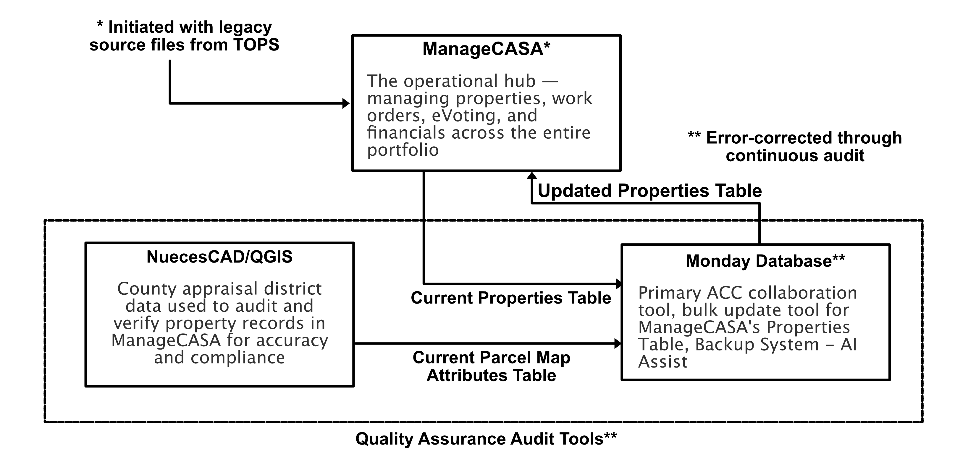
The 3-Part Property Management Tool Suite

Slide 4
Tool Suite - Part 1
ManageCASA
  Second full year of operation
  Still has lingering issues with invoices
    Staff confusion over undocumented features – Learning Curve
    Lack of adequate help files
    Major improvement areas identified
  Still working through TOPS legacy database transfer issues
    Being corrected via the Property Audit Process 87 -90% Complete
    Requires quarterly update to maintain accuracy – Regardless of the tool used

Slide 5
Part 1 continued
ManageCASA Strengths
  Adequate for Large Associations
  Update from local files (Excel, Monday, etc.)
  Secure eVoting and Survey Polls: Reliable and Quick
  Affordable when compared to alternatives
  Integrated financial tools work well with sufficient user training
  Excellent customer support

Slide 6
Part 1 continued
ManageCASA Recommendation
  Continue the course for another year
  Identify and resolve the short comings in the Invoice Process
  Evaluate cost effective solutions or refinements
    Conversion to a modern, database tool with Augmented AI tools
    Industry standard accounting and eVoting tools
    Simpler communications and calendar tools

Slide 7
Tool Suite - Part 2
Quantum Geographical Information System (QGIS) – Open Source
  More suitable than NuecesCAD
  Displays Nueces County Parcel Maps published multiple times each tax year
  Used to graphically create an attributes table of Island properties
    Forms the basis of our property audit and configuration management process
    Filtered attributes table uploaded to ManageCASA to update our property table
  Used to create Map Overlays for documenting bulkhead work, No Wake Sign locations, etc.
  Used with imported maps to generate “What-If” flood maps for the Island

Slide 8
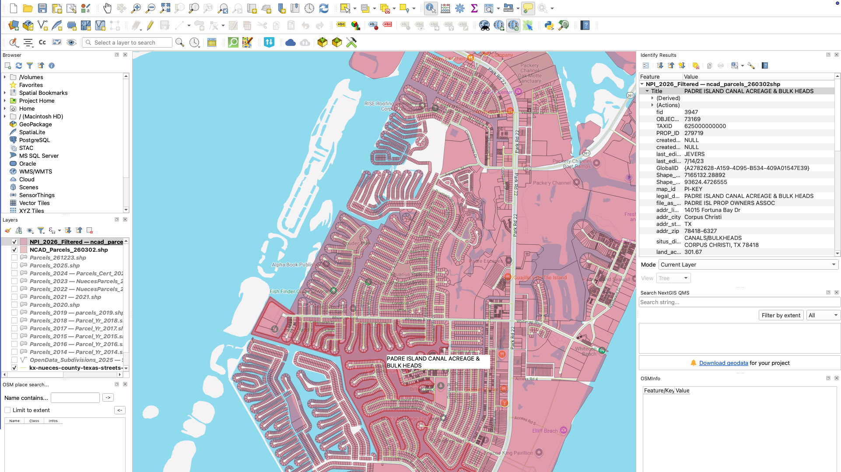
QGIS Examples – Parcel Maps by Year

Slide 9
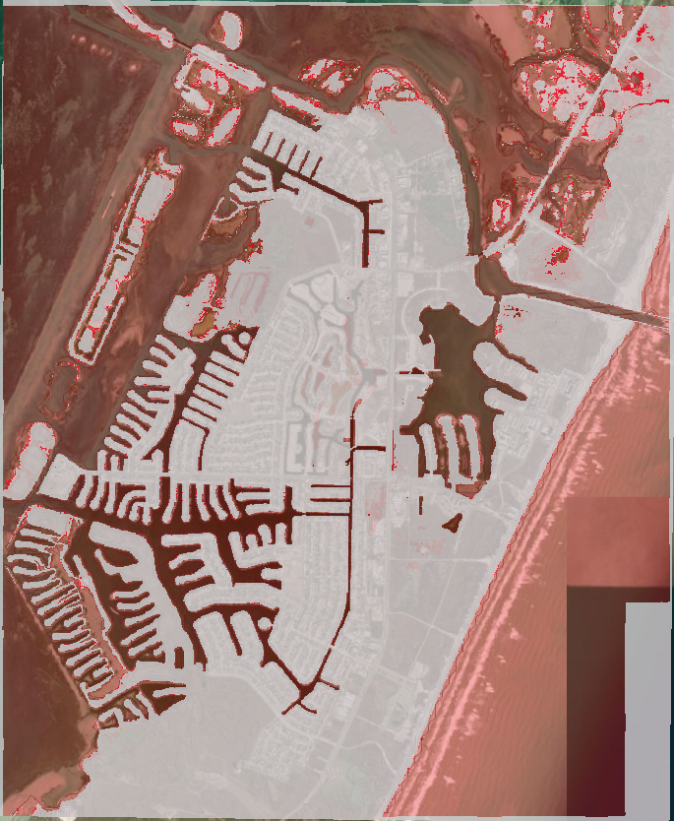
QGIS Examples – Flood Map Analysis
Actual 2017 Digital Elevation Map (DEM)
Includes 8 – 10 Foot Berm at the future site of the Don Pat Bridge
Flood Map shows the impact of a 6’ Tidal Surge
  Base on Landsat Elevation Data
Now with the Don Pat Bridge in place Tidal Surges above 1.5 to 2 feet threaten our properties
Gray is good; any shade of red is water

Slide 10
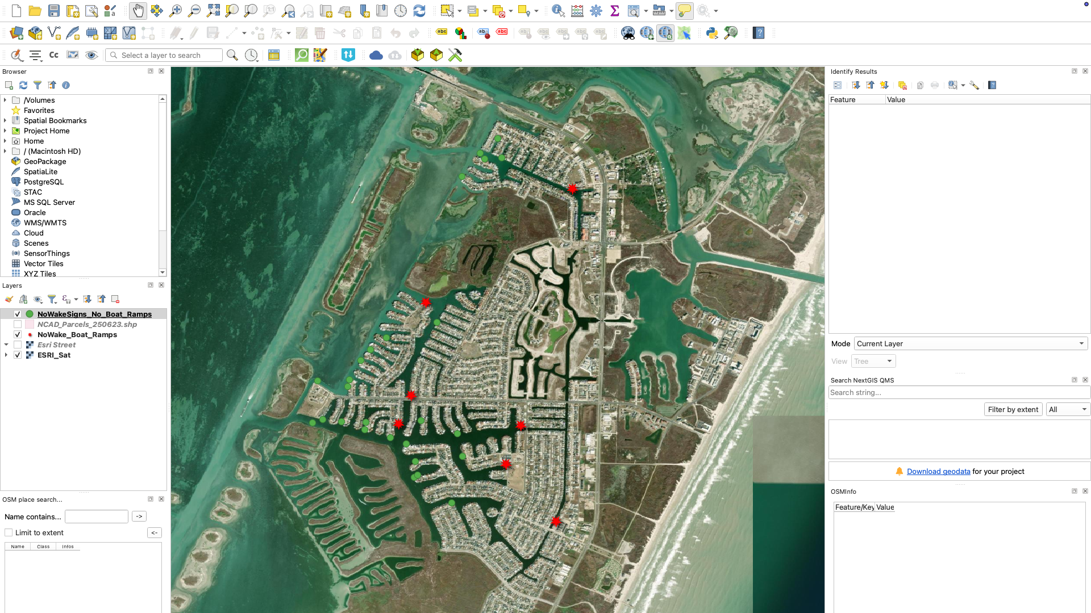
QGIS Examples – No Wake Sign Map Overlays

Slide 11
Tool Suite - Part 3
Monday Database
  ACC Central Operating Hub for all ACC applications and Bulkhead projects
  Provides an automation tool for bulkhead project schedule/documentation management, communications, and budget/expense alerts to cite a few
  Provides shared “boards” and activity logs with supporting photos and text files includes integrated communication module
  Handles large databases with static and real-time updates
  Enables fast queries, dashboards, and cross-board reports

Slide 12
Monday - Vs - ManageCASA
Aspect | monday.com | ManageCASA
Primary role | General work OS / project & workflow management platform. | Dedicated HOA/COA and rental management software with built‑in accounting and resident portals.
Out‑of‑box fit for POAs | Requires custom boards, fields, automations, and often integrations to PMS/accounting. | Designed specifically for associations: dues, portals, violations, maintenance, docs, accounting in one place.
System of record? | Best as workflow/ops layer, not primary accounting/owner system of record. | Intended to be the core system of record for units, owners, financials, and tickets.

Slide 13
The Future Road Map for our Property Management System
Keep all official owners/charges/billing in ManageCASA and mirror the properties table into Monday for day-to-day work
  Periodic Monday –to-ManageCASA updates for concurrency
  Improved graphical search
  Excellent Audit Support
Incorporate Monday automations and project management features into our ACC and bulkhead project workflow
Use “integrations” – the API connector – to link Monday with ManageCASA

Slide 14
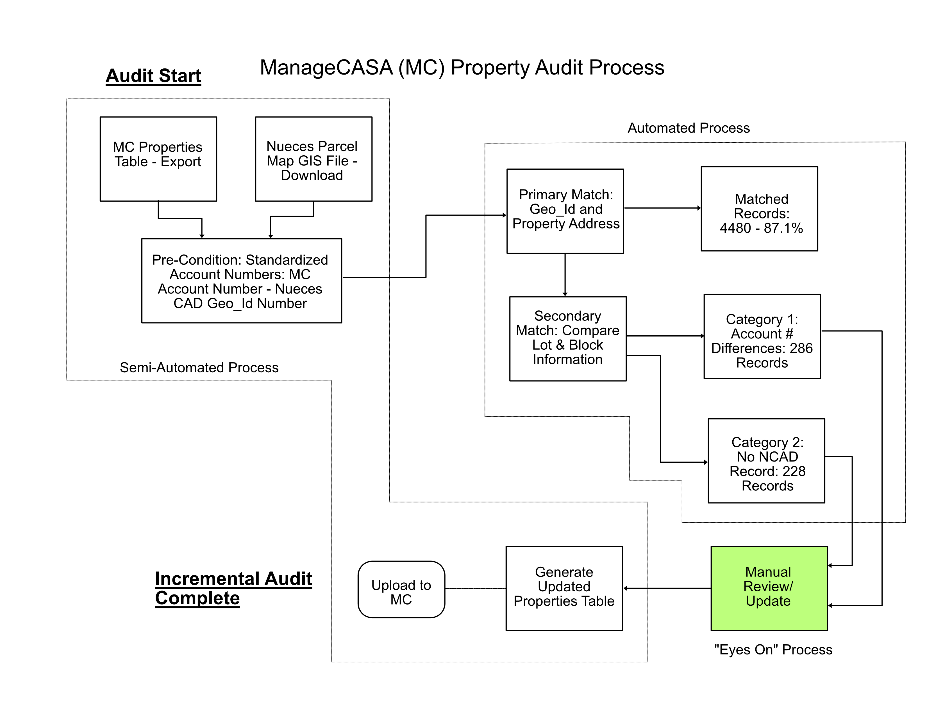
The Audit Process

Slide 15
PIPOA Canals and Waterways – A Synopsis
Our highest priority – The long-range plan for Bulkheads and Flow Controls within our Canals
On Self-Sufficiency – In-House Efforts to flag residual issues with opening the Canals…the “Trip Wire” approach
  Address flow controls within our canal system using (MATLAB 2D Shallow Water Equations and Claude Code)
  Address the requirement for box culverts at Encantada (Hydraulic Engineering Center River Analysis System, (HEC-RAS) and Claude Code)
  Asses the shortcomings of the studies efforts to date – “Study – Vs – Study peer Review”
  Minimize the impact on POA funding reserves
On recent consultations with the City – They acknowledged the inadequacies of their studies (width of the entrance into Lake Padre and the loss of the PR 22 berm)
The Path Forward – Protect our community by getting the analysis right

Slide 16
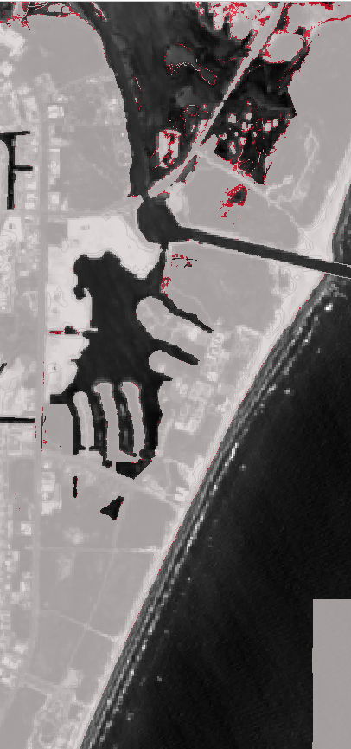
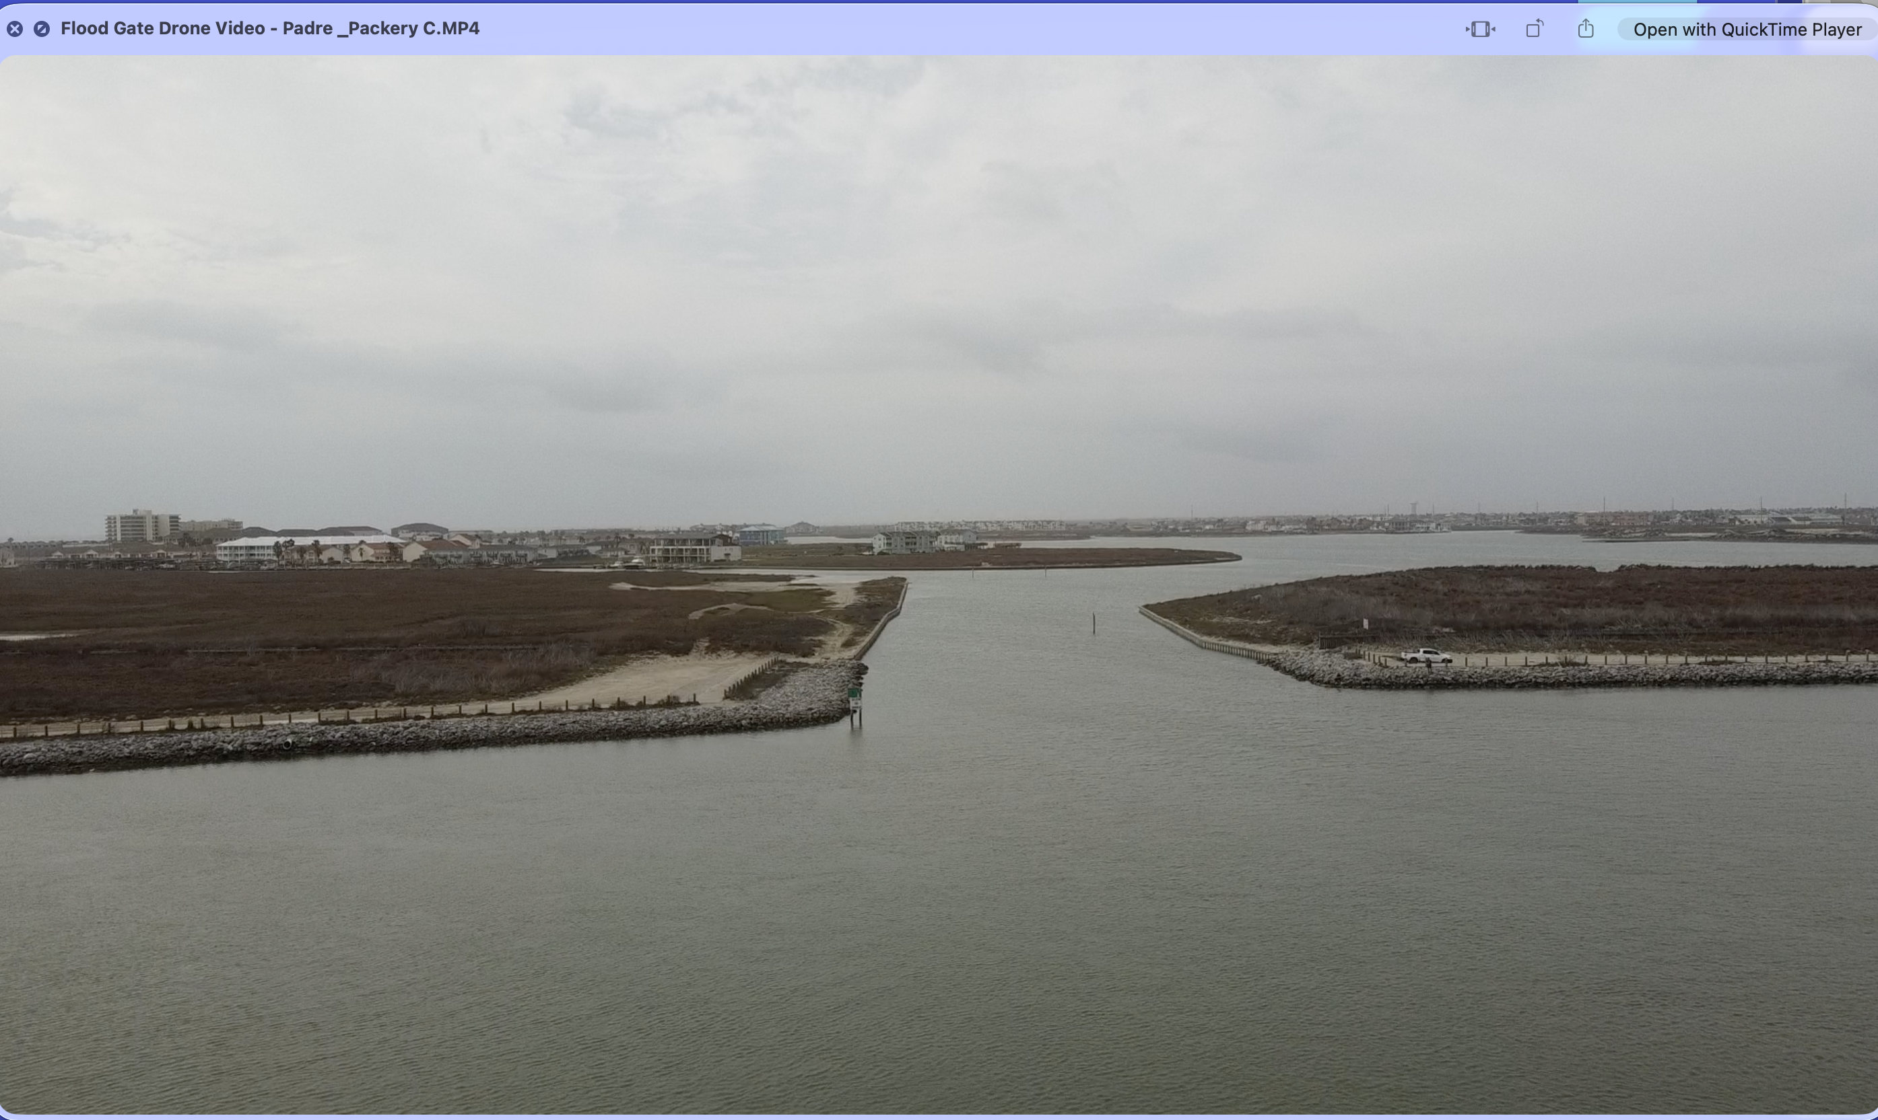
The Fundamental Modeling Dilemma
Actual Width Today ~ 177 feet at the natural berm
Study Width ~ 50 feet – 2018 Original Flood Gate Shown
Errors scale Linearly – The expected canal flow rate numbers in the study we saw were off by a factor between 3 and 4

Slide 17
Dilemma continued
The 2025 “First Order” Flow Analysis performed by the POA staff showed:
  To keep the flow rate in our canals to less than 1.9 feet per second under nominal conditions:
    The flood gate opening should be no larger than 44 feet wide
    The flood gate alone may not satisfy this condition
    We may need to augment our canals with velocity control gates
  Our results should be validated by a Hydrologist but they are “close enough” to generate a valid, defensible concern about re-opening our canals

Slide 18
Dilemma continued at Encantada
Key Definitions:
Invert: The lowest interior point of a conduit, such as a culvert, or canal.
Scour Depth: The depth of erosion caused by flowing water, which excavates and carries away bed material.
Scour Depth below Invert: Specifically, this is the distance from the original floor of the structure (like a culvert) down to the bottom of the newly formed "scour hole".

Slide 19
Dilemma continued at Encantada
What this first order analysis shows and why we are concerned about this location:
At a sustained 1.9 ft/s (canal velocity)
  Existing drainage pipes could potentially cause over 30 inches of upstream flooding
  By comparison a 3-box culvert solution would result in approximately 2 inches of upstream flooding
Scouring damage to the bulkheads begins at 1.9 feet per second due to the discharge velocity of the two drainage pipes: approximately 54 fps with a 1.9 fps flow in the canal

Slide 20
The Path Forward
The PIPOA is currently working with a responsible engineering company to consider the design elements of a flow control system for our canals
  These flow controls will need to be in-place before we can agree to re-open our canals to the Packery channel
  Flow controls must also include box culverts at Encantada
  The “Sand Dam” may remain in-place for an additional 5 years to aid in resolving this issue – USACOE Permit Issued to Lake Padre Development
The City now recognizes the inadequacies of their past study efforts

Slide 21
2026 Road Map
Process Improvement

Slide 22
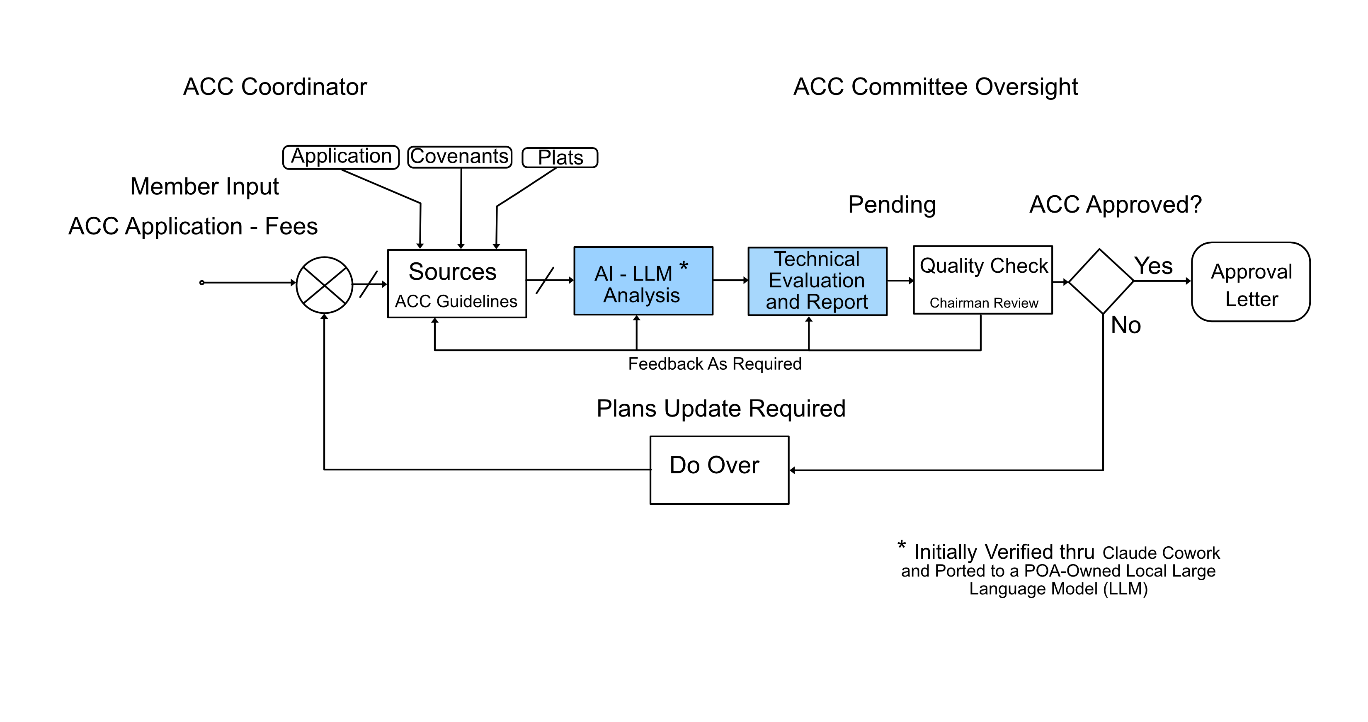
2026 ACC Process Improvement

Slide 23
ACC Semi-Automated Process via AI
Partially implemented now - all governing document, text extractions completed
Incorporates Retrieval Augmented Generation (RAG)
  Uses only the “training” information we upload – No Internet Connection Required and no fees
  Keeps learning constrained to our information for our use only
A Specific Test Case – Owner wanted to extend his new dock beyond his water build-line
  AI Read the ACC application, the applicable Covenants and Plat Maps and determined the water build-line couldn’t be extended due to the Navigation Channel requirements
  Eliminated the guess work or uncertainty
  Provided a clear, concise, consistent recommendation with options for the ACC’s consideration
  The ACC made the final decision

Slide 24
Semi-Automated Process via AI continued
Many critical documents have already been pre-processed by AI
  All 26 Covenant files
  Many of the existing Plat files
  Our current bylaws
  Our current ACC Guidelines
These documents form the base-line knowledge suite for the PIPOA’s own open-source, AI Model
The only remaining input is the property owner’s ACC application

Slide 25
Semi-Automated Process via AI continued
The Output Technical Report is structured:
  What is being requested
  A covenant analysis
    The controlling provisions with respect to any amendments
    An ACC Guidelines Analysis
  Application completeness
  Texas Wind Storm Certification Requirements
  The core problem, if any, in plain terms
  The paths forward for the committee
The ACC Chairman is responsible for determining the completeness of the AI Technical Report

Slide 26
Semi-Automated Process via AI continued
The precedent for AI within the ACC
  Question: Do ACC members have to be “Air Breathers” or can they be AI Agents?
  Answer: Currently under Texas Code Chapter 209 and our covenants, ACC members have to be “people” - AI cannot fill that “personhood” gap it has no legal standing to replace a human yet – Texas Property Code 311.005
However, according to our covenants and bylaws the ACC may use technical consultants and AI can reasonably be used for expert and consistent consulting services:
  Reading Plats
  Cross Referencing Documents
  Checking building codes
  Flagging conflicts
Our sanity check is the human sign off

Slide 27
Worksheet eVoting upgrade for Elections
Retains eVoting as the primary election tool
Simplifies Paper Ballot Worksheet Processing for the POA staff
Adds Owner Name, Property Address, Association to the form
Prototype system for test possible by October 2026

Slide 28
Boat Ramp Permits move to ManageCASA
We anticipate moving the Boat Ramp Application process to ManageCASA
  Saves filling out the form in the office
  Billed via ManageCASA Invoice
  Requires ManageCASA login to complete
  Rollout date by the end of 2026

Slide 29
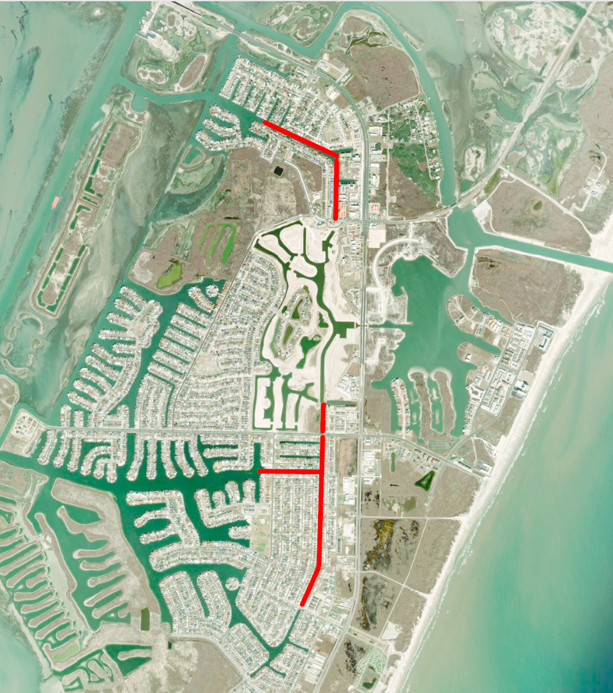
Bulkhead Plan for this Year
Our primary push is to harden the “Hot Zone”
  We anticipate installing another 620 feet of TruLine Bulkhead Material
  This gets through empty lots and minimally intrusive properties
  We have 8 properties that will need to take removal action in the near term
    The hard spot is the road is gaining access to properties with extensive decks, docks, and boat lifts
    Access is unavoidable – we can’t protect our canal and waterways without addressing all properties within the hot zone

Slide 30
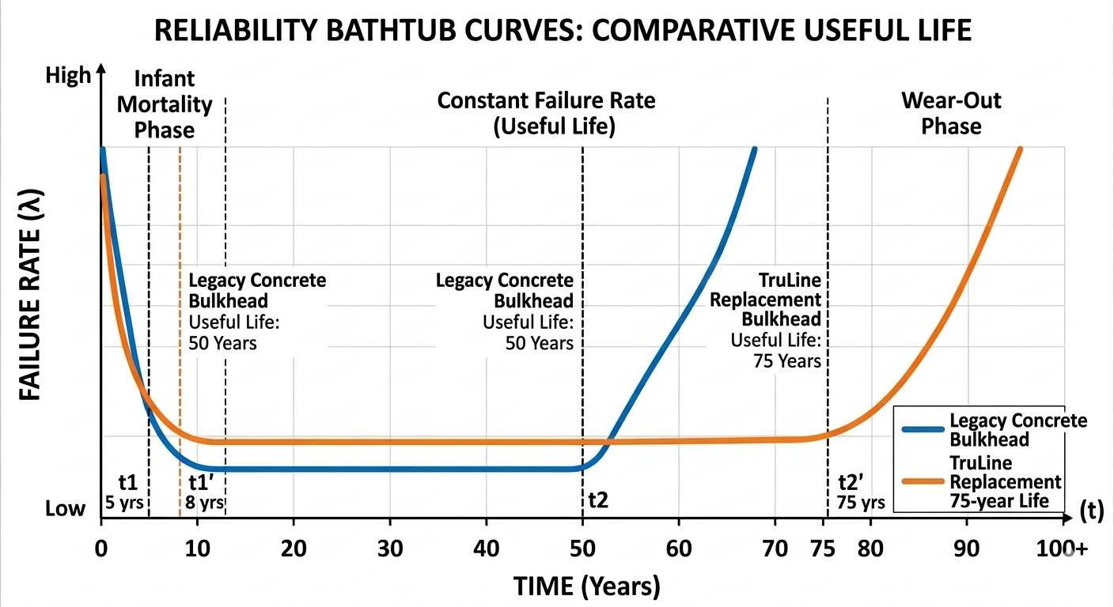
Bulkhead Plan continued
We now have 5 contractors qualified to install TruLine
We have 2 more we’re developing to perform repairs
From a long-term repair strategy TruLine has a “useful life” of 75 years when compared to the 50-year useful life of our legacy concrete bulkhead design

Slide 31
Anticipated Maintenance Costs
Legacy Concrete Bulkhead:
  Higher Cumulative Cost: Traditional concrete is porous and prone to steel rebar corrosion (spalling) over time
  Cost Spikes: You’ll notice significant jumps in the curve every 10–15 years. These represent major structural repairs, such as patching cracks, replacing caps, or addressing tie-back issues to prevent failure
TruLine Replacement Bulkhead:
  Lower Cumulative Cost: The vinyl form acts as a permanent protective barrier, shielding the internal concrete and rebar from the corrosive marine environment
Flat Growth: Because the core is protected, the need for major structural intervention is nearly eliminated, keeping maintenance costs low and predictable for decades

Slide 32
Maintenance Costs: A Summary
Concrete
TruLine
Typical Lifespan | 30 – 50 Years | 75+ Years
Initial Install (per LF) | $200 – $800+ | $1,200 - $1500
Minor Repair (per LF) | $100 – $250 | Virtually None
Major Structural Repair | $5,000 – $15,000 per event | Rarely Required
Primary Failure Cause | Rebar corrosion & spalling | UV/Impact (extremely rare)

