Slide 1

Homeowners’ Association
ANNUAL MEETING 2022
Notes:
John will welcome everyone and call the meeting to Order

Slide 2

John Cleveland
Lavinda Hedman
Susan Dewey
Ynette Marx
Laura MacBeth
Notes:
John will introduce the Board members

Slide 3
2022 Annual Meeting Agenda
Call Meeting to Order
Establish Quorum & Proof of Notice
Minutes of 2021 Annual Meeting
Power Point Presentation
  Financial Report
  Introduce Board
  Treasurer’s Report
  2022 Accomplishments
  2023 Goals
Governing Documents
  Bylaw Revisions
  Covenants, Conditions, and Restrictions Revisions
Call for Questions/Input from Homeowners
Introduction of Candidates & Nominations from the Floor
Election of Board of Directors
Volunteer Recruitment
Election Results
Close Meeting
Notes:
John will summarize what is going to happen and turn the time over to the Secretary

Slide 4

Establish Quorum & Proof of Notice
Quorum requires 19 members or proxies
(one member per property)
Notes:
Laura will announce that there is a quorum represented either in person or by proxy and confirm that the Notice of Annual Meeting was mailed 30 days prior to the meeting.

Slide 5

2021 Annual Meeting Minutes Review & Approval
Notes:
Laura will announce that minutes from last year have been available on the HOA website and we passed them out as members checked in today. Laura will ask that the reading of the Minutes from last year’s meeting be waived and ask for a motion to approve. If there are changes then ask for a motion to approve with the indicated changes.

Slide 6
Treasurer’s Report
FISCAL YEAR: OCTOBER 1, 2021 to SEPTEMBER 30, 2022
Notes:
John will introduce the Treasurer

Slide 7
Income and Expenses
TOTAL MEMBERSHIP INCOME | $36,734.24
OPERATING EXPENSES
Membership Expenses |  | $392.57
Landscaping and Groundskeeping
 | Lawn Care | $12,009.00
 | Tree & Shrub Care | $2,985.00
 | Maintenance & Repairs | $895.14
 | Snow Removal | $2,640.00
Total Landscaping and Groundskeeping |  | $18,529.14
Monthly Banking Costs
 | Venmo Fees | $50.04
 | Credit Card Processing Fees | $79.53
 | ACH Check Processing Fees | $15.00
 | Checks Printed | $165.56
Total Monthly Banking Costs |  | $310.13
Supplies & Services
 | Meeting Expense | $156.74
 | Office Supplies | $185.00
 | Miscellaneous Expense | $132.00
 | Total Supplies & Services | 473.74
Postage and Delivery |  | $711.64
Professional Fees
 | Accounting & Legal Fees | $878.00
 | Insurance & Bonding Costs | $1,228.00
 | Taxes - State of Idaho | $30.00
Total Professional Fees |  | $2,136.00
Utilities |  | $1,904.47
 | TOTAL REGULAR OPERATING EXPENSES | $24,457.69
NET INCOME | $12,276.55
All members are current on their annual dues!
Notes:
Susan will present the financial report

Slide 8
CAPITAL EXPENDITURES
Capital Improvements
 | Upgrades to Bridge Area | $2,360.00
 | North Entrance Sprinkler System Upgrade | $12,504.00
 | TOTAL CAPITAL IMPROVEMENT EXPENDITURES | $14,864.00
Notes:
Susan will Explain the Capital Expenditures

Slide 9

Assets
Bank of Idaho Checking Account $ 6,377.74
Bank of Idaho Savings Account $50,976.37
TOTAL CASH ON HAND $57,354.11
Notes:
Review the assets of the Association

Slide 10
Previous Year Comparison
 | 2017 | 2018 | 2019 | 2020 | 2021 | 2022
Income | 35,508 | 35,292 | 36,872 | 36,062 | 34,552 | 36,734
Expenses
1. Insurance | 1,319 | 1,360 | 1,360 | 1,228 | 1,221 | 1,228
2. Landscaping | 22,097 | 16,793 | 13,364 | 14,602 | 11,595 | 12,009
Landscaping (Unusual) | 5,000 |  |  | 12,873 | 1,739 | 3,880
3. Snow Removal | 2,160 | 1,260 | 2,640 | 3,630 | 2,228 | 2,640
4. Decorations & Social | 1,061 | 220 | 160 | 1,491 | 882 | 393
5. Pump Repair |  |  | 210 | -105
6. Utilities | 2,275 | 1,848 | 1,575 | 1,585 | 1,485 | 1,904
7. Postage & Office | 363 | 325 | 393 | 780 | 1,392 | 1,496
8. QuickbookS Update | 414 | 0 | 0 | 0 | 430
9. Professional Fees | 5,040 | 0 | 0 | 0 | 325 | 908
10. Bad Debt |  |  |  | 151 | 0
TOTAL EXPENSES | 39,729 | 21,806 | 19,702 | 36,235 | 21,297 | 24,458
NET INCOME | <4,221> | 13,486 | 17,170 | <173> | 12,948 | 12,276
Notes:
Compare with other years (input from all board members). Susan will turn in back to John who will call for a motion to accept the Treasurer’s Report

Slide 11
2021 Audit Response
Auditor’s Concerns from 2021 Audit have been addressed
1. Individuals are billed rather than the property address.
We have set up in our Quickbook file a means to attach the individual to the property address, and the Division/Block/Lot Number are attached to the homeowner of record. This past year they were audited against the County Records.
2. Tax Returns were incomplete.
The HOA retained the CPA to file the 2021 Taxes at a cost of $550.
3. Checks and Balances.
The Board passed a resolution that all checks that are regular and recurring costs, and paid by AUTO PAY or through the Bank of Idaho BILL PAY may be issued without prior authorization and then reviewed and approved at the monthly Board Meeting.
Checks that are reimbursement to members must have prior authorization and must have two signatures on the actual check.
Disbursements for out-of-the-ordinary must have prior board approval and must have two signatures on the actual check. A Reimbursement Request Form was developed.
4. Bank Account Balances.
The HOA has established that any funds received that are not used for the current year are to be placed in the Bank of Idaho Savings Account for future capital expenditures
5. Transfer Fees should be increased.
The Board passed a resolution that ownership transfers are now $50, an increase from $15
Notes:
John The Bylaw assign the responsibility to the President to have the Association’s records audited or reviewed each year. These are the actions we have put in place in response to the 2021 audit.

Slide 12
2022 Audit/Review
Discuss CPA’s Review
Compare the $700 cost from the full Audit to the $300 cost for a Review
Board has made a resolution that the Association’s records will be Audited every other year simply reviewed and in the alternate years.
The HOA will have the full Audit the end of the Treasurer’s first year in office, and again at the end of the Treasurer’s third year in office, or before a new Treasurer will take office.
The incoming Board will determine the need to have the CPA prepare the taxes each year.
Present the Review Letter from CPA
Notes:
John The Board requested a review Association’s records for the past fiscal year. You will read the portions of the report that state the good things we are doing, and point out the things we should work on. (It is not necessary that the entire report be read)

Slide 13
2022 Achievements
Notes:
John will present our achievements for the past year

Slide 14
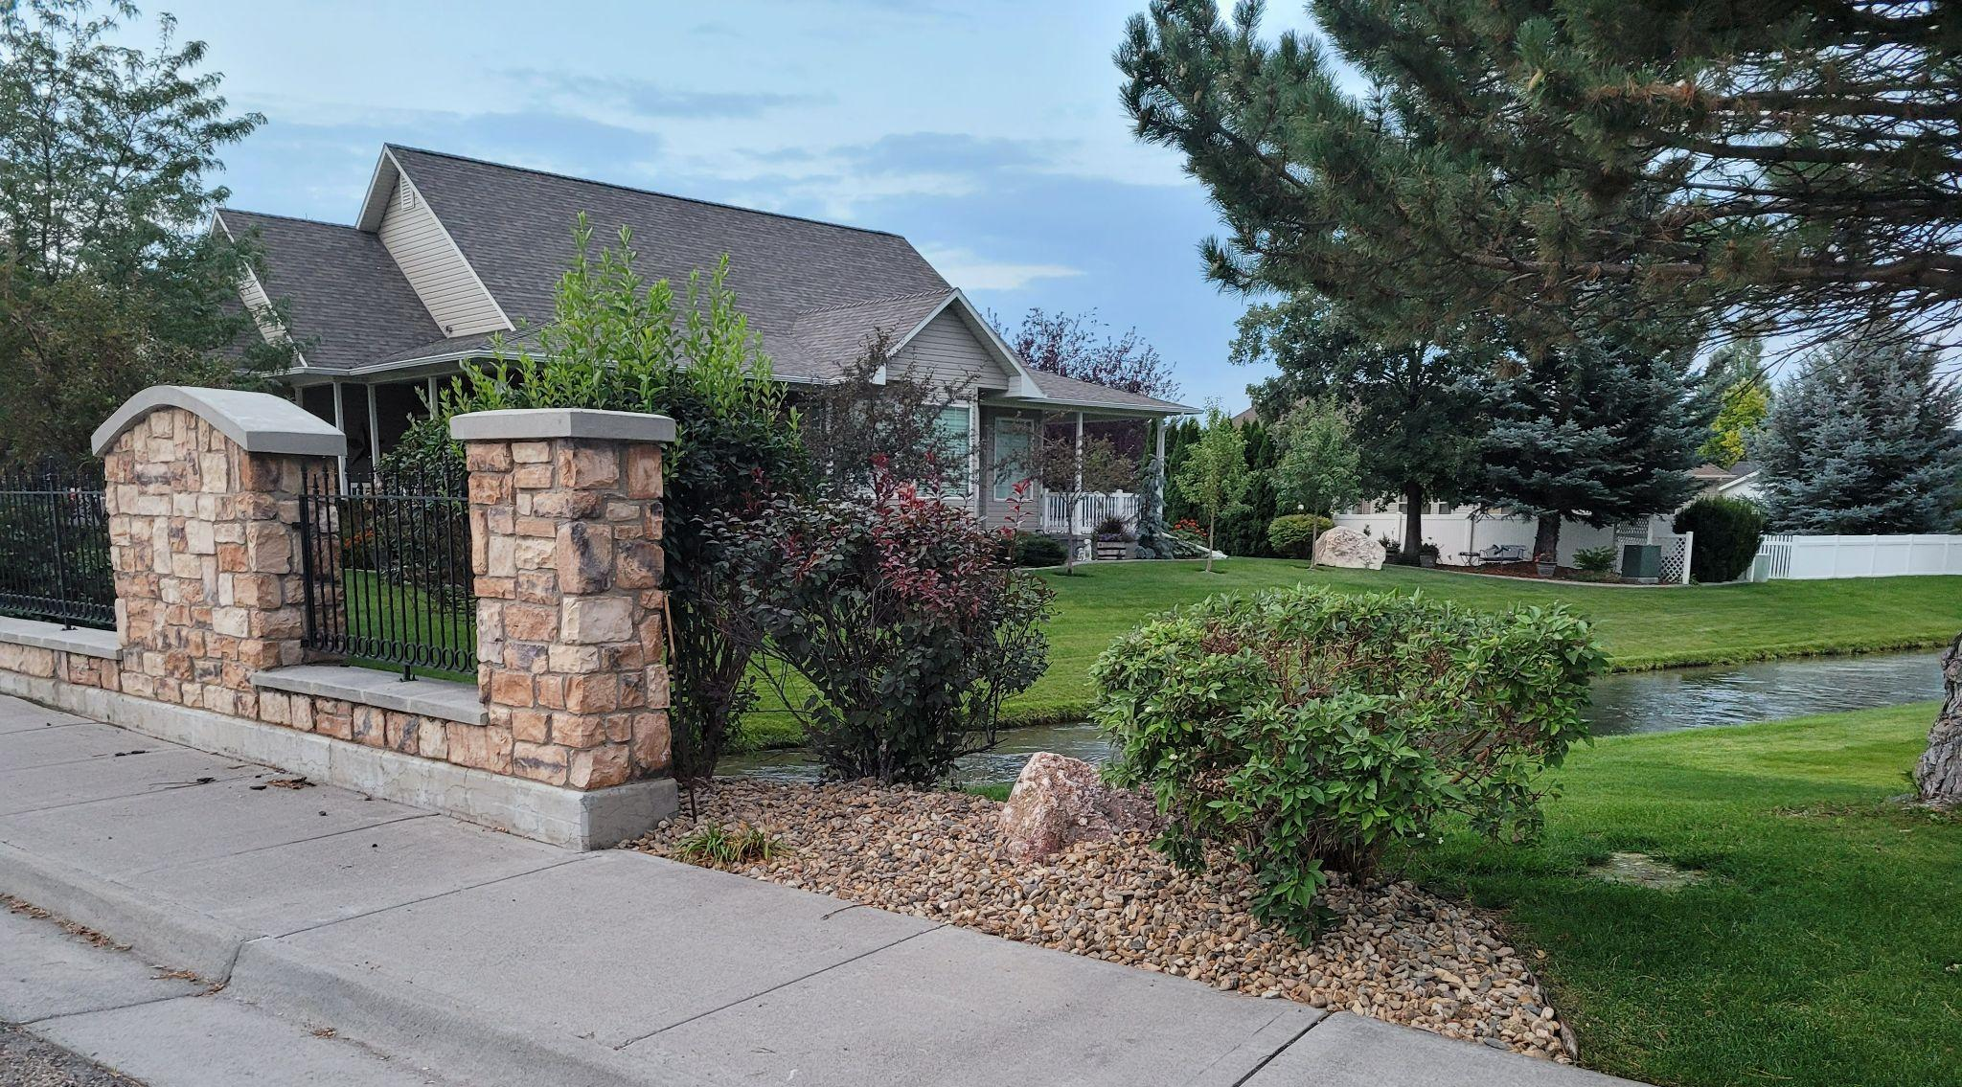
#1 Update Bridge Landscape
Notes:
Replace the bark with stone and cleaned up the south side of the bridge

Slide 15
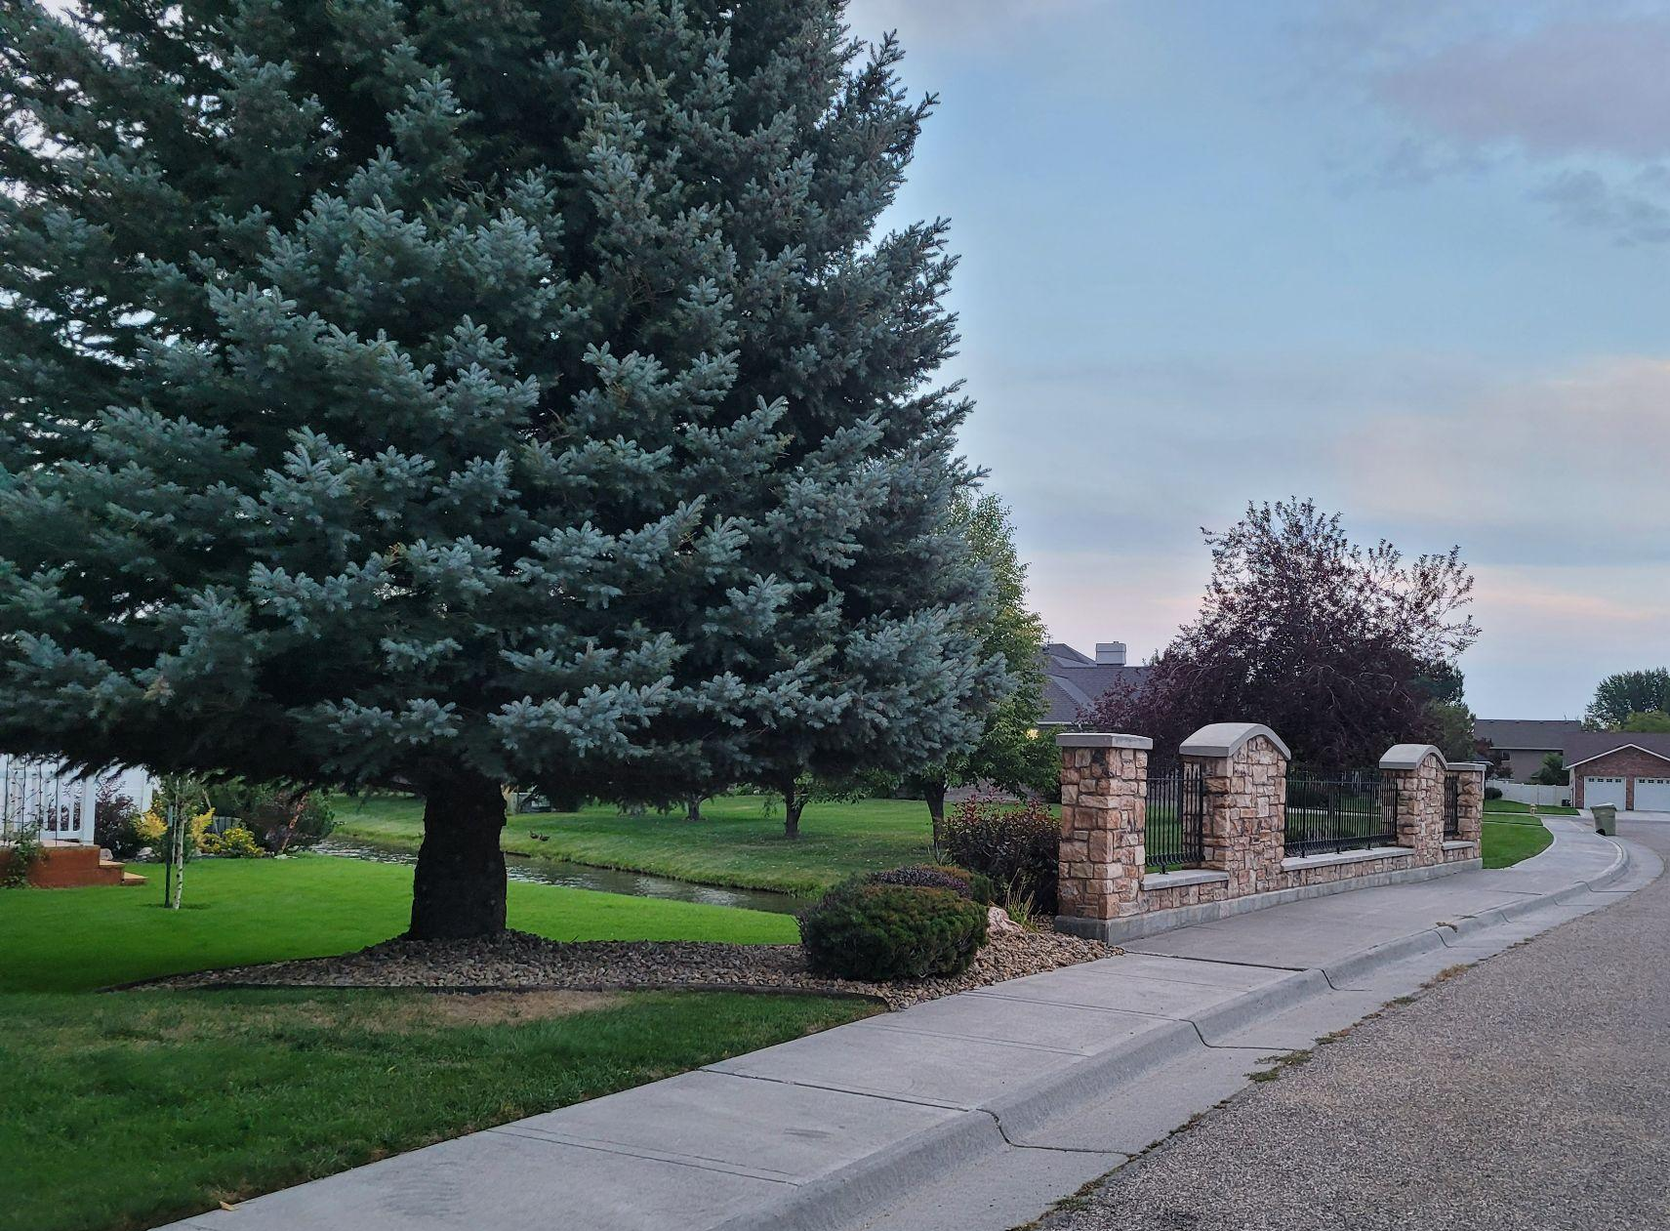
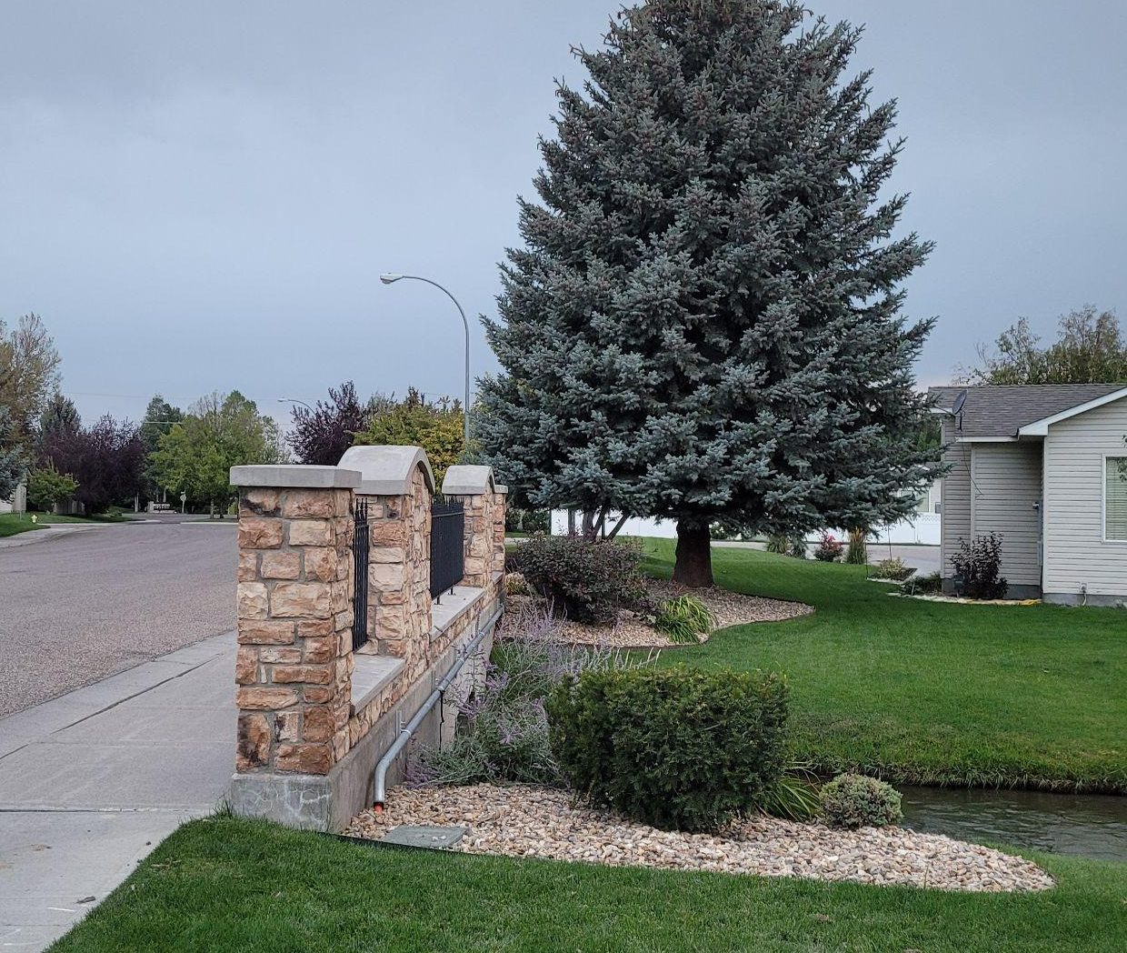
Notes:
Limbed up the tree adjacent to the bridge, cleaned up the flower beds and improved the appearance overall

Slide 16
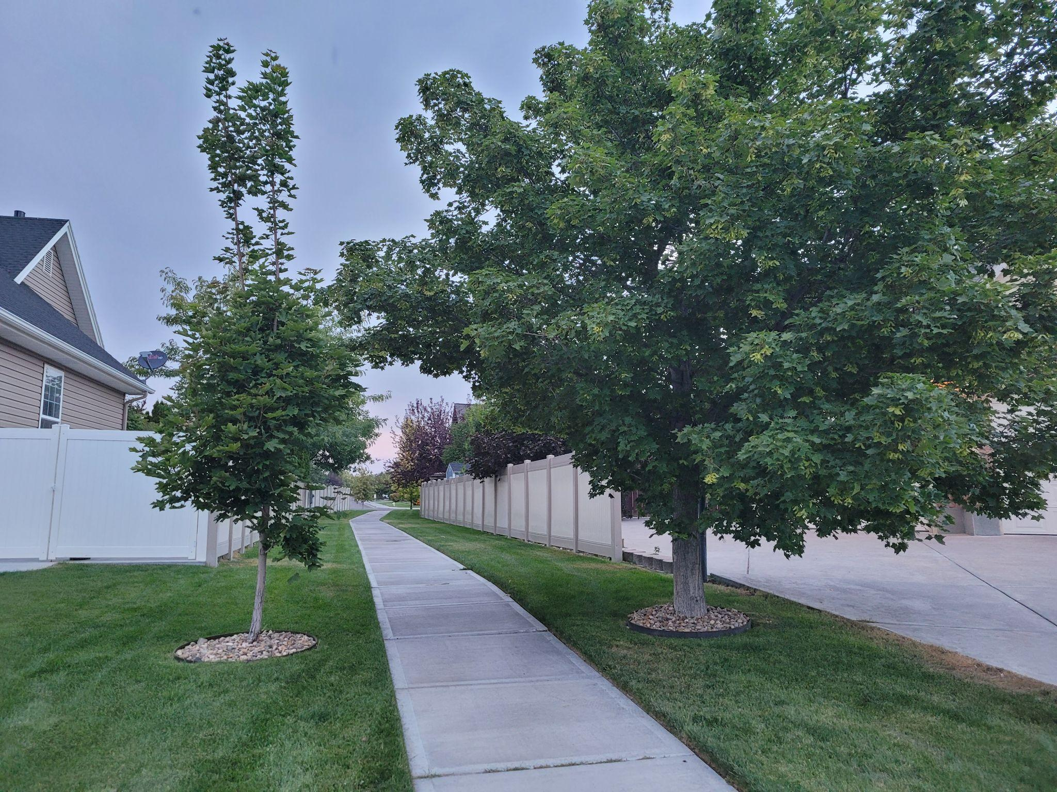
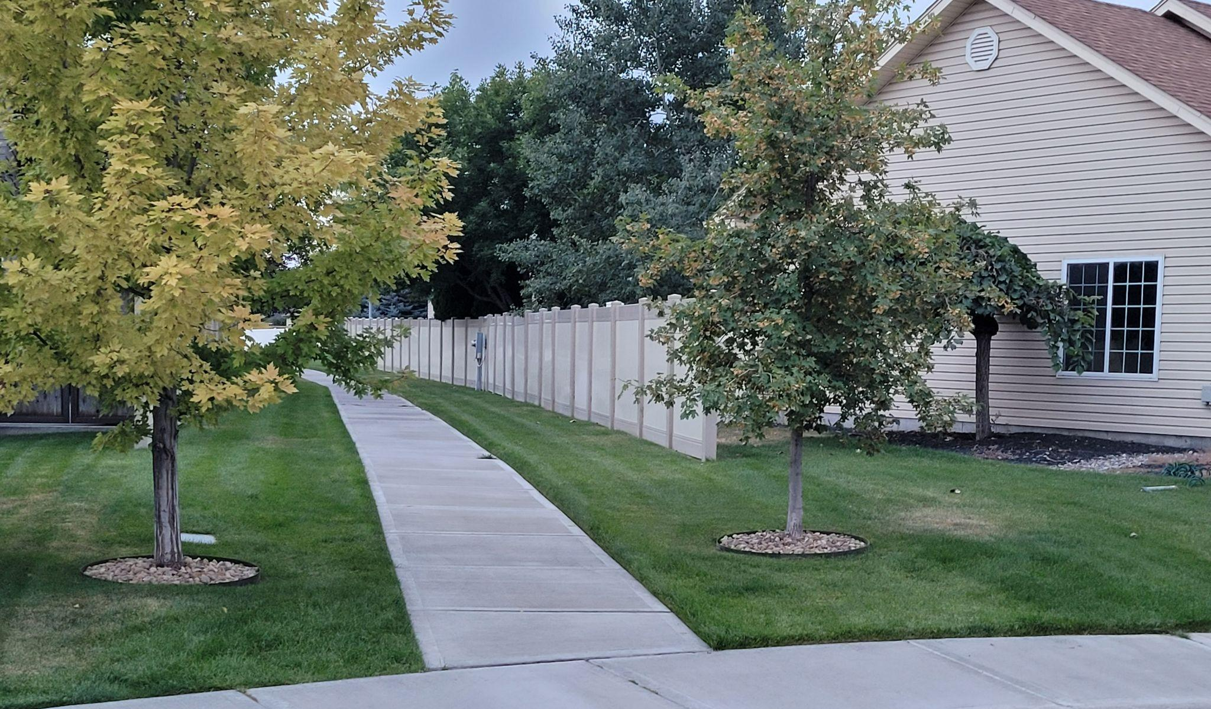
#2 Burgundy Path Entrances
Notes:
There were problems with the sprinkler system on the Burgundy/Napa pathway. Those were repaired and the trees had rings placed around them with rocks.

Slide 17
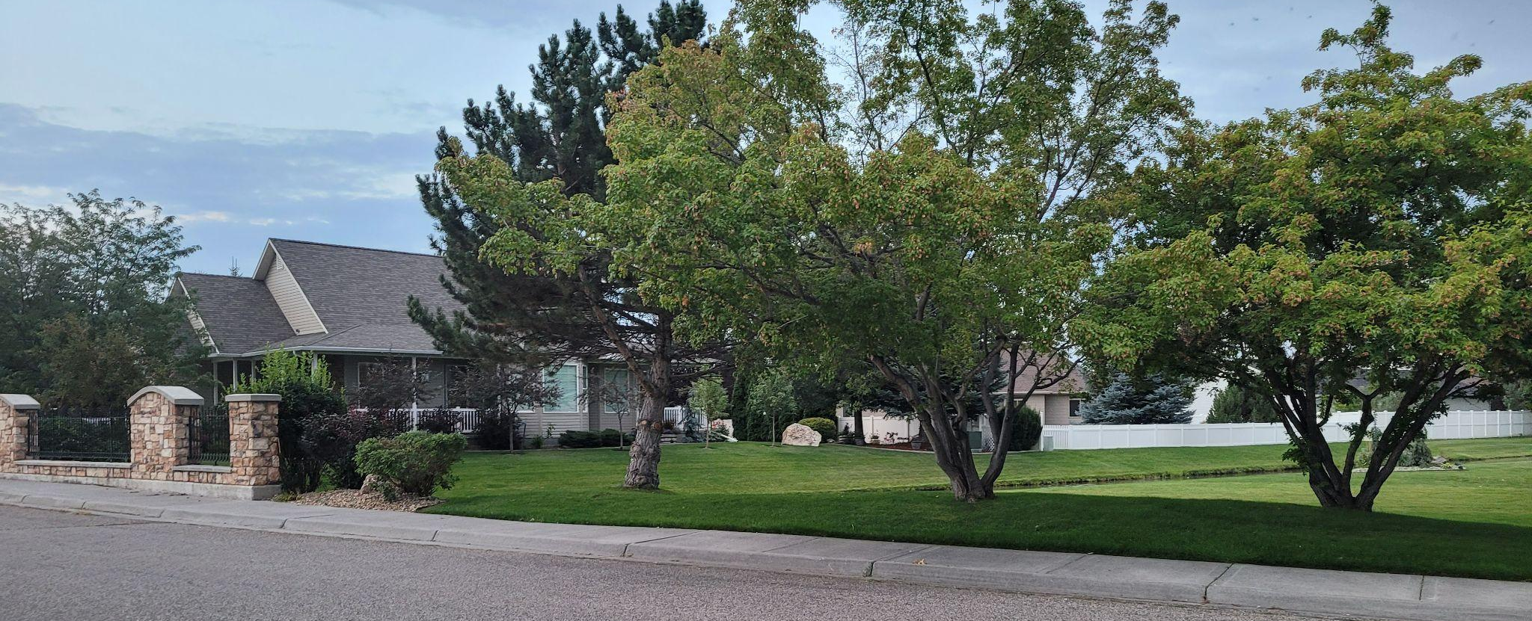
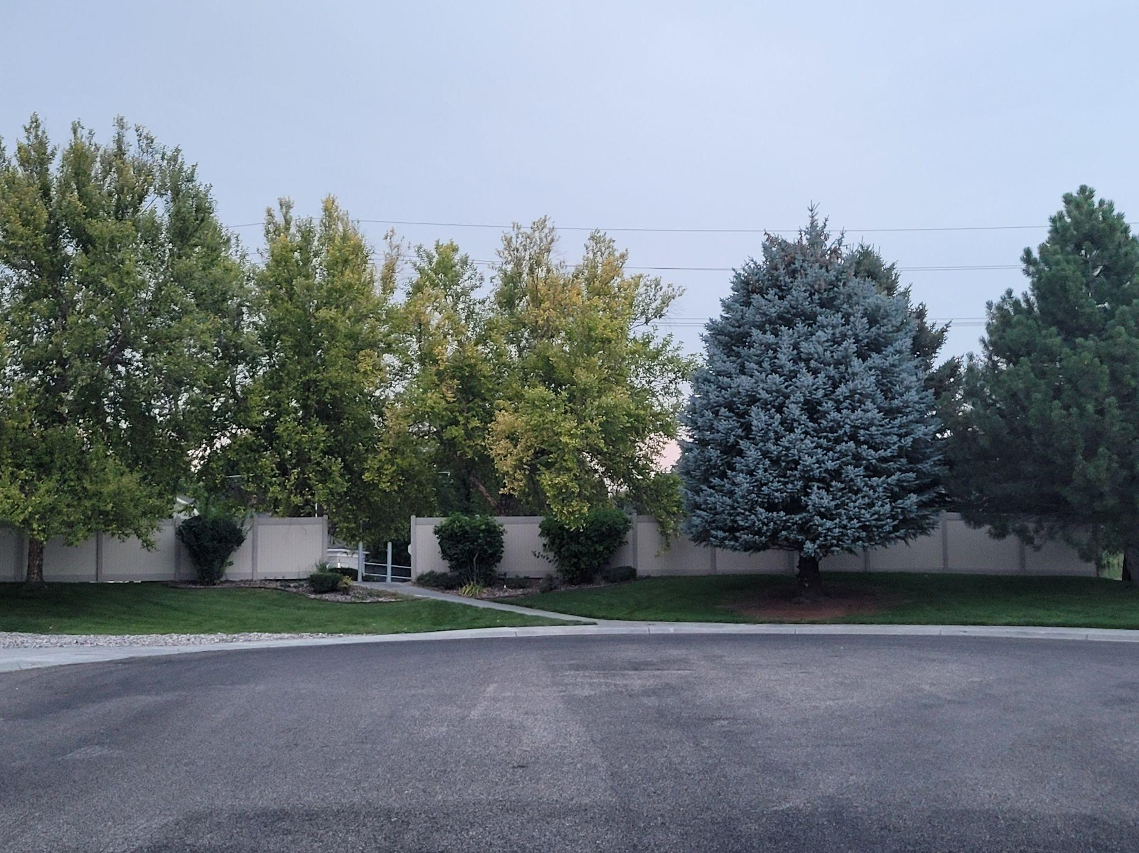
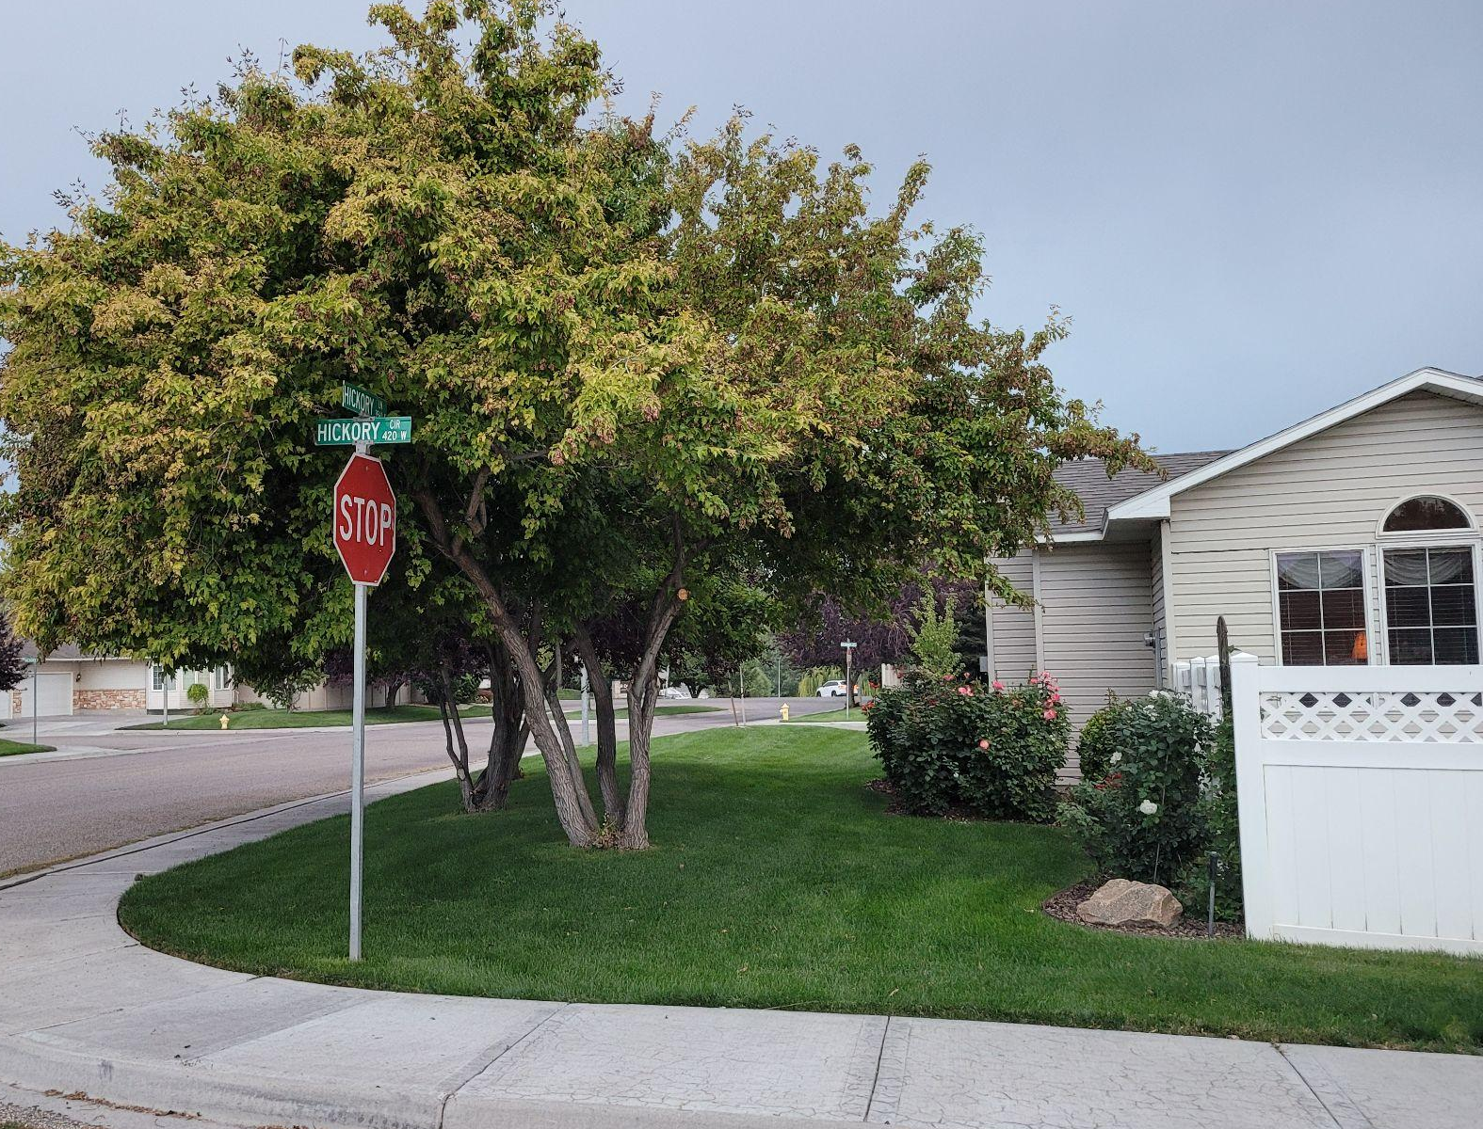
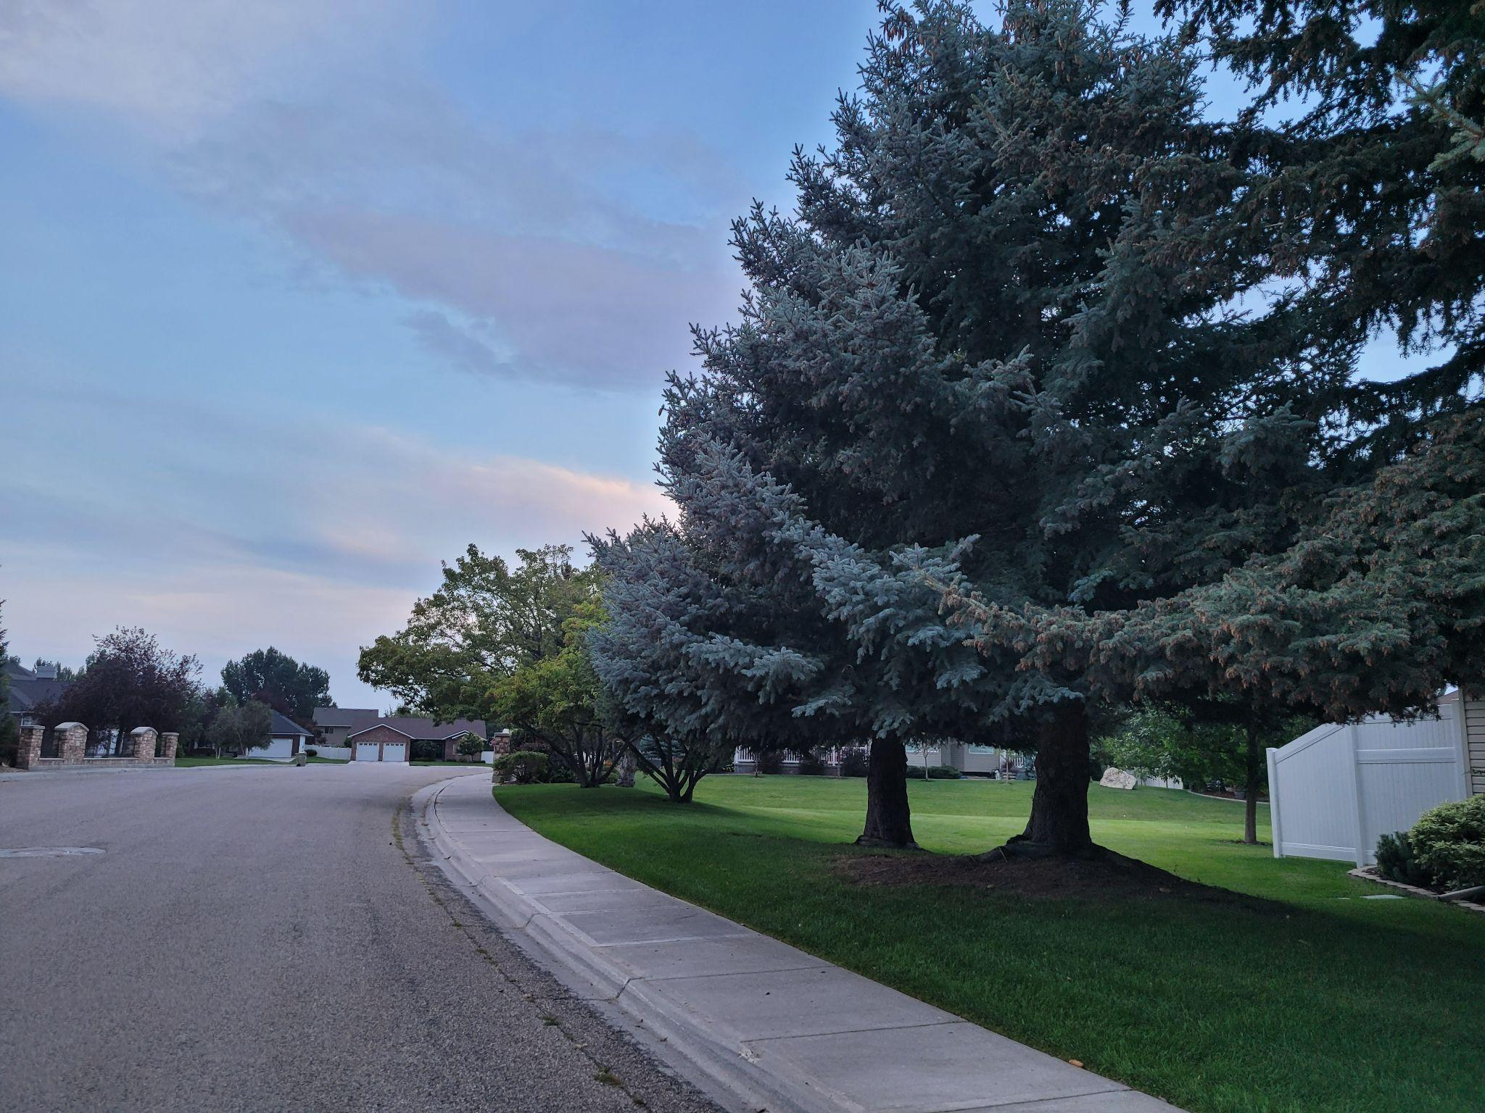
#3 Tree Care
Notes:
Several trees around the neighborhood were trimmed and “limbed up”

Slide 18

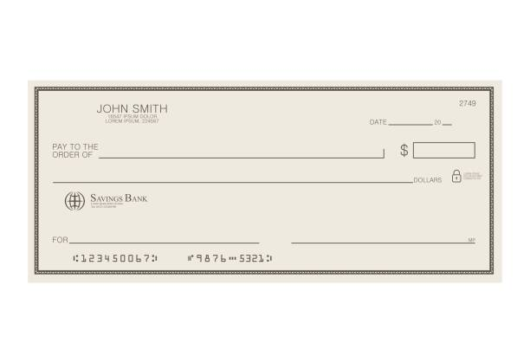

#4 Implemented Online Payments
Venmo
Credit/Debit Cards
ACH Checks
Notes:
the HOA is now able to accept Venmo, Credit Cards and online checks (ACH). These benefits cost the HOA less than $150, but has enabled us to have everyone’s due paid in full, something is a big accomplishment.

Slide 19

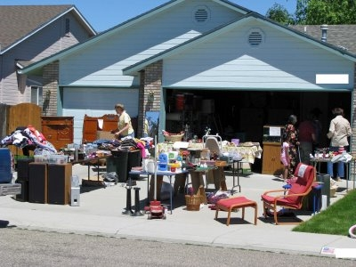
#5 Neighborhood Yard Sale
Notes:
Lavinda will discuss the yard sale and let everyone know that it will be an annual event

Slide 20
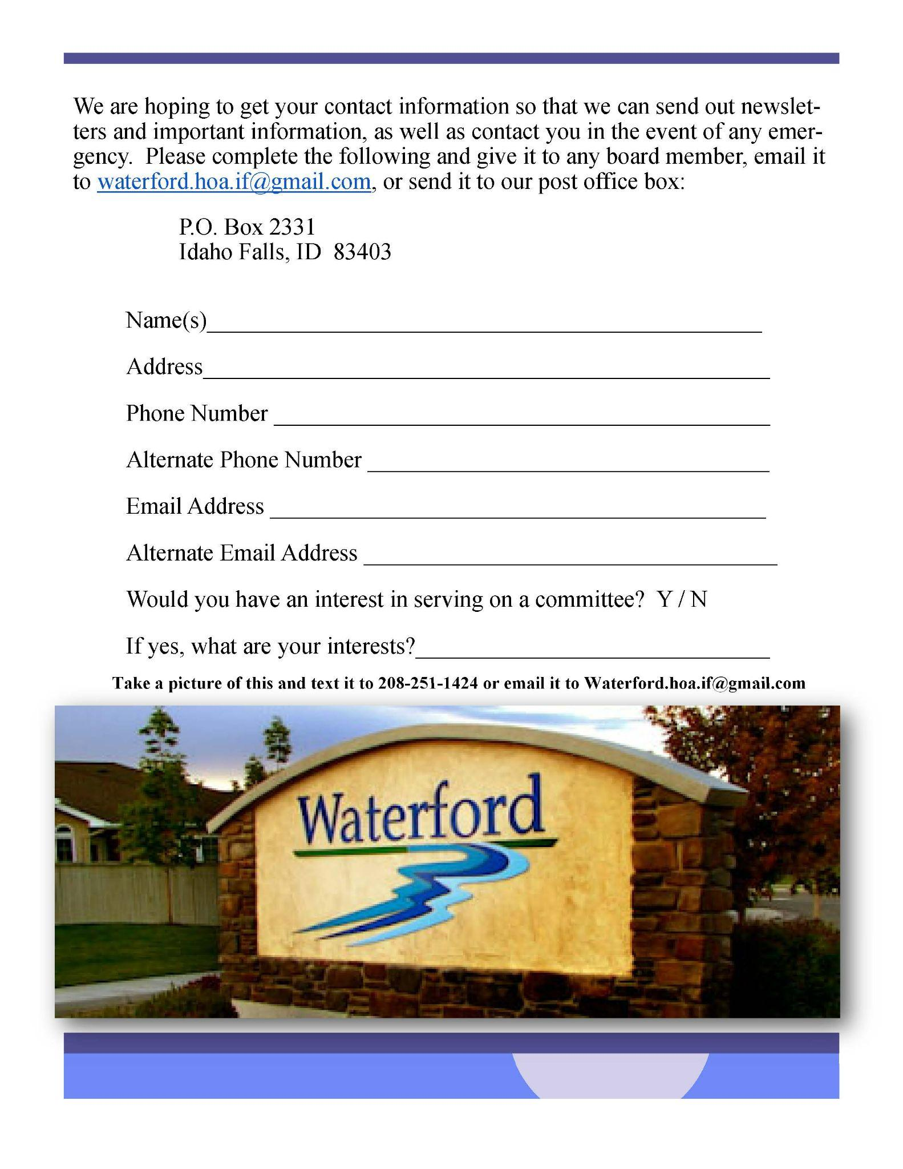
#6 Updates to Membership
Data Base
Notes:
Lavinda will explain that the board went to great lengths to update everyone’s contact information, especially email addresses.

Slide 21

#7 Transition to Google Drive Storage
Notes:
Susan will explain that we transferred all of our records to Google Drive, rather than One Drive, which was going to incur significant charges. There is no charge for Google Drive,unless we use a great deal more storage.

Slide 22


#8 Implemented Email Communications
Neighborhood Alerts
Newsletter (contributors needed)
Billing by Email
Notes:
Susan will explain how we use email communications
Alerts
Billings (US Mail is now $.70 per letter)
Newsletter - we need volunteers to contribute articles, photos, etc.

Slide 23
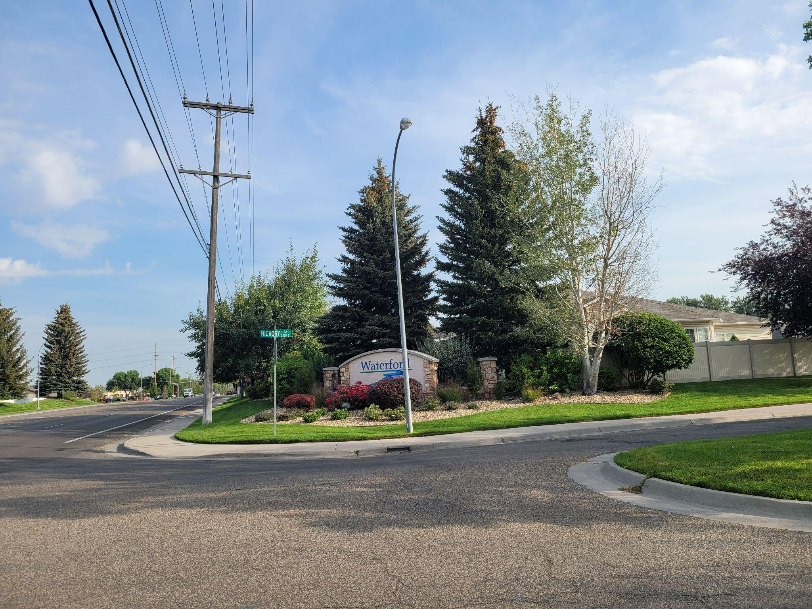
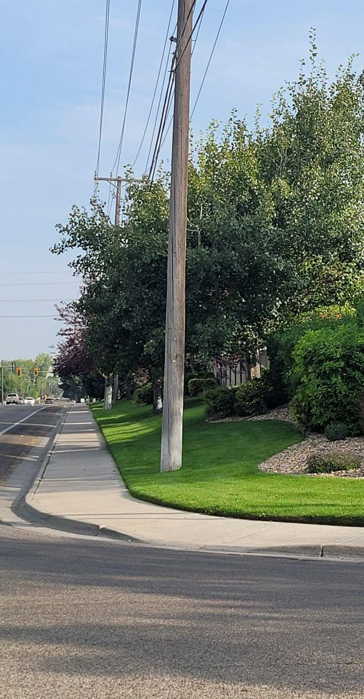
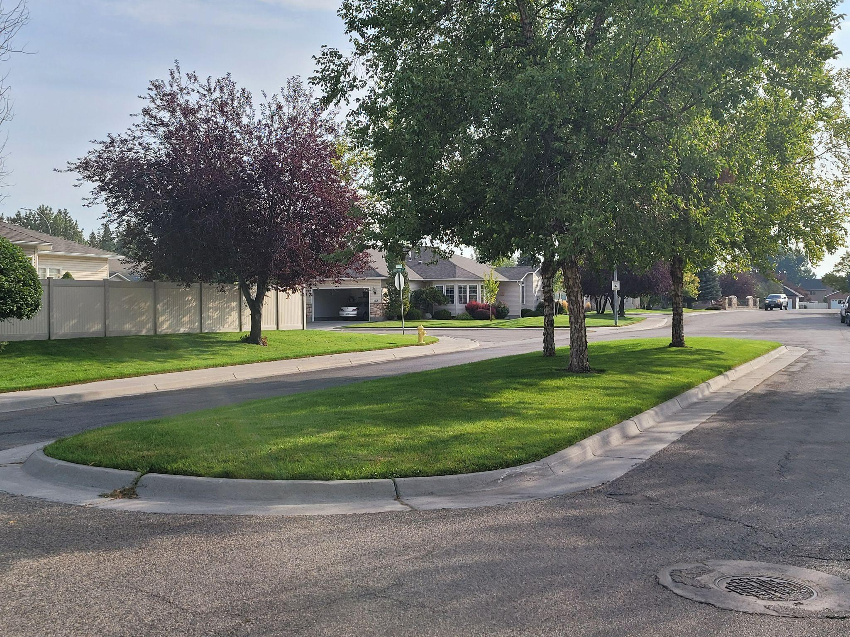
#9 Updated North Entrance Sprinkler System
Notes:
John will explain the update to the north entrance sprinkler system and whether we will move forward with further updates at this time.

Slide 24
2023 Goals & Plans
Notes:
John will present the next year’s goals and plans

Slide 25
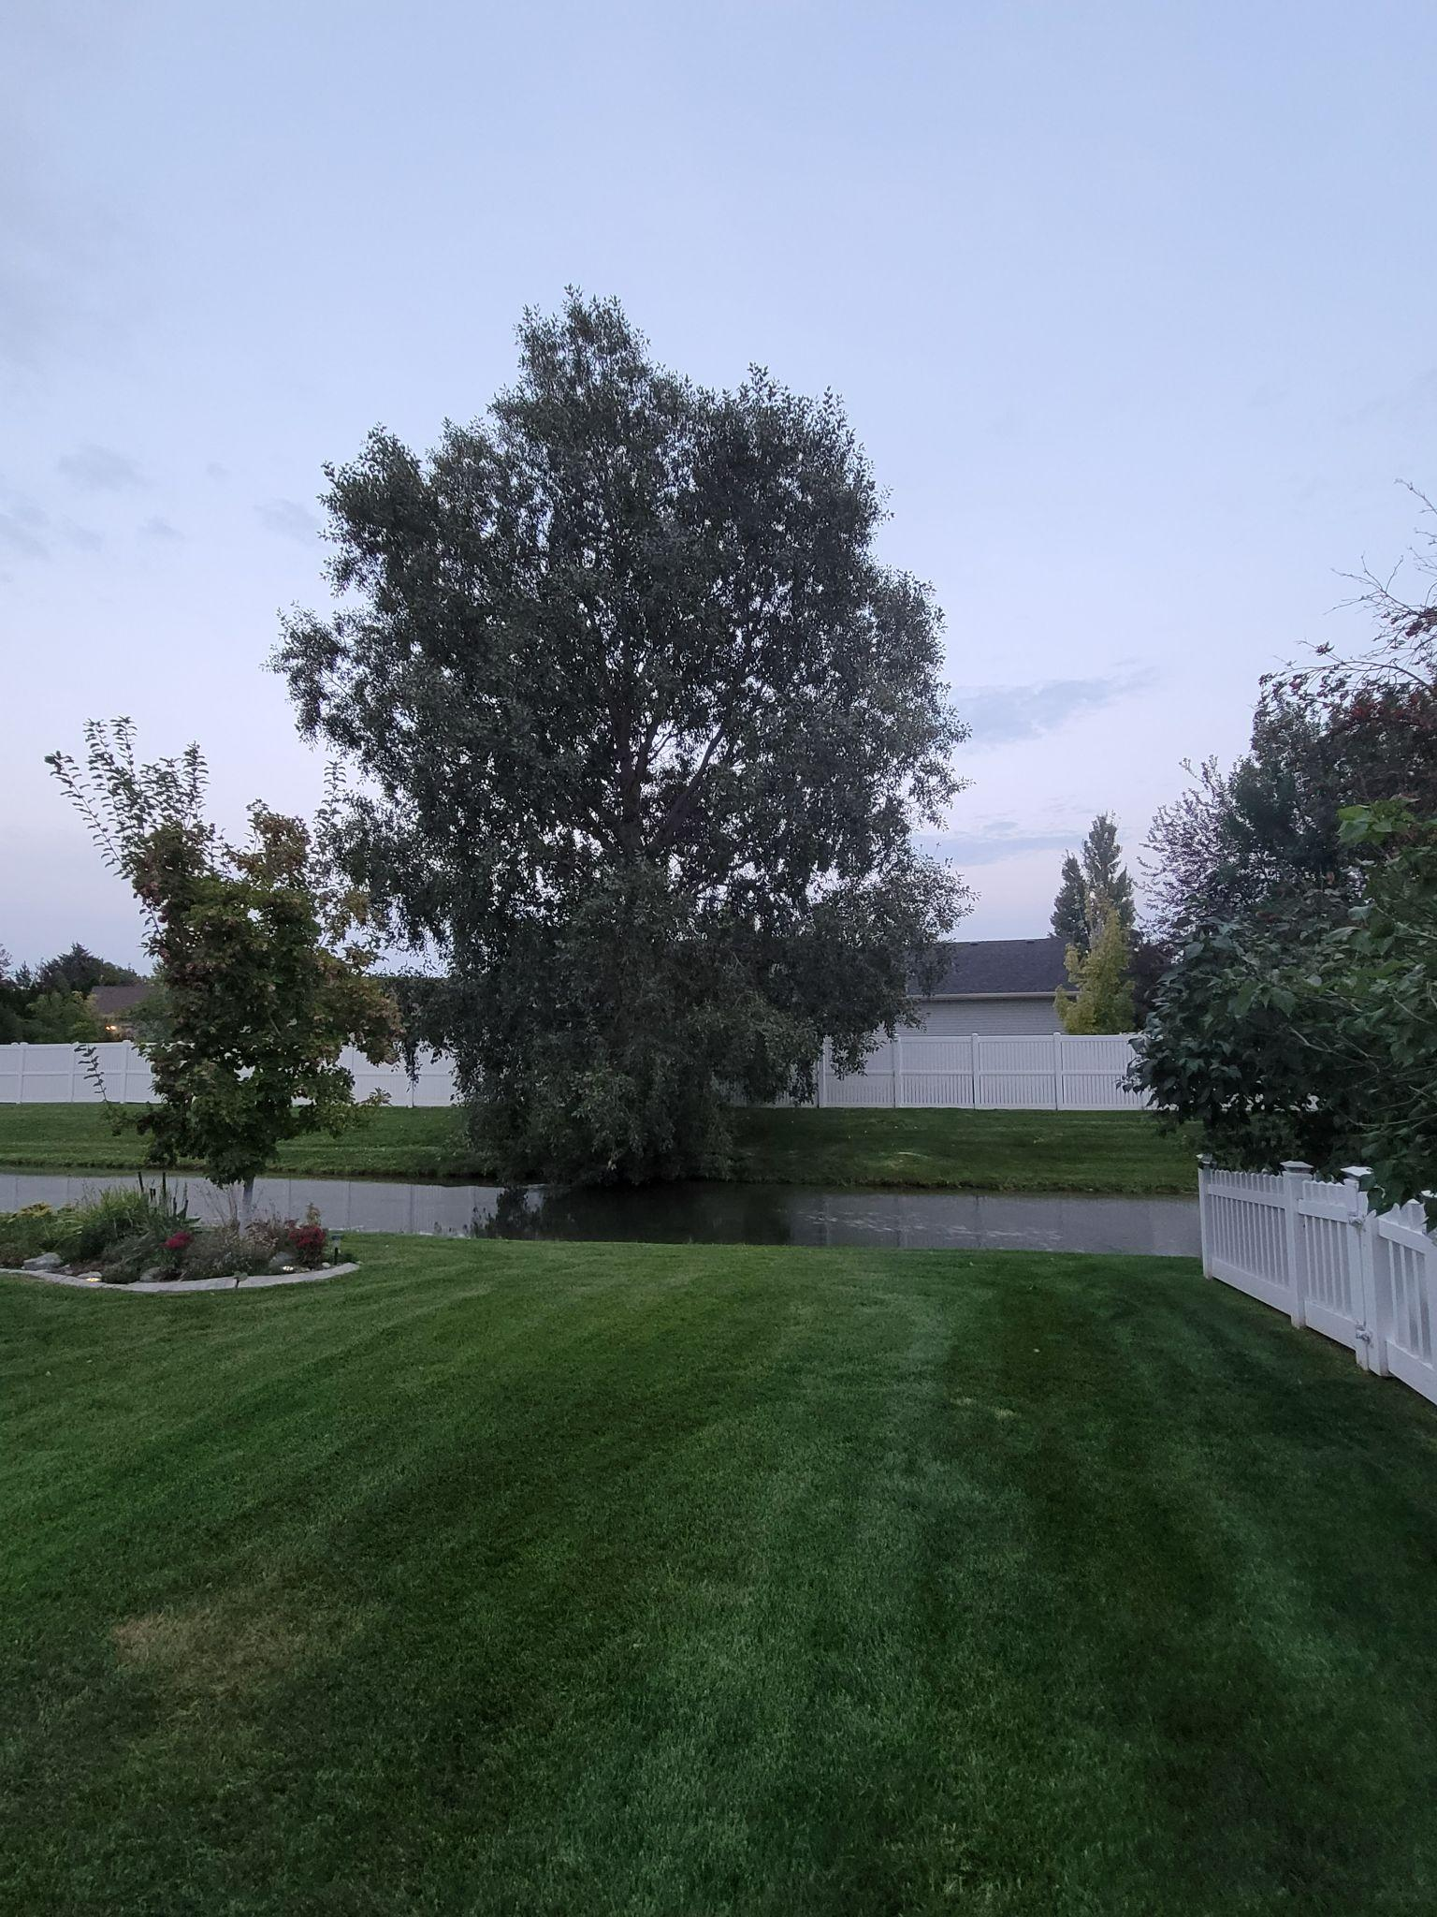
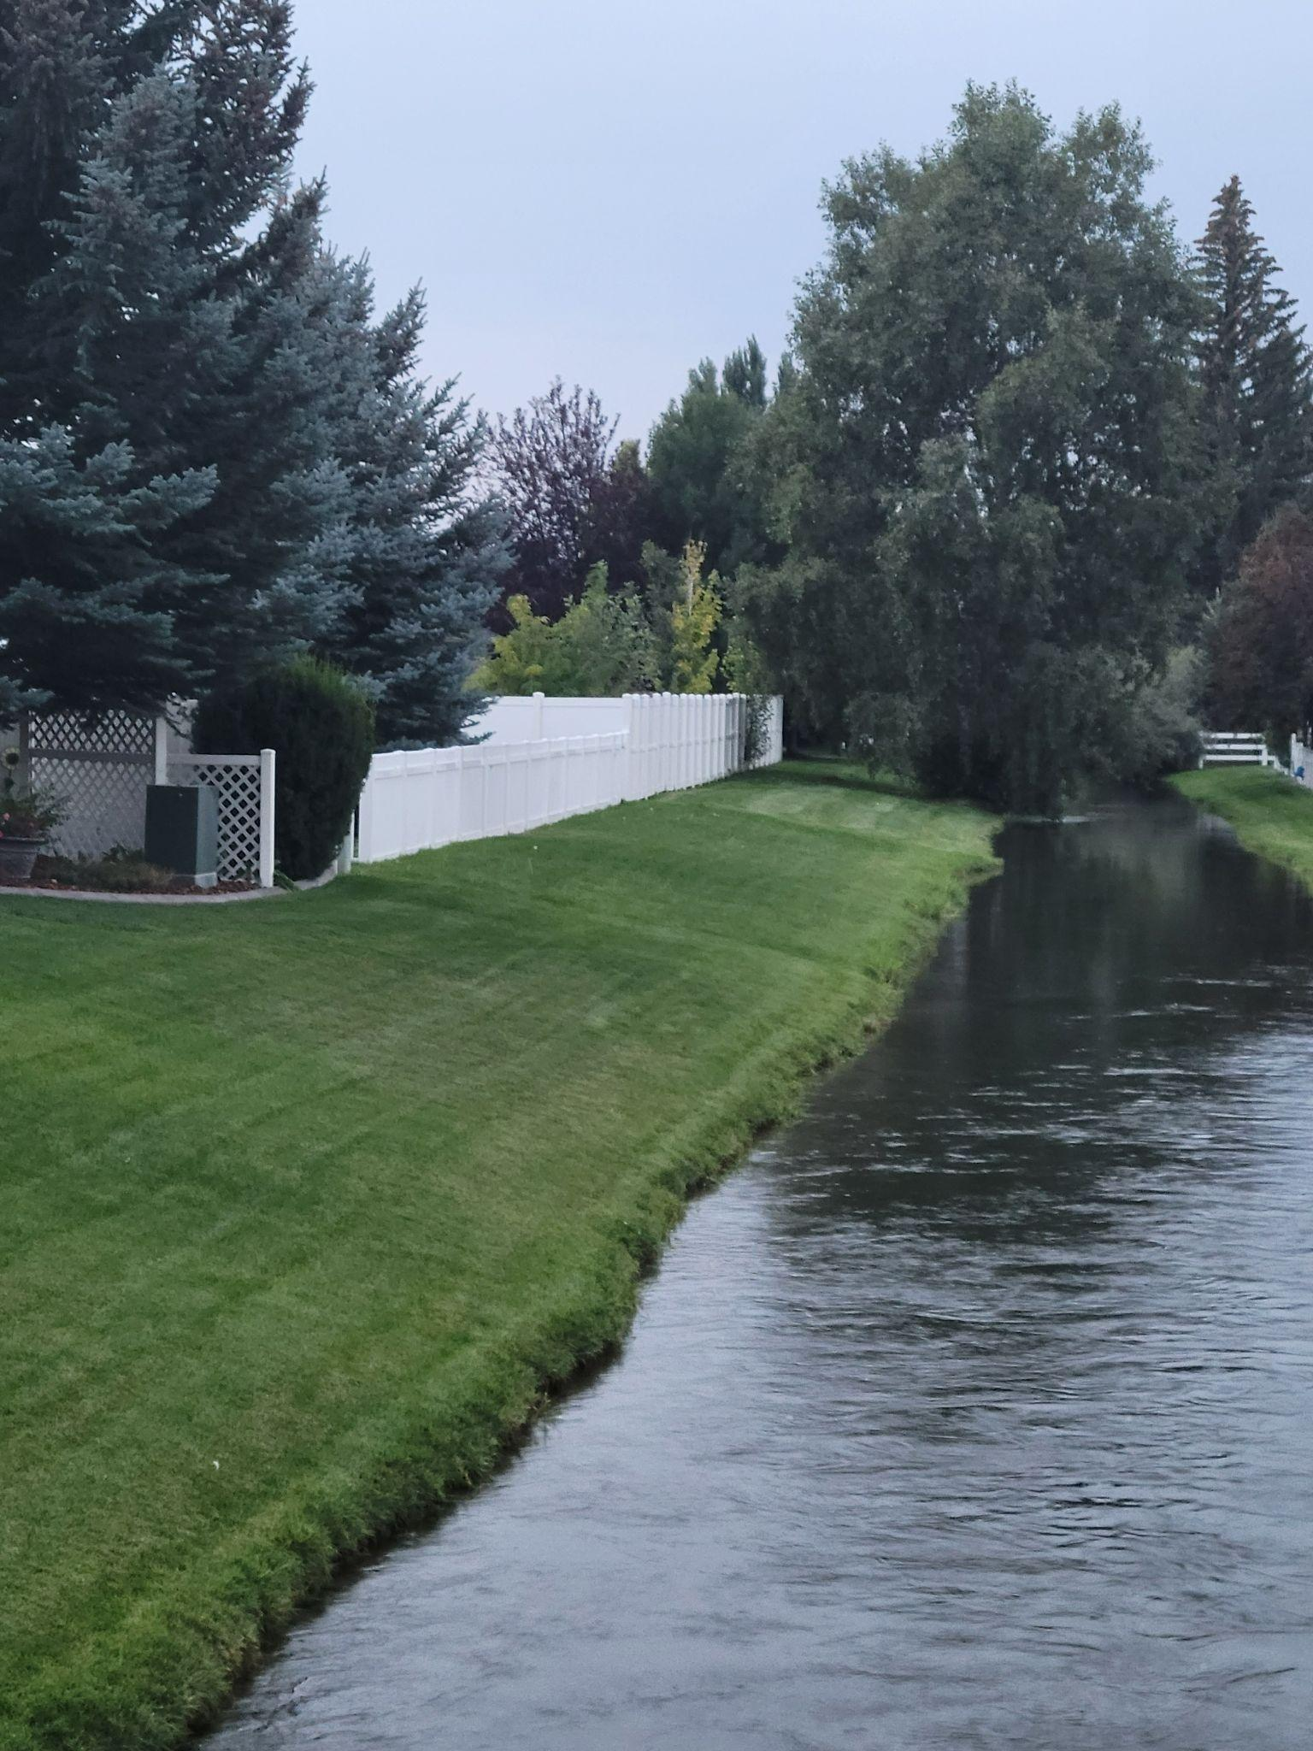
#1 Remove large tree growing in the canal
Notes:
The tree along the east side of Gustafson Canal must be removed as the integrity of the root system is compromised. We will be waiting until the water is out of the canal

Slide 26
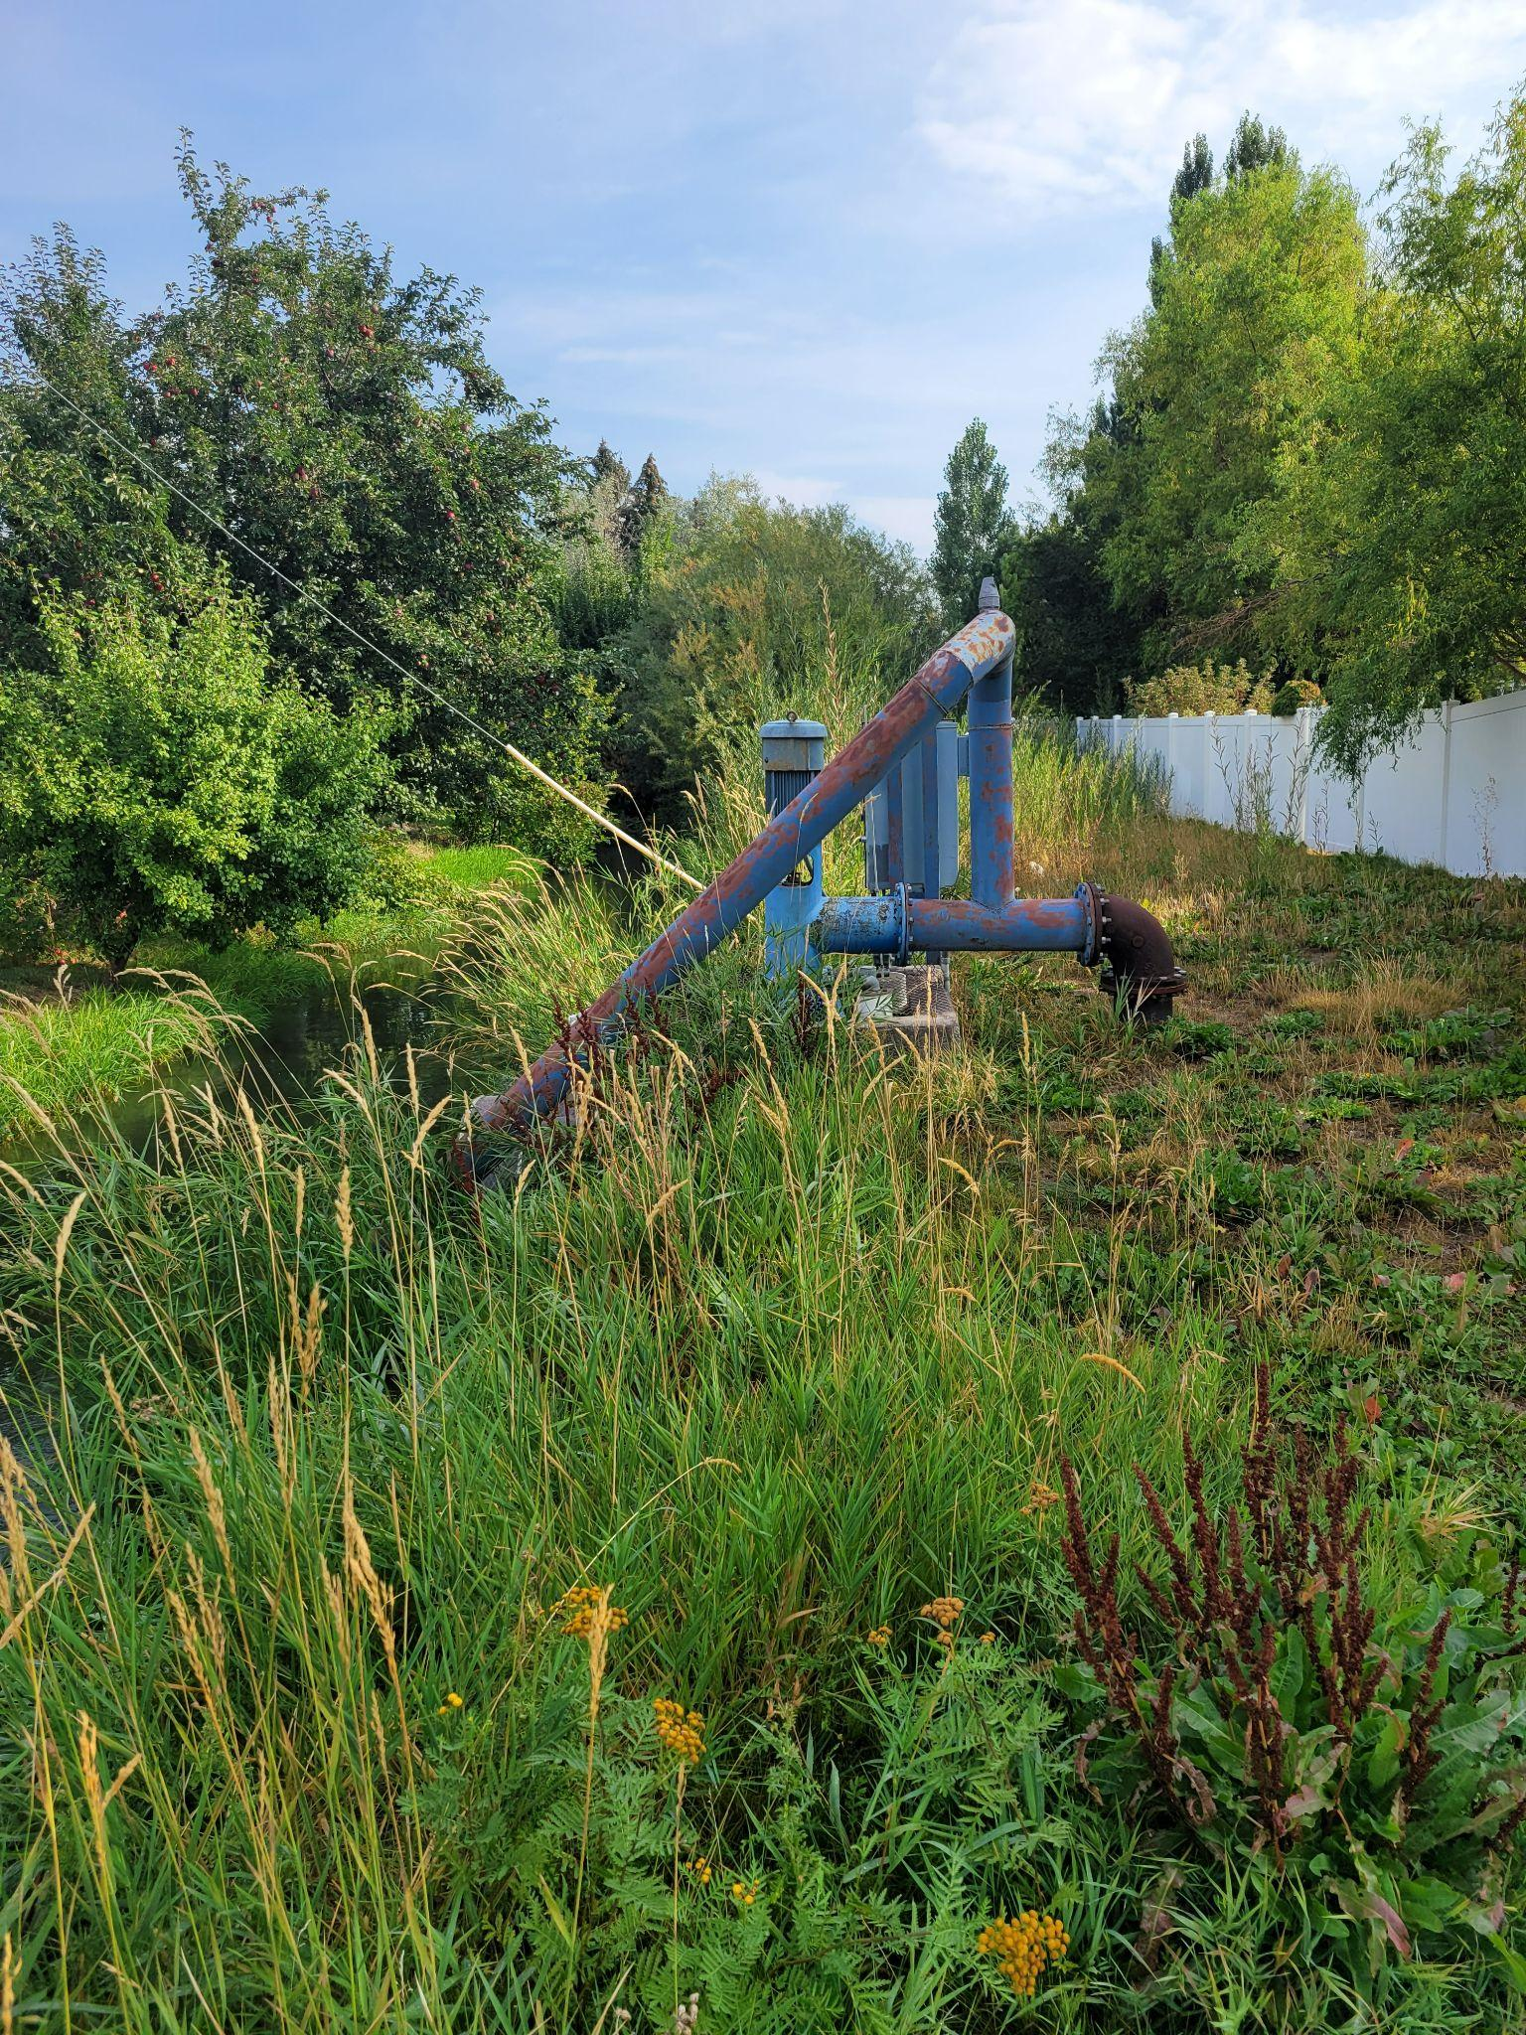
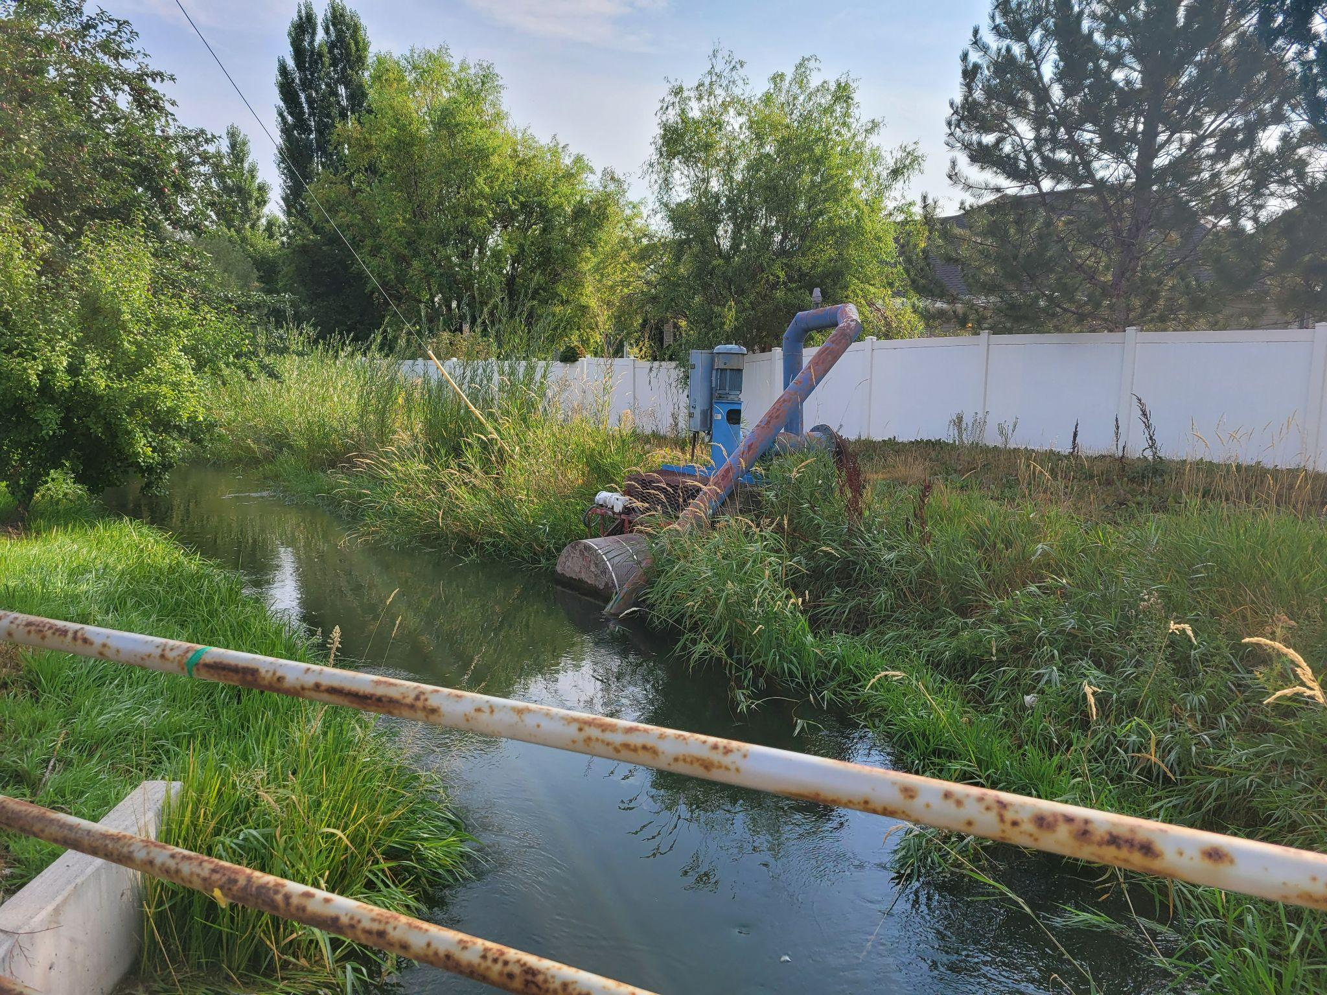
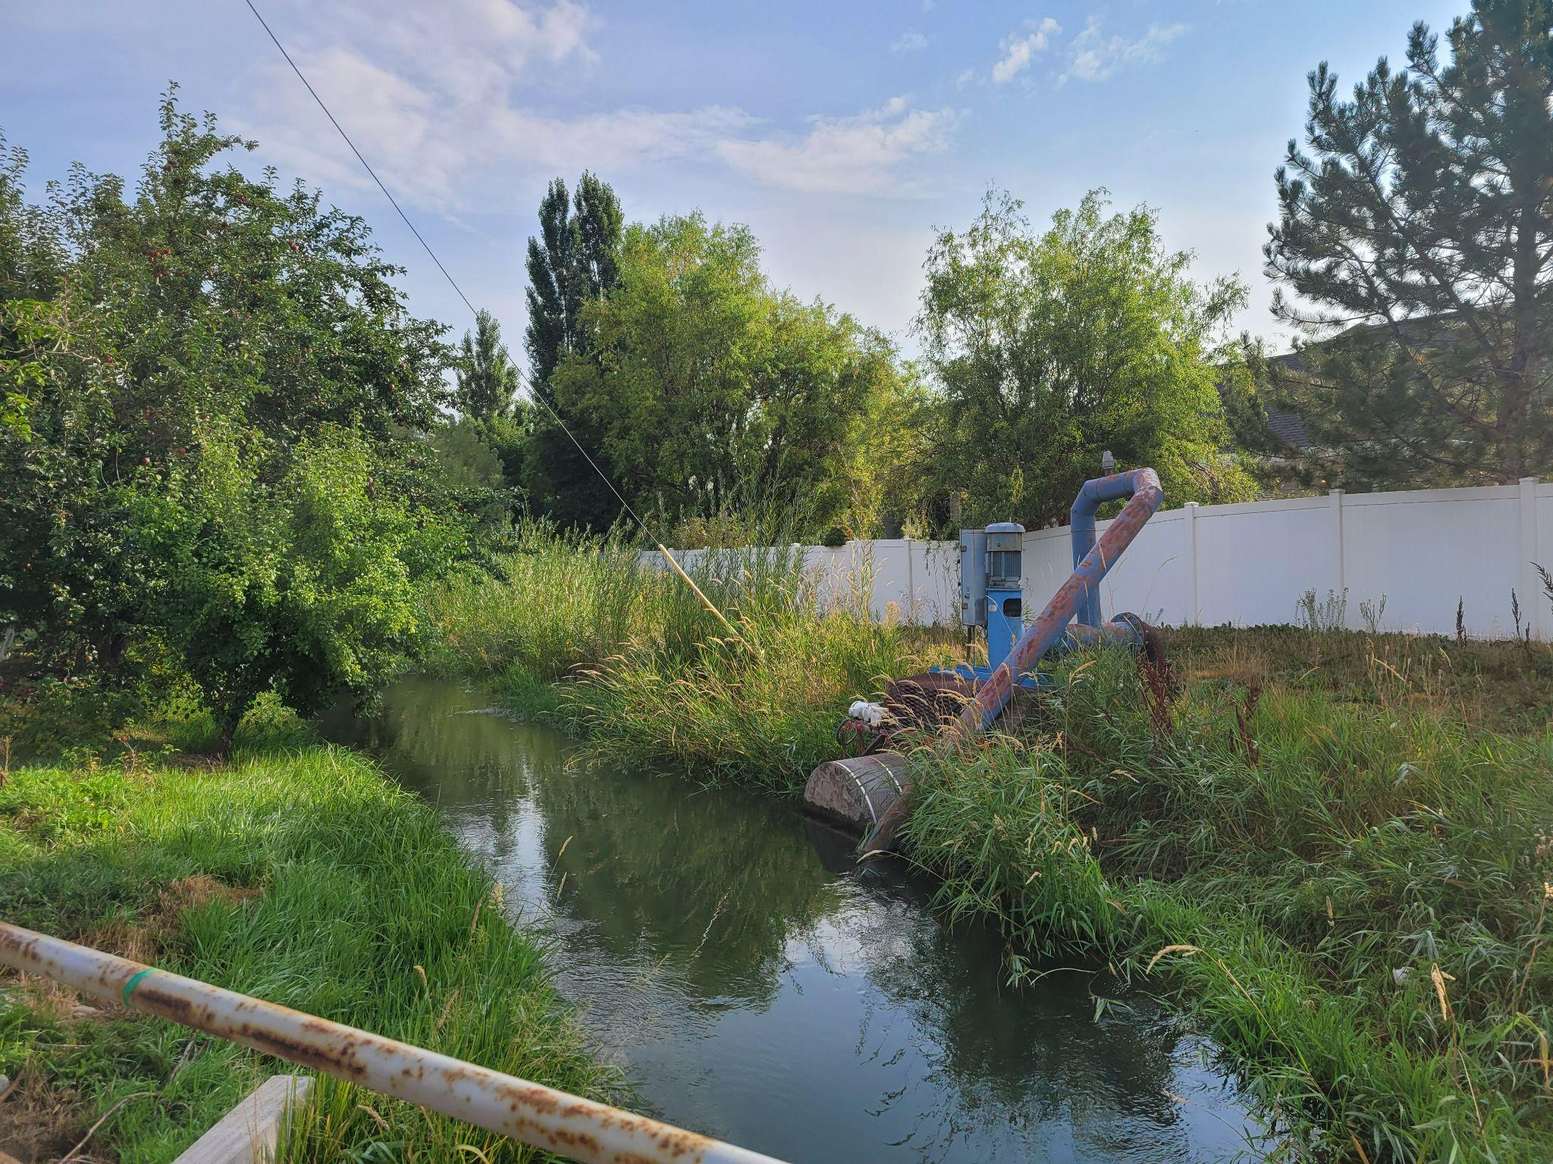
#2 Clean up Pump and Canal Area
Notes:
The pump area is the HOA’s responsibility. When the canal is empty we plan to clean the area up. Along the canal is the homeowner’s responsibility. We are going to clean up along the entire area and then turn it back to the homeowners along the canal.

Slide 27
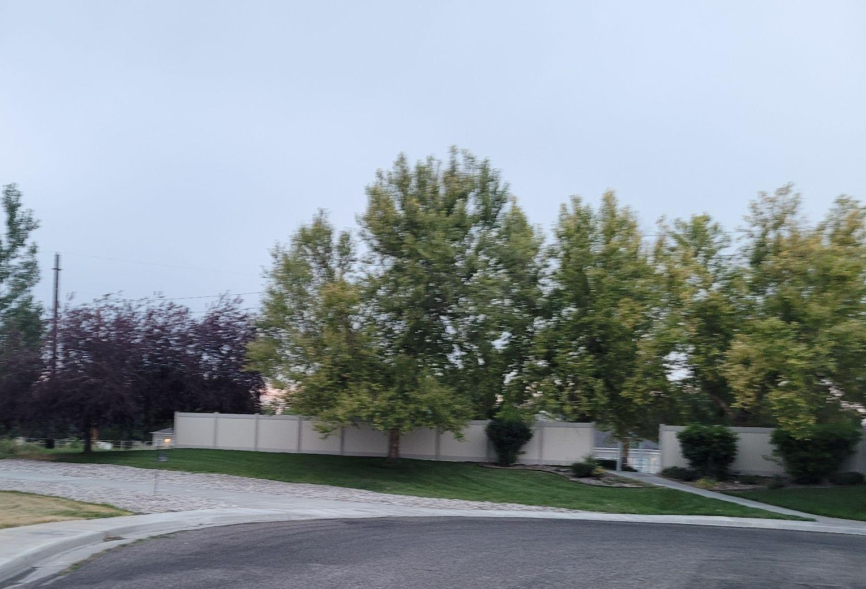
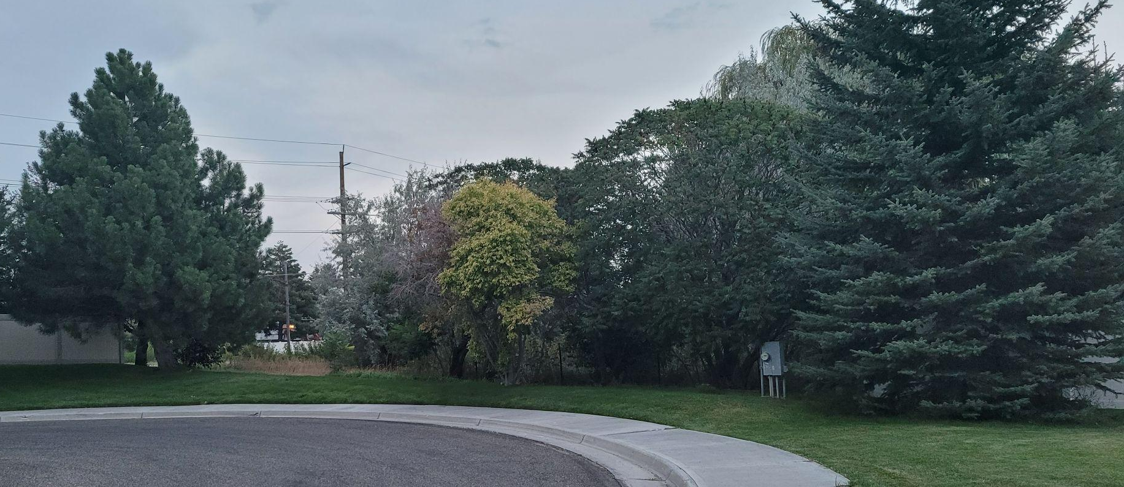
#3 Fencing at north end of Burgundy
Notes:
At the end of Burgundy we plan to install a fence on the east, from the Creager’s fence line along our property line and over to the existing fence. Then on the west side we are going to continue the fencing over to the canal area. The canal is partially on our property here as well.

Slide 28
#4 Remove Dead Trees
Notes:
There are some dead trees that need to be addressed. They will be removed and replaced on a case by case basis.

Slide 29

#5 Holiday Lights
Notes:
Lavinda will talk about our plans for holiday lights

Slide 30


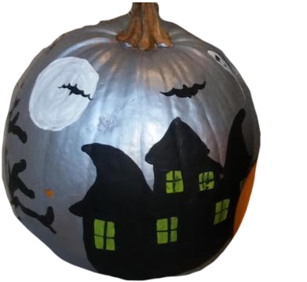
#6 Social Gatherings
Fall Fest
Pumpkin Painting Contest to October 22nd at the Playground Park
Notes:
Lavinda will explain the Fall Pumpkin Painting Event and ask for ideas and volunteers for other events

Slide 31

#7 Board and Committee Training
Notes:
Ynette will detail the training for the board and ACC to take place soon and the expansion of the ACC Committee and new Compliance Committee

Slide 32
#8 Recruit Volunteers
Board Members
New Bylaws will allow for 2 more Board Members
The first two new ones will be by appointment
Committees
Nominating Committee
Architectural Control Committee
Compliance Committee
Social & Events Committee
Landscape Committee
Notes:
John will discuss the need for more people to get involved and participate on the board and on the committees.

Slide 33
Revisions to HOA Documents
The Idaho Homeowners’ Association Act went into effect July 2022.
These changes will keep us compliant with the new statutes
WE NEED YOUR VOTES!
Bylaws
Covenants, Conditions & Restrictions
Notes:
John will explain that the State of Idaho passed a new law that went into effect this year and we had to change our governing documents in order to comply with the new Statutes. We have been working on these for some time and it is going to take a massive effort on everyone’s part to get the signatures we need to approve the revisions.

Slide 34
Bylaw Changes
a) Removes verbiage pertaining to annexing additional properties since all lots are now built and surrounding lands are also developed.
b) Removes verbiage pertaining to the developer
c) Clarifies that one single family home, whether on one platted lot or more, constitutes one Unit, allowing for one membership vote, regardless of the number of owners of the home.
d) Clarifies that the annual meeting may be set on a date in October as can be reasonably scheduled
e) Defines Regular Board meetings and Executive Board meetings
f) Allows for virtual attendance at meetings
g) Provides for up to seven board members (ideally one from each Waterford Division)
h) Provides that board members receive a waiver of their annual dues during their term of office long as they remain in good standing on the Board.
i) Provides that a Board Member should serve on the board for at least one year before serving as president
j) Provides that the Chairperson of the ACC Committee is a Board member
k) Provides authority to impose fines and penalties for violations and non-compliance with the CC&R’s
l) Provides that minutes of board meetings shall be available on the HOA website once they have been approved. Minutes from Executive sessions will not be published.
m) Sets the fiscal year to start on October 1st to coincide with new Board, but for tax purposes the fiscal year is still the calendar year
REQUIRES 51% OF MEMBERSHIP TO VOTE APPROVING REVISIONS
Notes:
Idea: Maybe we should go down the panel of board members and each read one

Slide 35
Covenants, Conditions, and Restrictions Changes
a) Consolidates the CCR’s for all seven divisions into one comprehensive document
b) Removes verbiage pertaining to annexing additional properties
c) Provides authority to impose fines and penalties for violations and non-compliance with the CC&R’s
d) Clarifies the use of political signs in yards in accordance with Idaho Statute (6 weeks prior to an election until 1 week after the election)
e) Clarifies the use of flags in yards in accordance with Idaho Statute
f) Allows for use of exterior self-contained fire pits when attended
g) Allows the Board to increase the annual assessment by not more than 10% without a majority vote of the membership
h) Increases the number of Board members to seven
i) Increases the number of members of the Architectural Control Committee (ACC) to at least three, rather than limiting it to three
REQUIRES 75% OF MEMBERSHIP TO SIGN APPROVING REVISIONS
Notes:
Idea: Maybe we should go down the panel of board members and each read one

Slide 36
Homeowner Input
What’s on your mind?
Notes:
John will ask for comments, questions, and concerns
Verlin Squeek Stuart would like to see all incoming RENTER and new homeowner receive a copy of the CCR’s (discuss owners are responsible for yard/home maintenance, not renters)

Slide 37
Introduction of Candidate
And nominations from the floor
Notes:
Lavinda will explain that there is only one position open. John is running, but write in ballots can be submitted as well

Slide 38
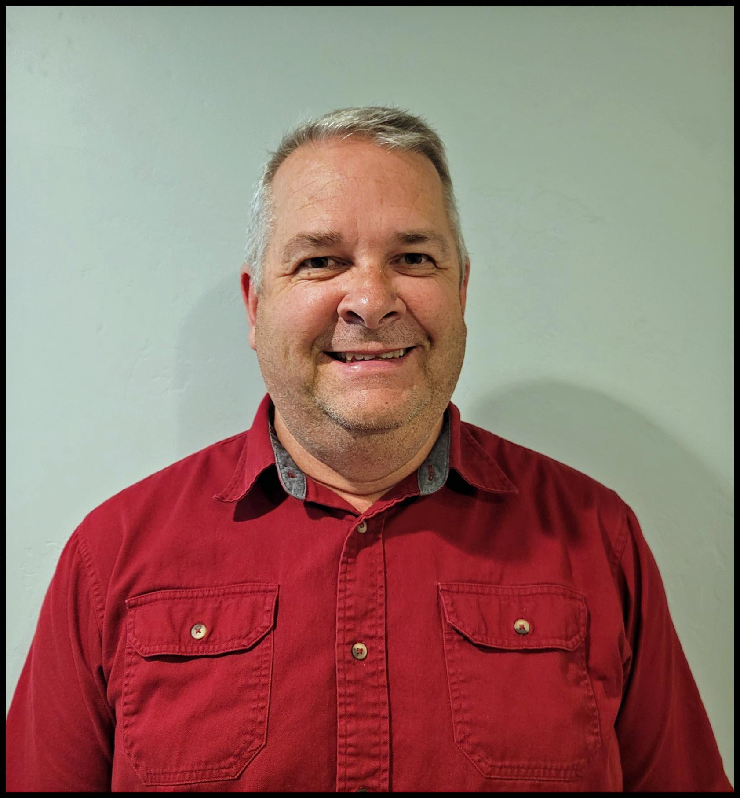
Candidate for Three Year Term
John Cleveland: Our address is 3530 Burgundy Dr. I was born and raised in Idaho Falls. My wife, Brenda and I built our house in 2016 and have enjoyed the neighborhood since moving in. I have a Bachelor of Business Administration degree in Finance from Idaho State University. I work for the Idaho Transportation Department as a Project Manager administering contract for road construction. I have worked for the Idaho Transportation Department for 28 years. One of the reasons I chose to build in Waterford was for the closeness of the parks and the river. I believe that the Waterford community is one where families feel welcomed by their neighbors, and I see the effort from past board members that have led this community to be a desirable place to live. Moving forward, I would like to see the standards of the community consistently maintained, with quick resolution to any requests or issues that arise.
Notes:
Lavinda will introduce John

Slide 39
Voting
Notes:
Laura will ask for ballots to be turned in. Votes will be added up.

Slide 40
Volunteers Needed
We need you help to make our neighborhood strong.
Notes:
While ballots are being counted all of Board can discuss the need for

Slide 41
Election Results
We need you help to make our neighborhood strong.
Notes:
While ballots are being counted all of Board can discuss the need for volunteers. Laura will announce voting results and ask for a motion that the ballots be destroyed.

Slide 42
Meeting Adjourned
Thank you for your contribution to our neighborhood!
Notes:
John will thank everyone for their participation and adjourn the meeting. “Meeting is Adjourned until Next October”

