Slide 1

Homeowners’ Association
ANNUAL MEETING
October 19, 2024
Notes:
JOHN will welcome everyone and call the meeting to Order

Slide 2

John Cleveland, President
Christopher Mitcham, Vice President
Susan Dewey, Treasurer
Ynette Marx, CC&R Committee Chair
Laura Macbeth, Secretary
Lavinda Hedman
Abraham Romo
Notes:
JOHN will introduce the Board members. Announce Ynette Marx will be taking minutes for tonight’s business.

Slide 3

Establish Quorum & Proof of Notice
Quorum requires 19 members present, proxies or ballots representing absent members.
(one member per property)
Notes:
LAURA will announce: Mr. President, we have determined there is a quorum represented either in person, by proxy, mail in, or digital ballots and I confirm that the Notice of Annual Meeting was mailed 30 days prior to the meeting.
There are 182 households in Waterford. Ten percent constitutes a quorum, which translates to 19 households.. There are _________ represented in person here today. In addition, we have _______ signed proxy assignments/or valid ballots that were submitted prior to the meeting. That is a total of ________. Therefore, we have met the requirement for a quorum.

Slide 4

2023 Annual Meeting Minutes Review & Approval
PAGE 5 in Handout
Notes:
JOHN will announce that minutes from last year have been available on the HOA website and we have passed them out as members checked in today. Hopefully, everyone has had ann opportunity to review them. He will ask that the reading of the Minutes from last year’s meeting be waived and ask for a motion and second to approve.. If there are changes then ask for a motion to approve with the indicated changes. Then ask for a vote of those present. The “motion has passed”

Slide 5
Treasurer’s Report
FISCAL YEAR:
OCTOBER 1, 2023, to SEPTEMBER 30, 2024
PAGE 11 in Handout
Notes:
JOHN will introduce the Susan as the Treasurer.
He will explain our fiscal year ends on September 30th of each year so that we can have reports ready for the Annual Meeting.
Turn time over to Susan for the Treasurer’s Report.

Slide 6
Income
MEMBERSHIP DUES INCOME | $34,452.00
TRANSFER FEES INCOME | 500.00
INTEREST INCOME | 2,296.10
TOTAL INCOME | $37,248.10
All members are current on their annual dues!
6
Notes:
Susan will present the financial report. For convenience everyone received a copy of the treasurer’s official report in their packet. Note that on their copy, we have included the prior year’s figure to compare.
HIGHLIGHT INCOME SOURCES

Slide 7
OPERATING EXPENSES
Landscaping and Groundskeeping
 | Lawn Care | $ 14,355.00
 | Tree & Shrub Care | $ 3,045.00
 | Sprinkler Maintenance & Repairs | $ 2,489.31
 | Snow Removal | $ 2,867.50
Total Landscaping and Groundskeeping |  | $ 22,756.81
Membership Expenses
 | Events & Promotions (Ice Cream Social) | $ 385.29
 | Holiday Decorations | $ 3,868.12
Total Membership Expenses |  | $ 4,253.41
Monthly Banking Costs
 | Credit Card Processing Fees | $ 101.22
 | Venmo Fees | $ 235.61
 | ACH Check Processing Fees | $ 6.00
Total Monthly Banking Costs |  | $ 342.83
7
Notes:
Lawn Care was up by $1700, sprinkler repair up $1246, tree and shrub care up $2600 ( a result of storms, dead trees, and removing stumps)
Snow removal was down $1488
Holiday Decorations included the labor on the Christmas lights, as well as the 4th of July Decorations. The actual lights were purchased from the Capital Expense Savings since they will be a long term asset.

Slide 8
Postage and Delivery
 | Postal Box Rent | $ 182.00
 | Stamps | $ 198.00
Total Postage and Delivery |  | $ 380.00
Professional Fees
 | Accounting & Audit Fees | $ 800.00
 | Insurance & Bonding Costs | $ 1,241.00
 | Federal Taxes | $ 555.76
 | Taxes - State of Idaho | $ 110.65
Total Professional Fees |  | $ 2,707.41
Supplies & Services
 | Meeting Expense | $ 116.22
 | QuickBooks Online | $ 534.60
 | Office Supplies | $ 355.60
 | Internet & Website | $ 273.93
Total Supplies & Services |  | $ 1,280.35
8
Notes:
Postage was down $256 because of emailing communications with members.
Office supplies were down $356
But we had $535 expense to convert to QBOOKS Online
Internet costs changed because we upgraded the website
We had a full audit last year so the cost was up $300 This year is just the review so it should be back at the $300 level
Taxes – Because of the interest we earned on our money, we had to pay taxes this past year. It worked out to be about 45% last year, but 55% of $2090 is better than all of the $25 we earned at Bank of Idaho

Slide 9
Utilities
 | 0340 Napa Drive | $ 312.00
 | 3330 Burgundy Drive | $ 517.96
 | 3561 South 5th West | $ 334.08
 | 3900 Tuscany Drive | $ 364.66
 | 3811 South 5th West (Pump) | $ 398.39
Total Utilities |  | $ 1,927.09
TOTAL OPERATING EXPENSES | $33,647.90
9
Notes:
Utilities are pretty constant each year. Overall total operating expenses came to $33,647.90

Slide 10
INCOME LESS EXPENSES
Gross Income $37,248.10
Operating Expenses (33,647.90)
Net Income $ 3,600.20*
*Moves into Equity Account (Savings) for Capital Expenditures
Notes:
Explain this, see next slide

Slide 11
CAPITAL EXPENSE “EQUITY” SAVING ACCOUNTS
Beginning Balance on 10/1/23 $58,512.16
2024 Net Income + $ 3,600.20
Total Equity Account $62,112.36
11
Notes:
Our extra income of $3600 went into the Equity pot. This is basically our savings accounts.

Slide 12
2023 CAPITAL EQUITY SAVINGS ACCOUNT EXPENDITURES
Capital Improvements
 | Purchase Holiday Lights | $3,425.00
 | Sod & Sprinkler at Pump on South 5th West and clean up by the Wetlands area & flowerbeds | $6,400.00
 | TOTAL CAPITAL IMPROVEMENT EXPENDITURES | $9,825.00
12
Notes:
Susan will Explain the Capital Expenditures. This is what was spent from the savings accounts, not from our annual income.

Slide 13
Total Equity Account $62,112.36
Less 2023-2024 Capital Expenses (9,825.00)
Remaining Capital Expense Equity /Savings $52,287.36
13
Notes:
Last Year’s Equity was at the end of the year was $62,112.36 so there was an overall decrease to the Equity, which is basically our “savings”

Slide 14
BALANCE SHEET
Assets
-
Checking Account (non- interest bearing) $ 148.33
Money Market Savings Account $ 21,872.69
Certificates of Deposit (3 Six months CD’s) $ 30,266.34
TOTAL CASH ON DEPOSIT $ 52,287.36
14
Notes:
Turn to next page in book
Review the assets of the Association – The $52,287.36 that we ended the fiscal year with is divided between these accounts. We cannot put it all into certificates and tie it up because we need it for operating expenses until dues start coming in this fall.
Ask if there are questions
Turn it back to John

Slide 15
2024 Audit/Review
The Board made a resolution in 2022 that the Association’s records will be Audited every other year and Reviewed in the alternate years.
The HOA will have the full Audit the end of the Treasurer’s first year in office, and again at the end of the Treasurer’s third year in office, or before a new Treasurer will take office.
The incoming Board will determine the need to have the CPA prepare the taxes each year.
Present the Review Letter from CPA
PAGE 15 in Handout
Notes:
John: Ask for a motion to accept the treasurer’s report as presented. Ask for a second. All in favor. The motion has passed
Review the points on this slide and then note the Board requested a REVIEW AUDIT of the Association’s records for the past fiscal year. PAGE 16 in Handout
Read the portions of the audit report that state the good things we are doing and point out the things we should work on. (It is not necessary that the entire report be read)

Slide 16
2024 Accomplishments
Notes:
JOHN will announce that board members will present our accomplishments for the past year

Slide 17
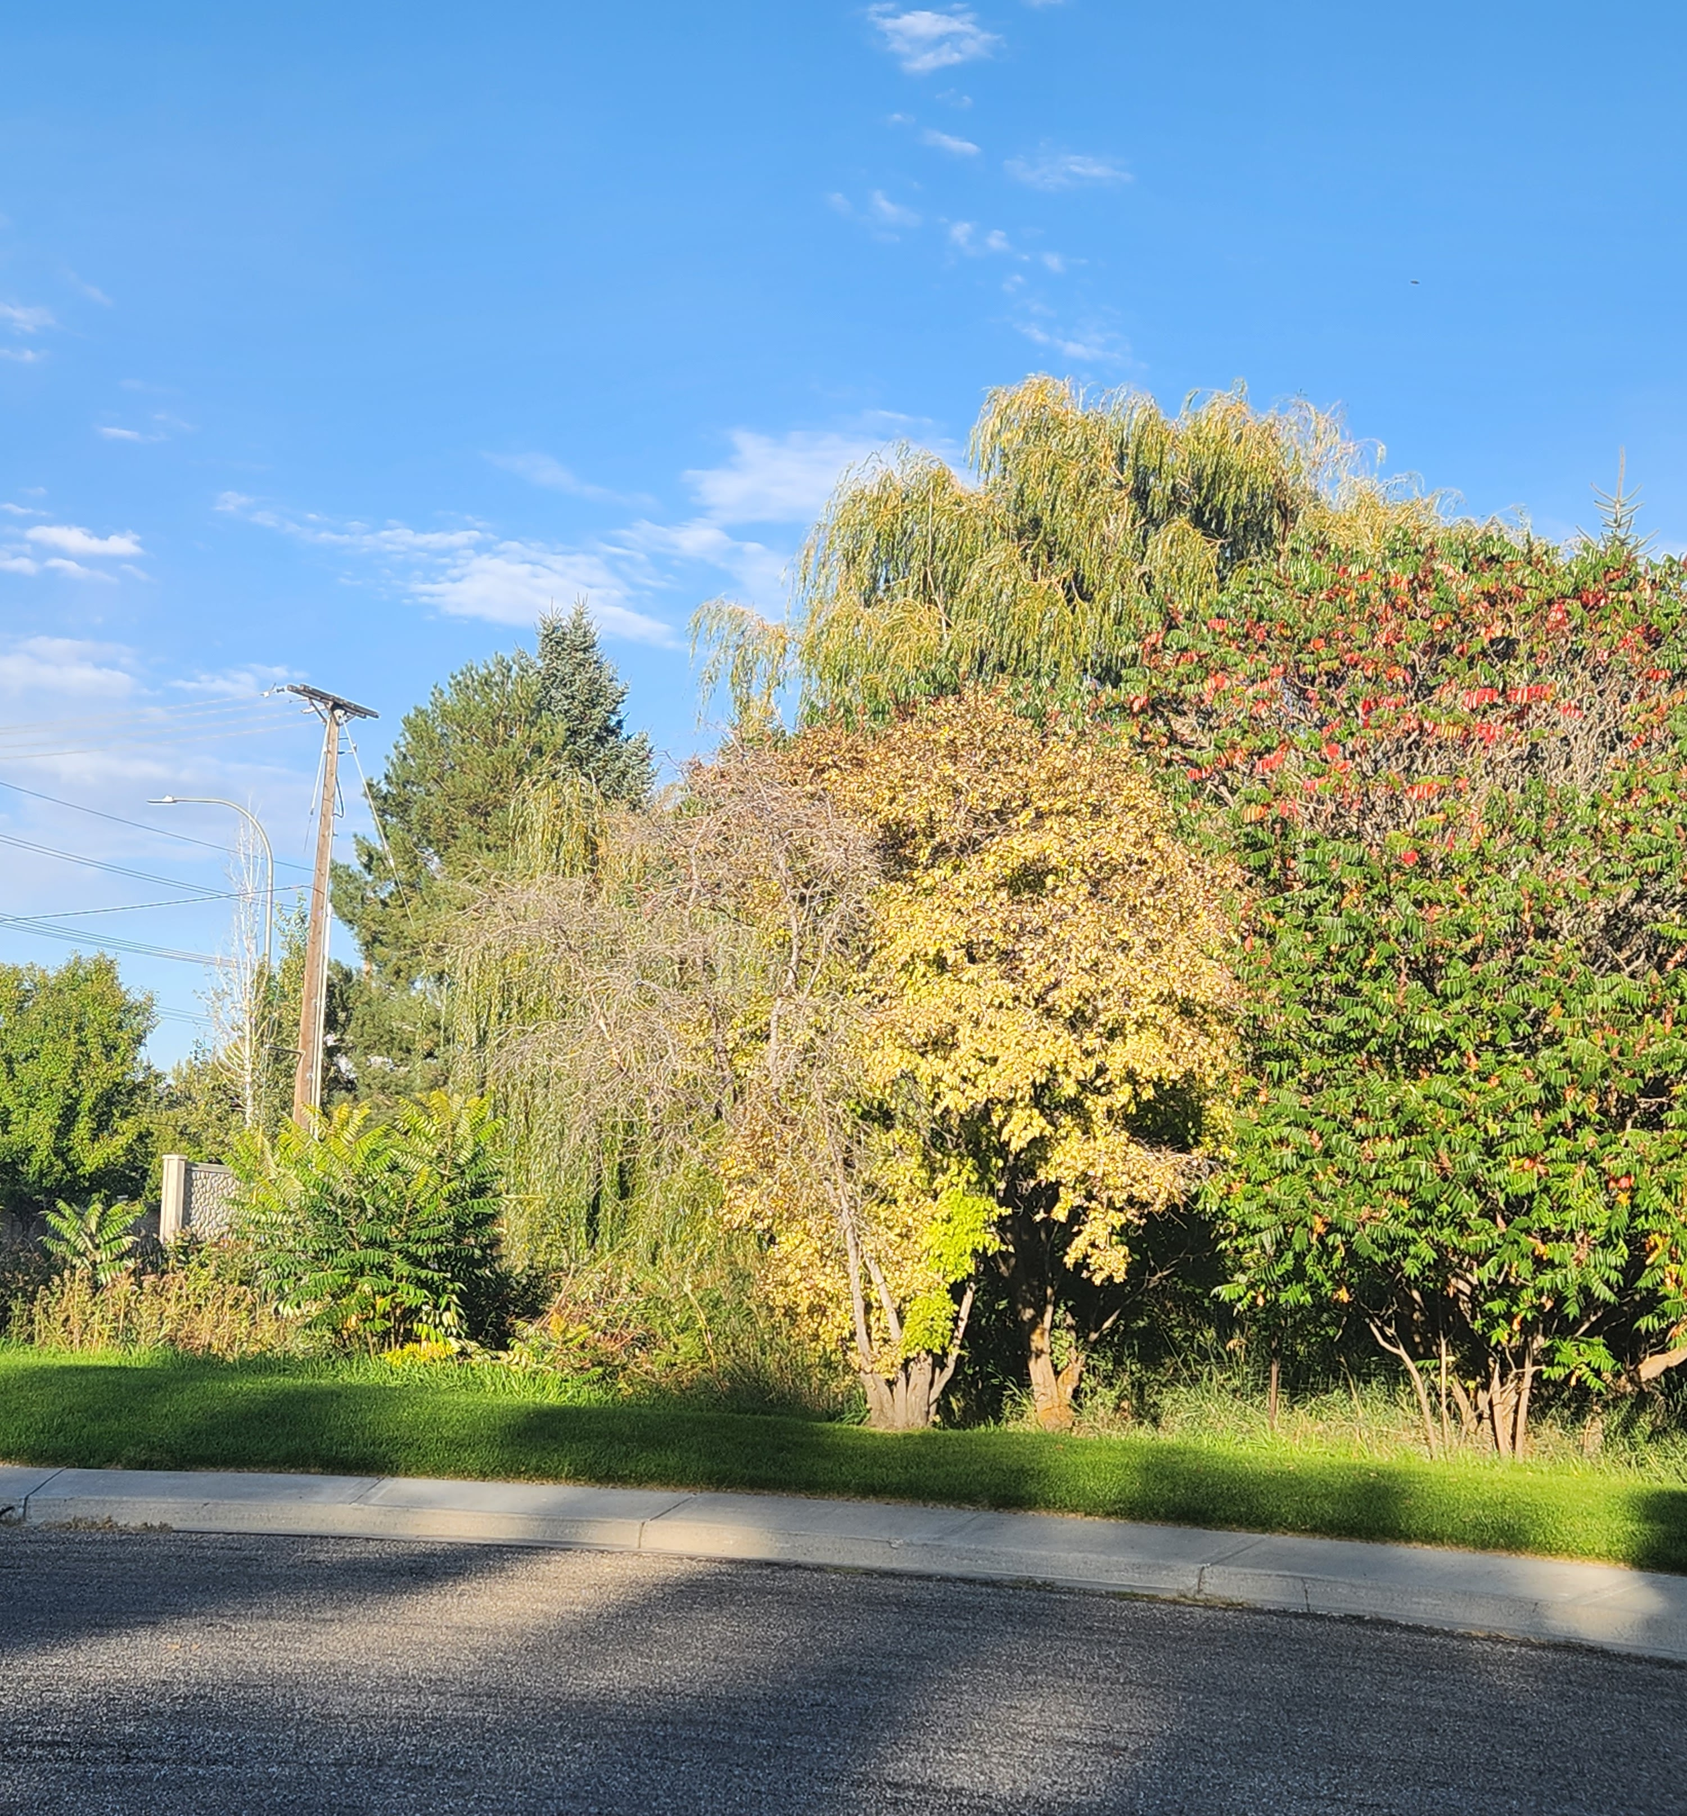
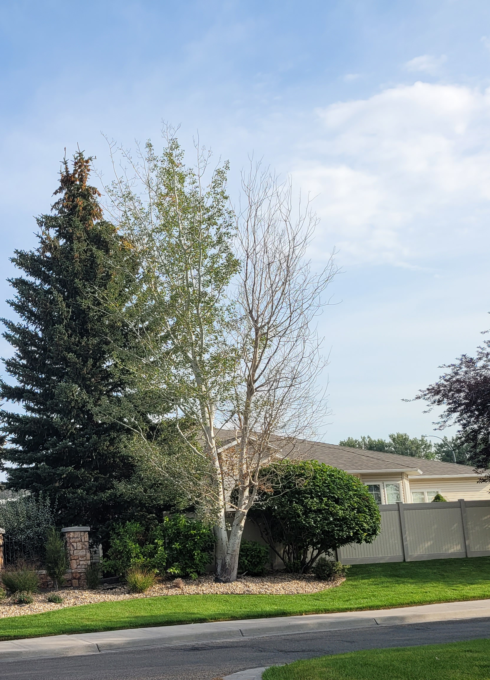
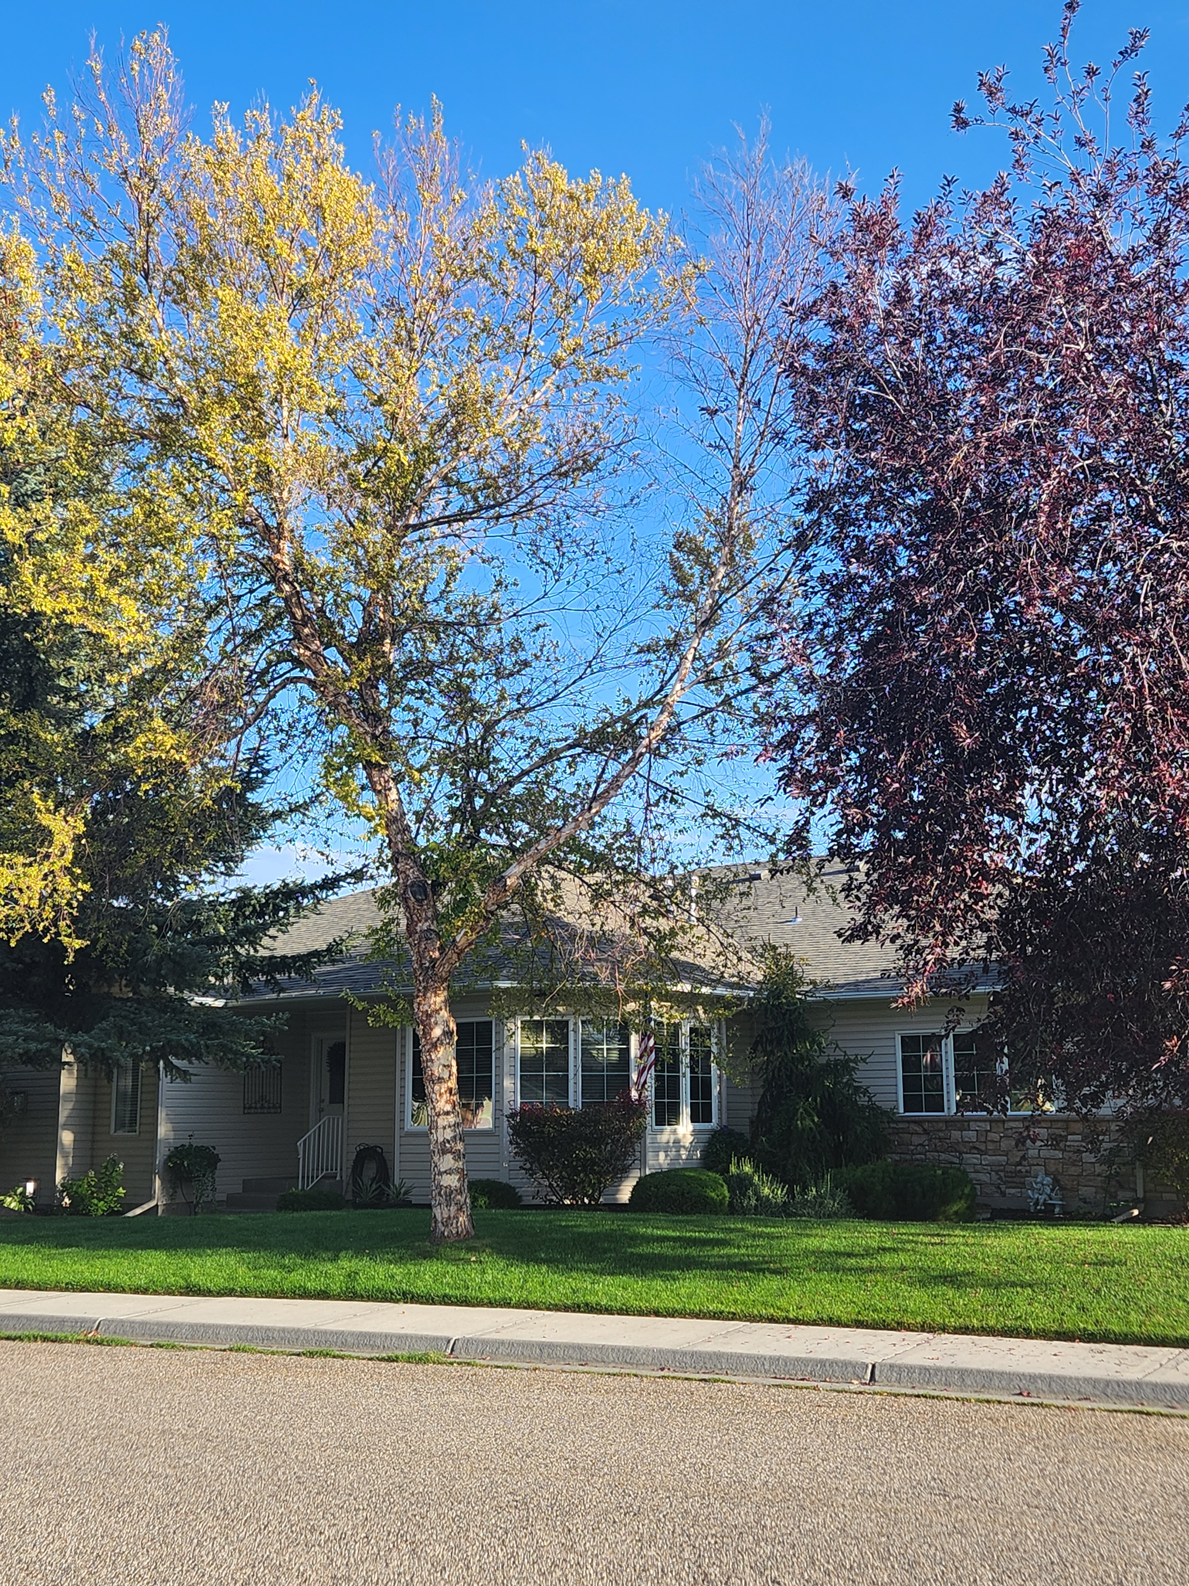
#1 Removed
Dead Trees Around the Neighborhood
Notes:
JOHN There were some dead trees that need to be addressed. They were removed, trimmed, or replaced on a case-by-case basis.

Slide 18
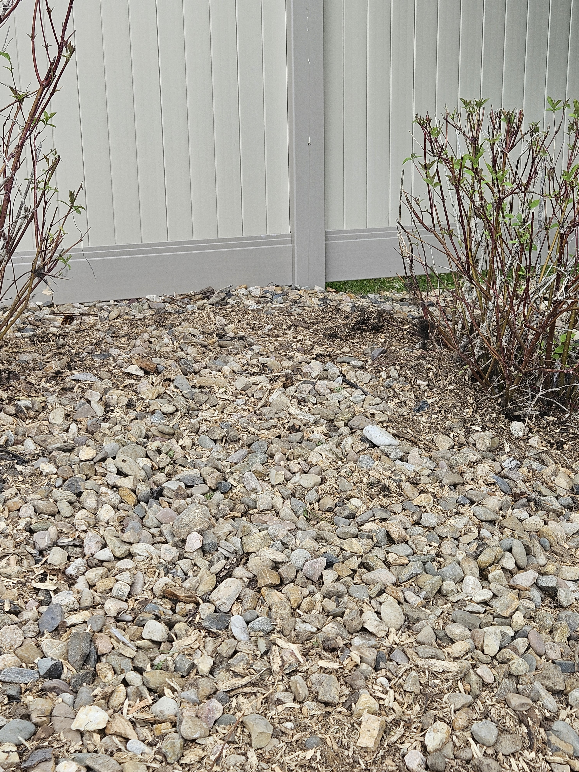
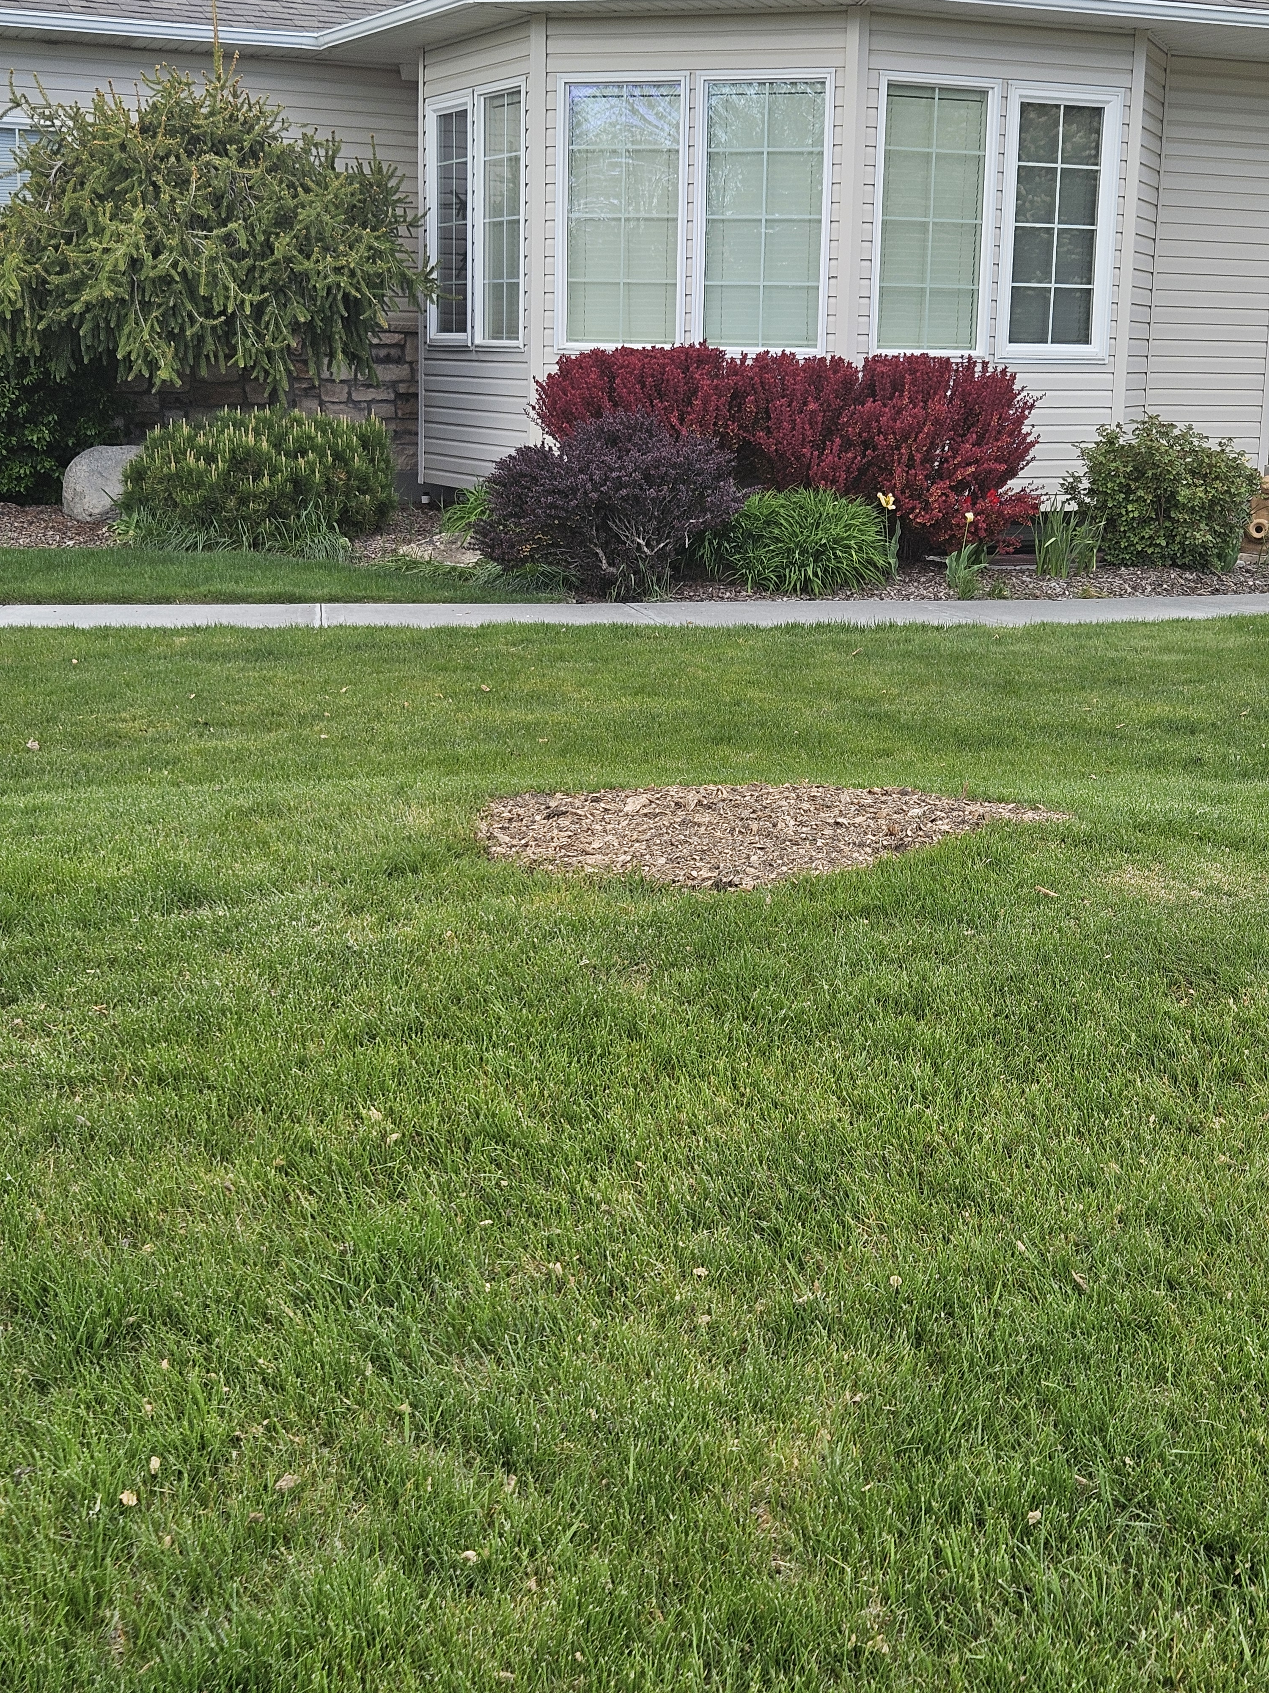
#2
Removed Stumps on Common Areas
Before
Notes:
SUSAN The stump grinding was done on several stumps around the neighborhood where trees have been removed over the years.

Slide 19
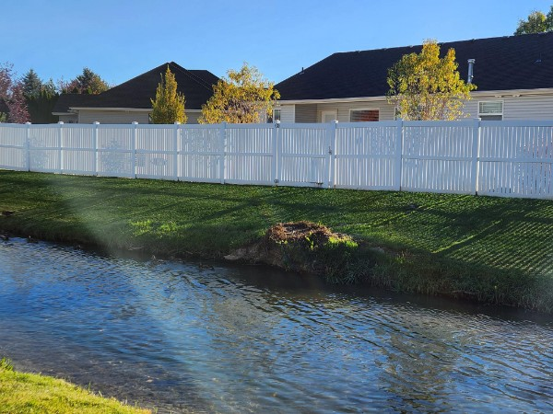
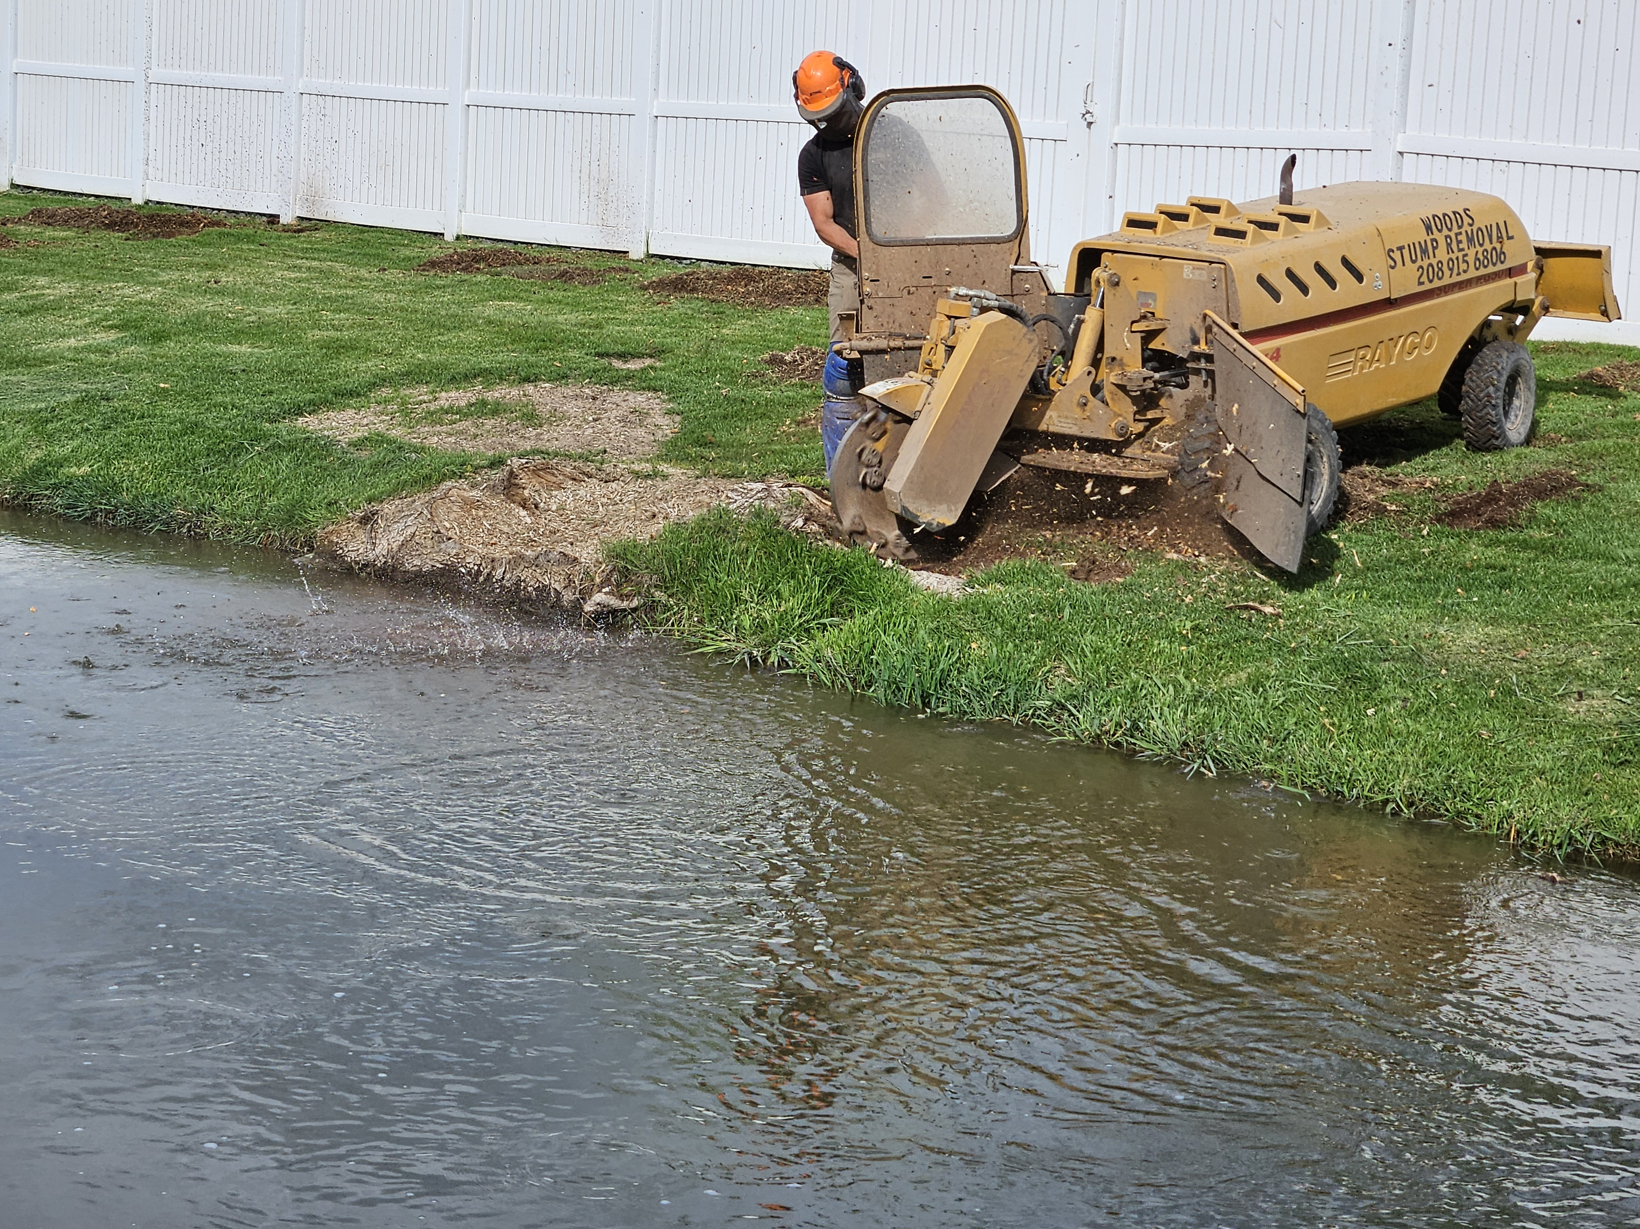
#3 Removed large stump and roots in the canal bank.
Notes:
SUSAN Last year we had the large tree removed from the canal bank. This year we authorized payment to have the stump ground down. The root system of the tree had encroached all along the bank, so it was not just the stump, but the large roots as well.

Slide 20
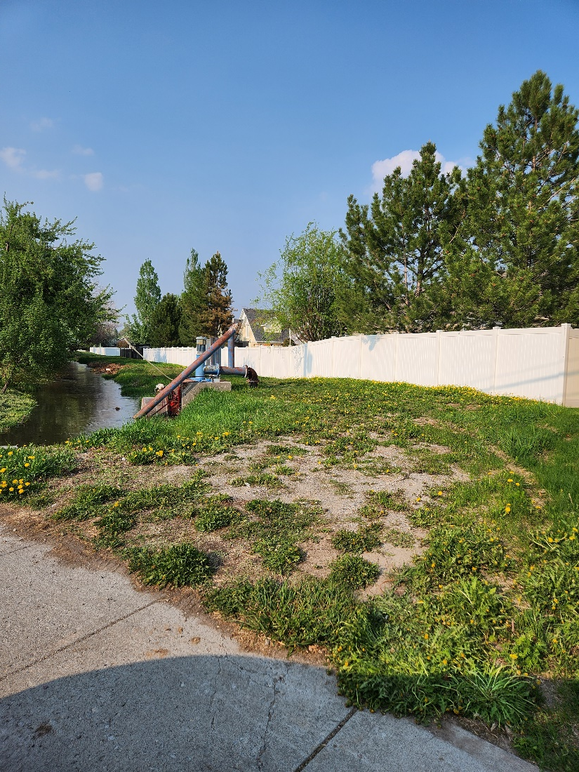
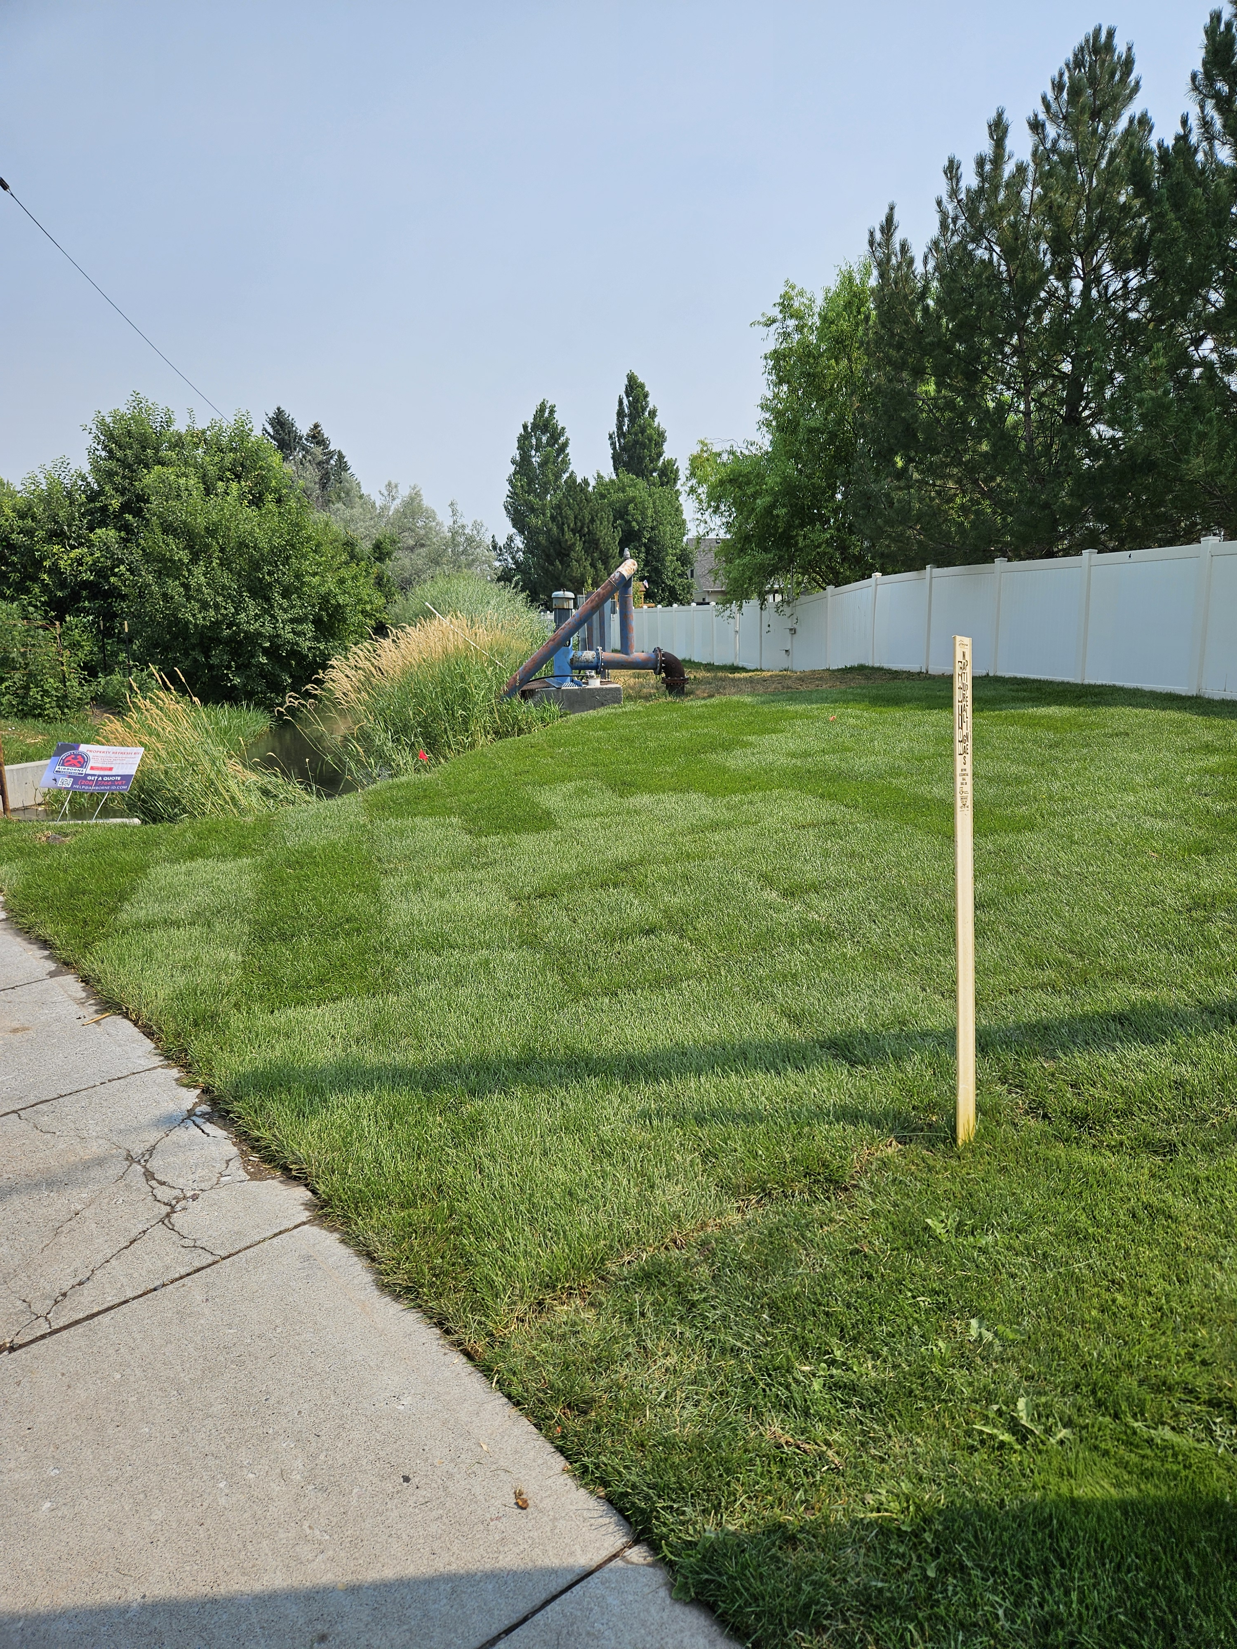
#4 Before and After Landscaping & Sprinklers at the Pump Site.
After
Notes:
CHRISTOPHER The pump area is the HOA’s responsibility. The Waterford Homeowners’ Association planted sod and installed sprinklers in the area. T & T will now include that area in the weekly lawn care.
Now that is has been cleaned up, we have informed the homeowners along the canal that it is their responsibility to maintain it. Nothing but grass should be planted between the fence line and the water. Willows especially must be removed or cut down.

Slide 21
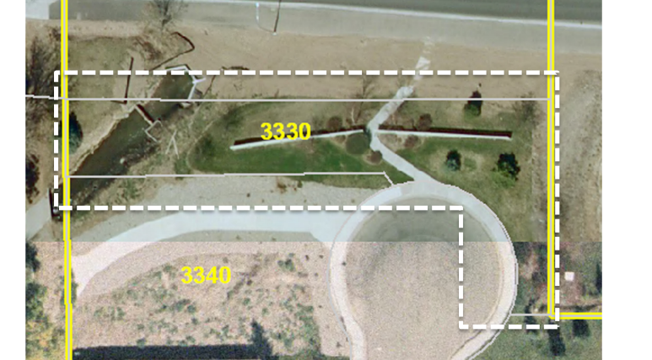
#5
Plat map of Waterford Homeowners’ Association’s common area at th end of Burgundy
Notes:
YNETTE At the end of Burgundy Drive we worked with the city to get the wetlands cleaned up last year. This a map showing the scope of our common area.

Slide 22
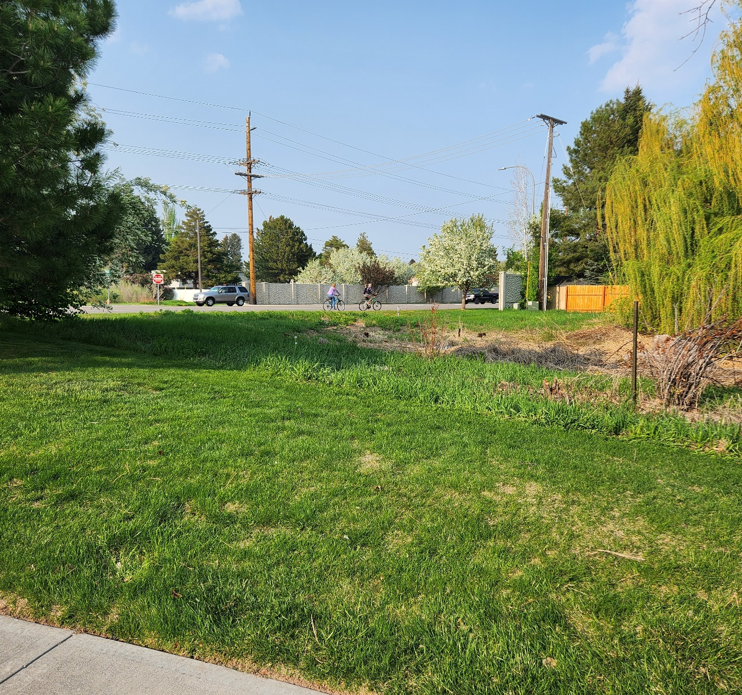
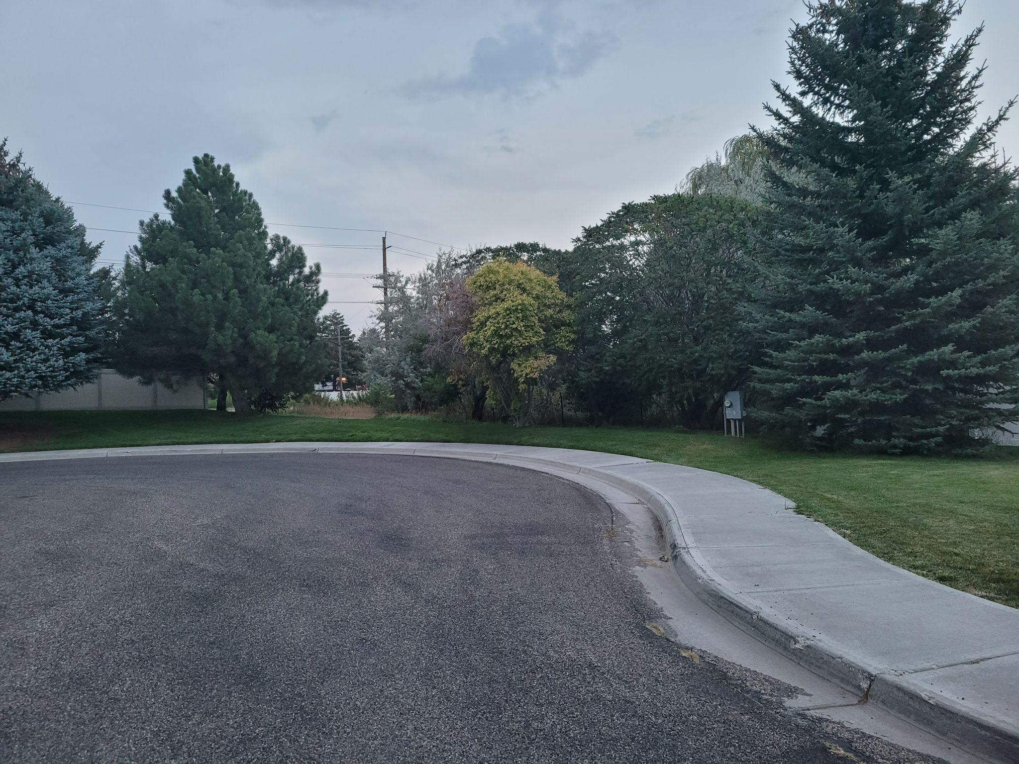
# 5
Before photos of the area at the end of Burgundy
Notes:
YNETTE Last year, at the end of Burgundy Drive, we worked with the city to get the wetlands cleaned. up. This year we have been working on additional fencing and trees. This was completed just before our fiscal year - September 30th (we were not billed until the 24-25 fiscal year.

Slide 23
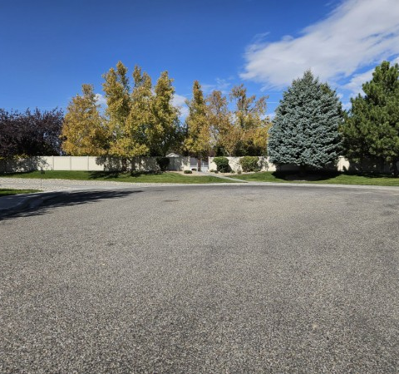
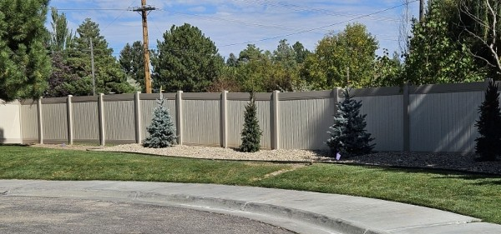
#5
Completed improvements at the end of Burgundy
Notes:
At the end of Burgundy Drive we worked with the city to get the wetlands cleaned up last year. This year we have been working on additional fencing and trees. This was completed just before our fiscal year ended on September 30th

Slide 24
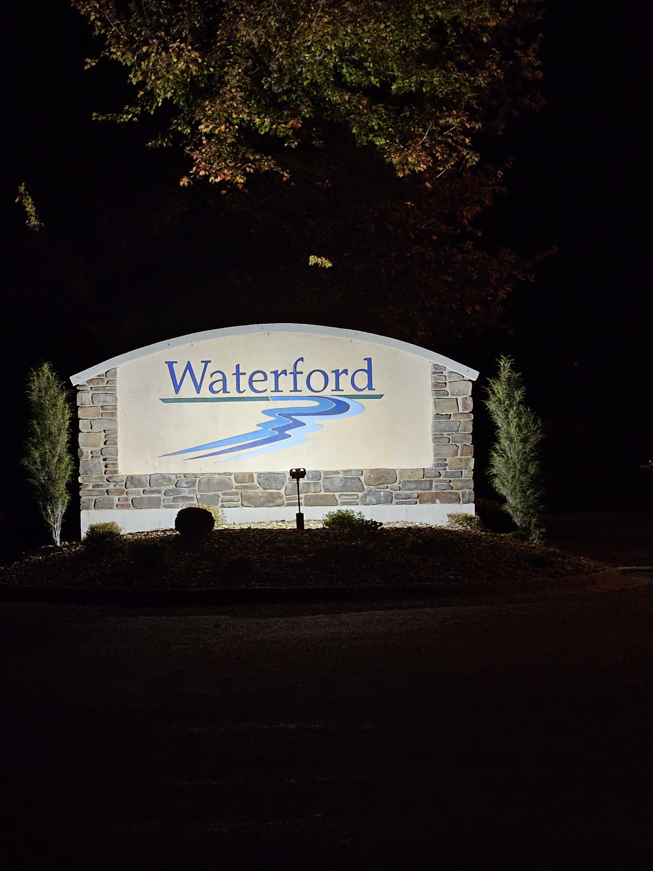
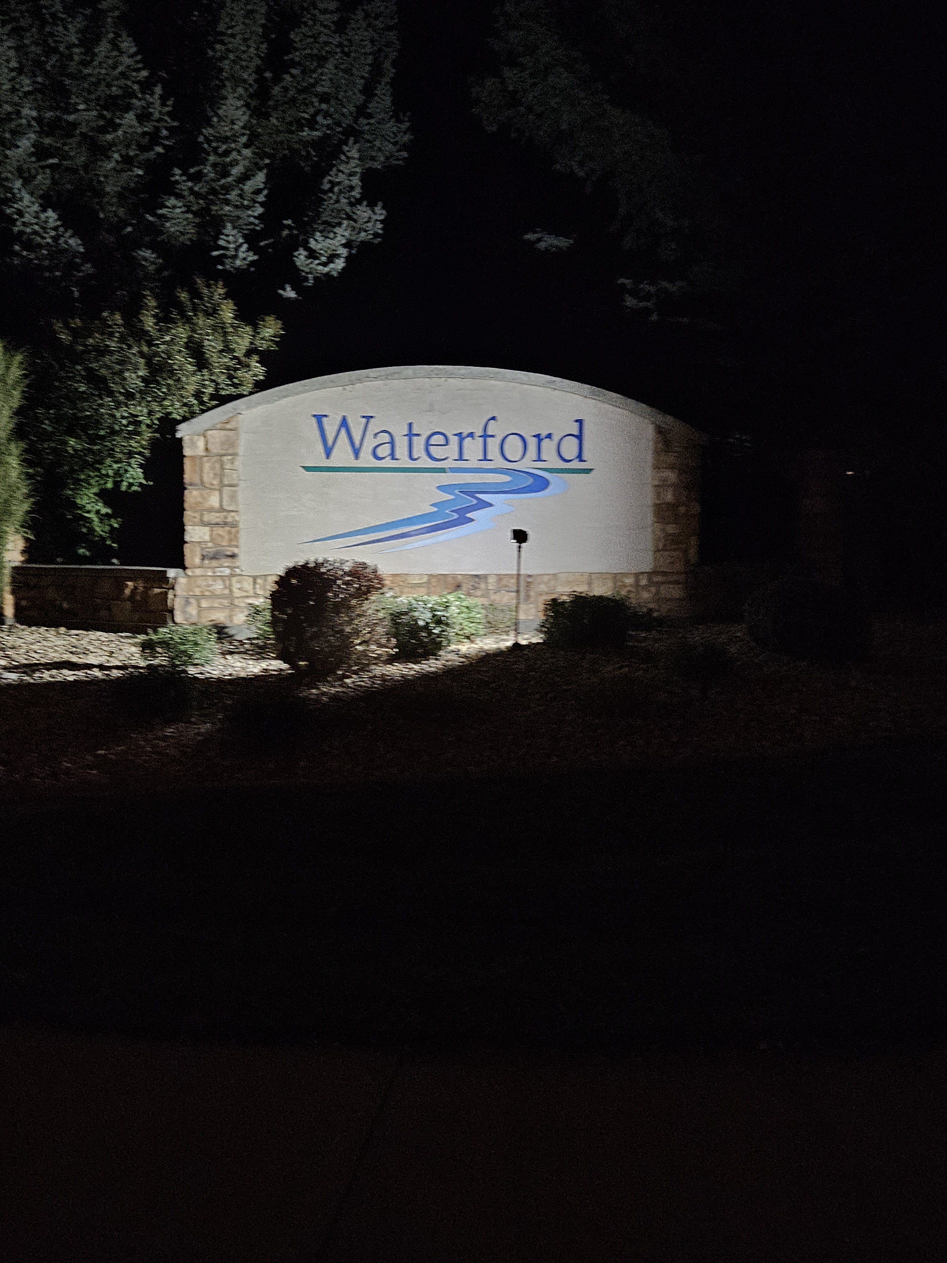
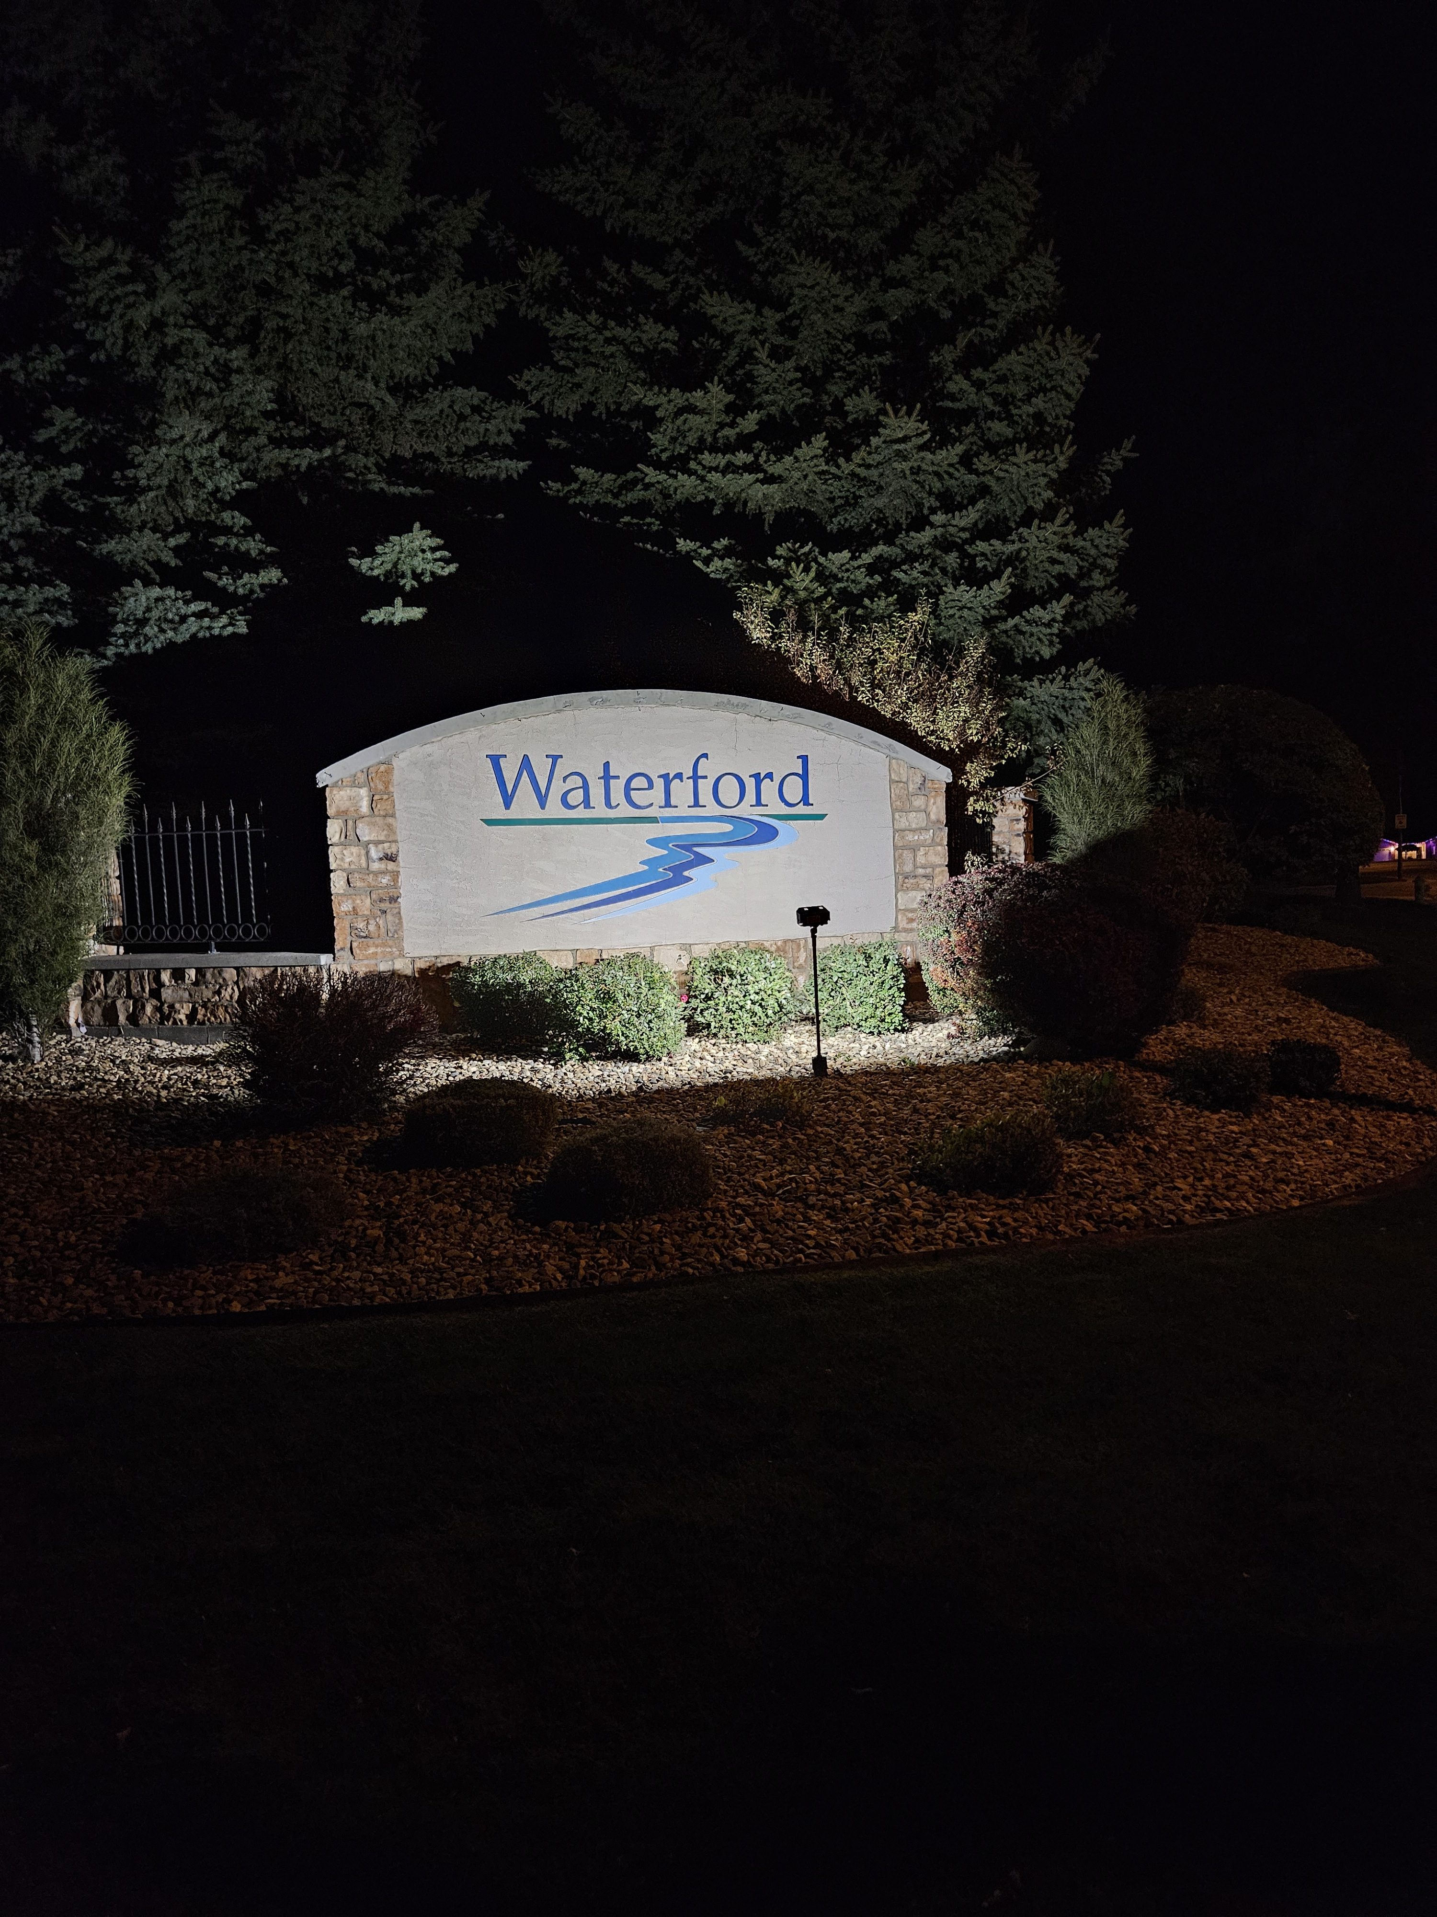
#6
New Lighting on Entrance Signs
Notes:
CHRISTOPHER Each sign, two at the north entrance and one at the south entrance had new lighting installed. Thank you, Christopher

Slide 25
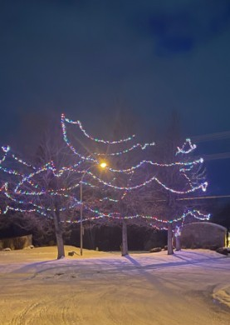
#7 Holiday Lights
Notes:
LAVINDA Last November the Board purchased some holiday lights from Top Tier Lighting. They store the lights and then put them up each November. This way we only pay for the labor year
Our goal is to get power to the island at the north entrance (possibly solar) and then next add the islands’ trees to the plan.

Slide 26
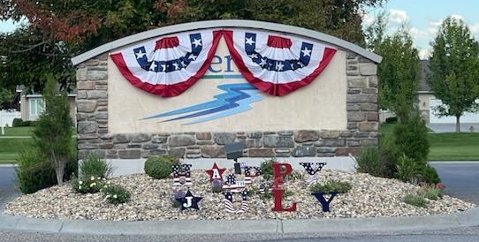
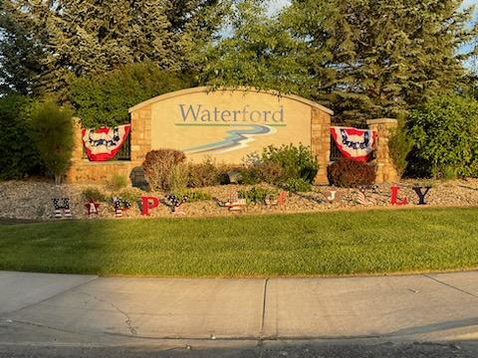
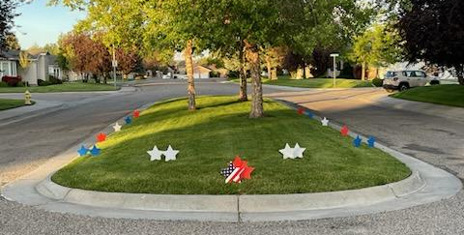
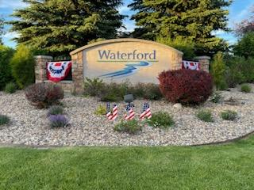
#8
Fourth of July Decorations
Notes:
LAVINDA We decorated the HOA entrances for the 4th of July this year. We plan to use the same decorations each year on Veterans Day this November.

Slide 27
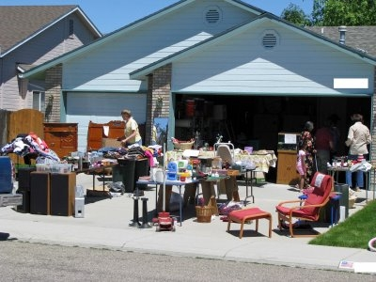

#9 Neighborhood Yard Sale Sale
Notes:
LAVINDA We had the 3rd annual neighborhood yard sale. Those that participated did well. Next year we are changing the date to coincide with the Stonegate Neighborhood Annual Sale. Hopefully this will bring more participation.

Slide 28
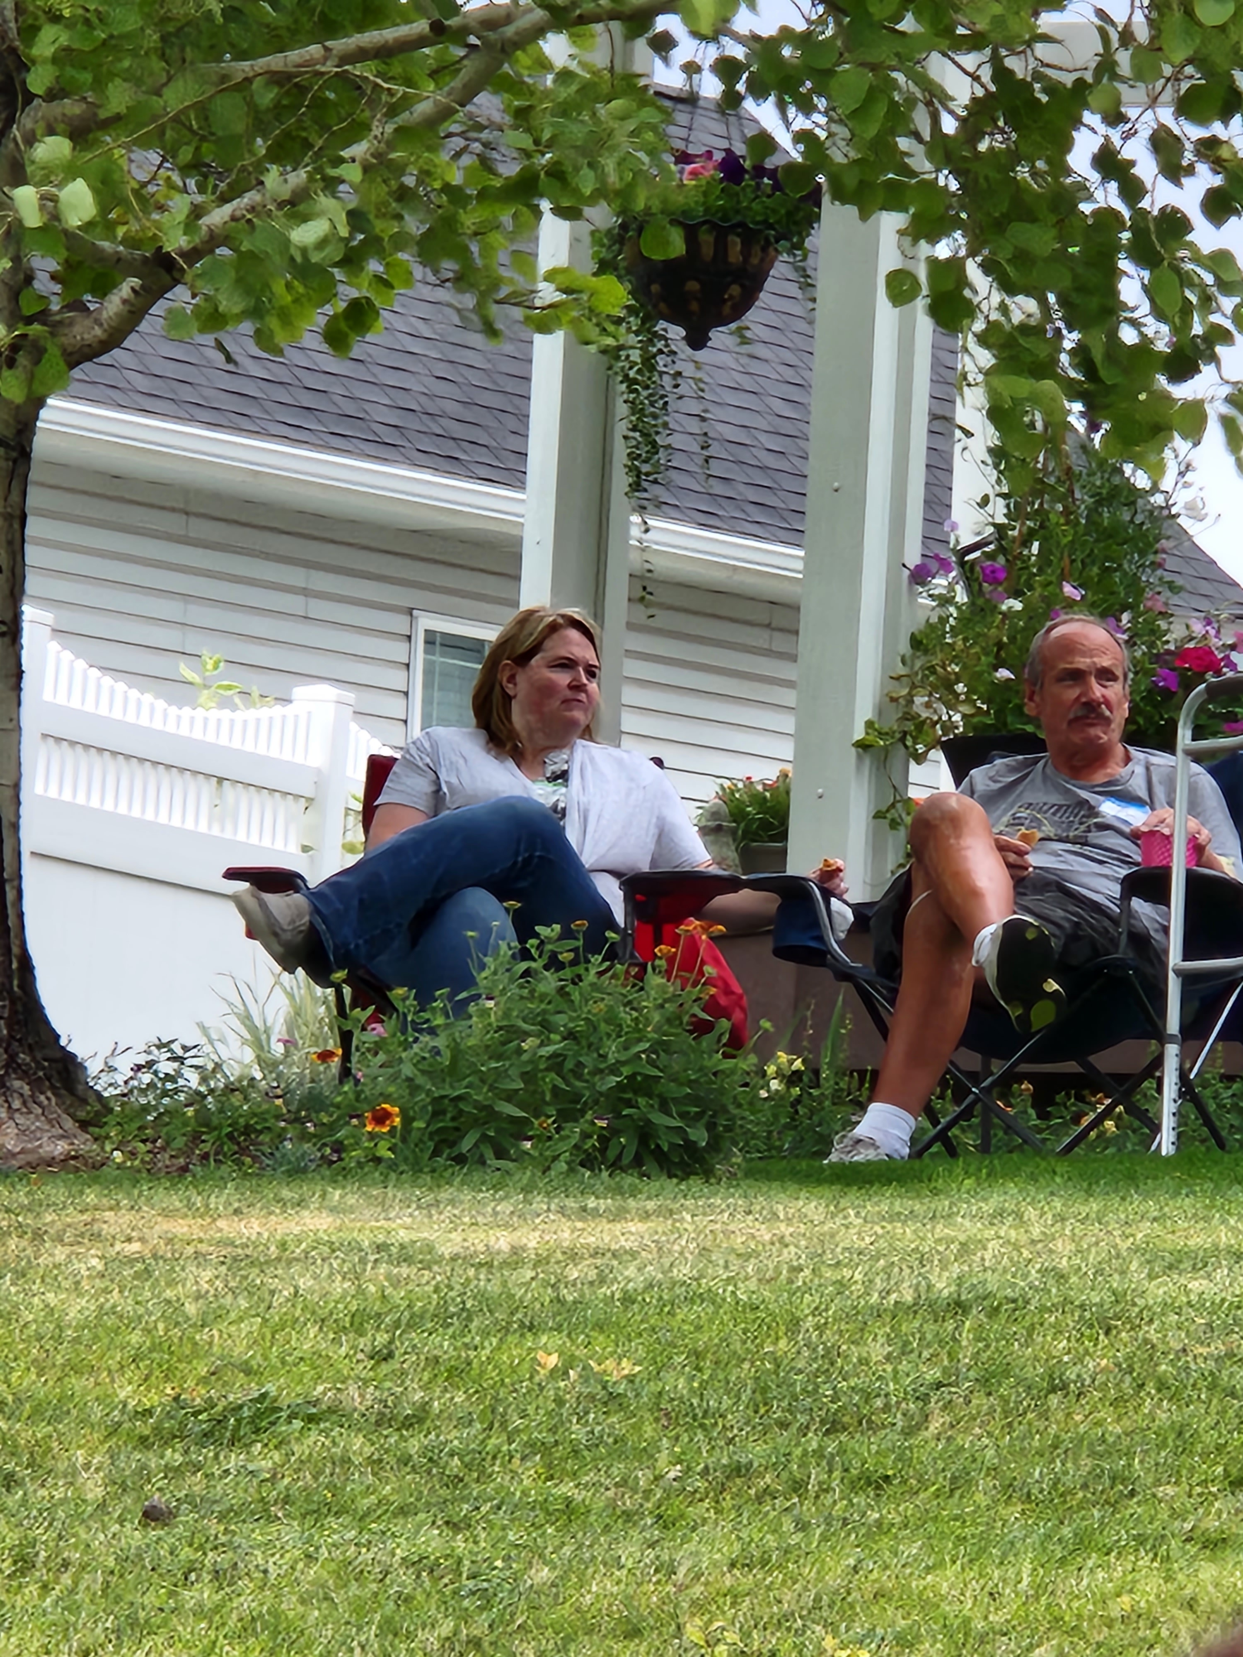
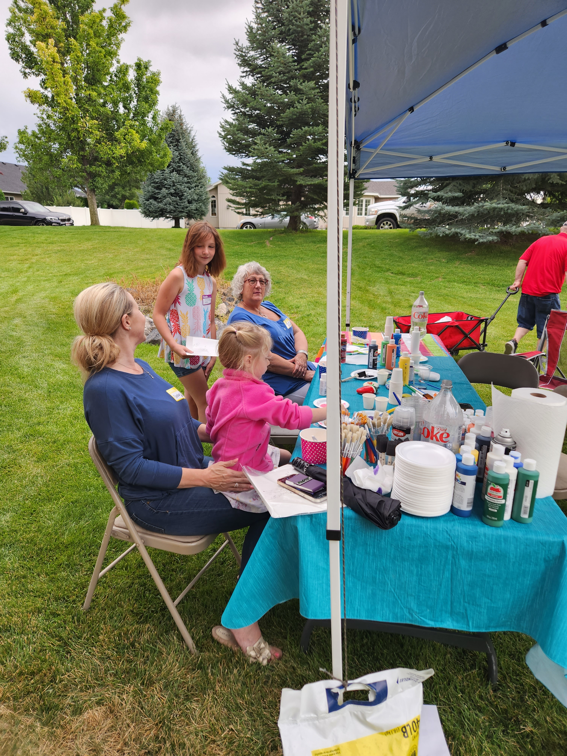
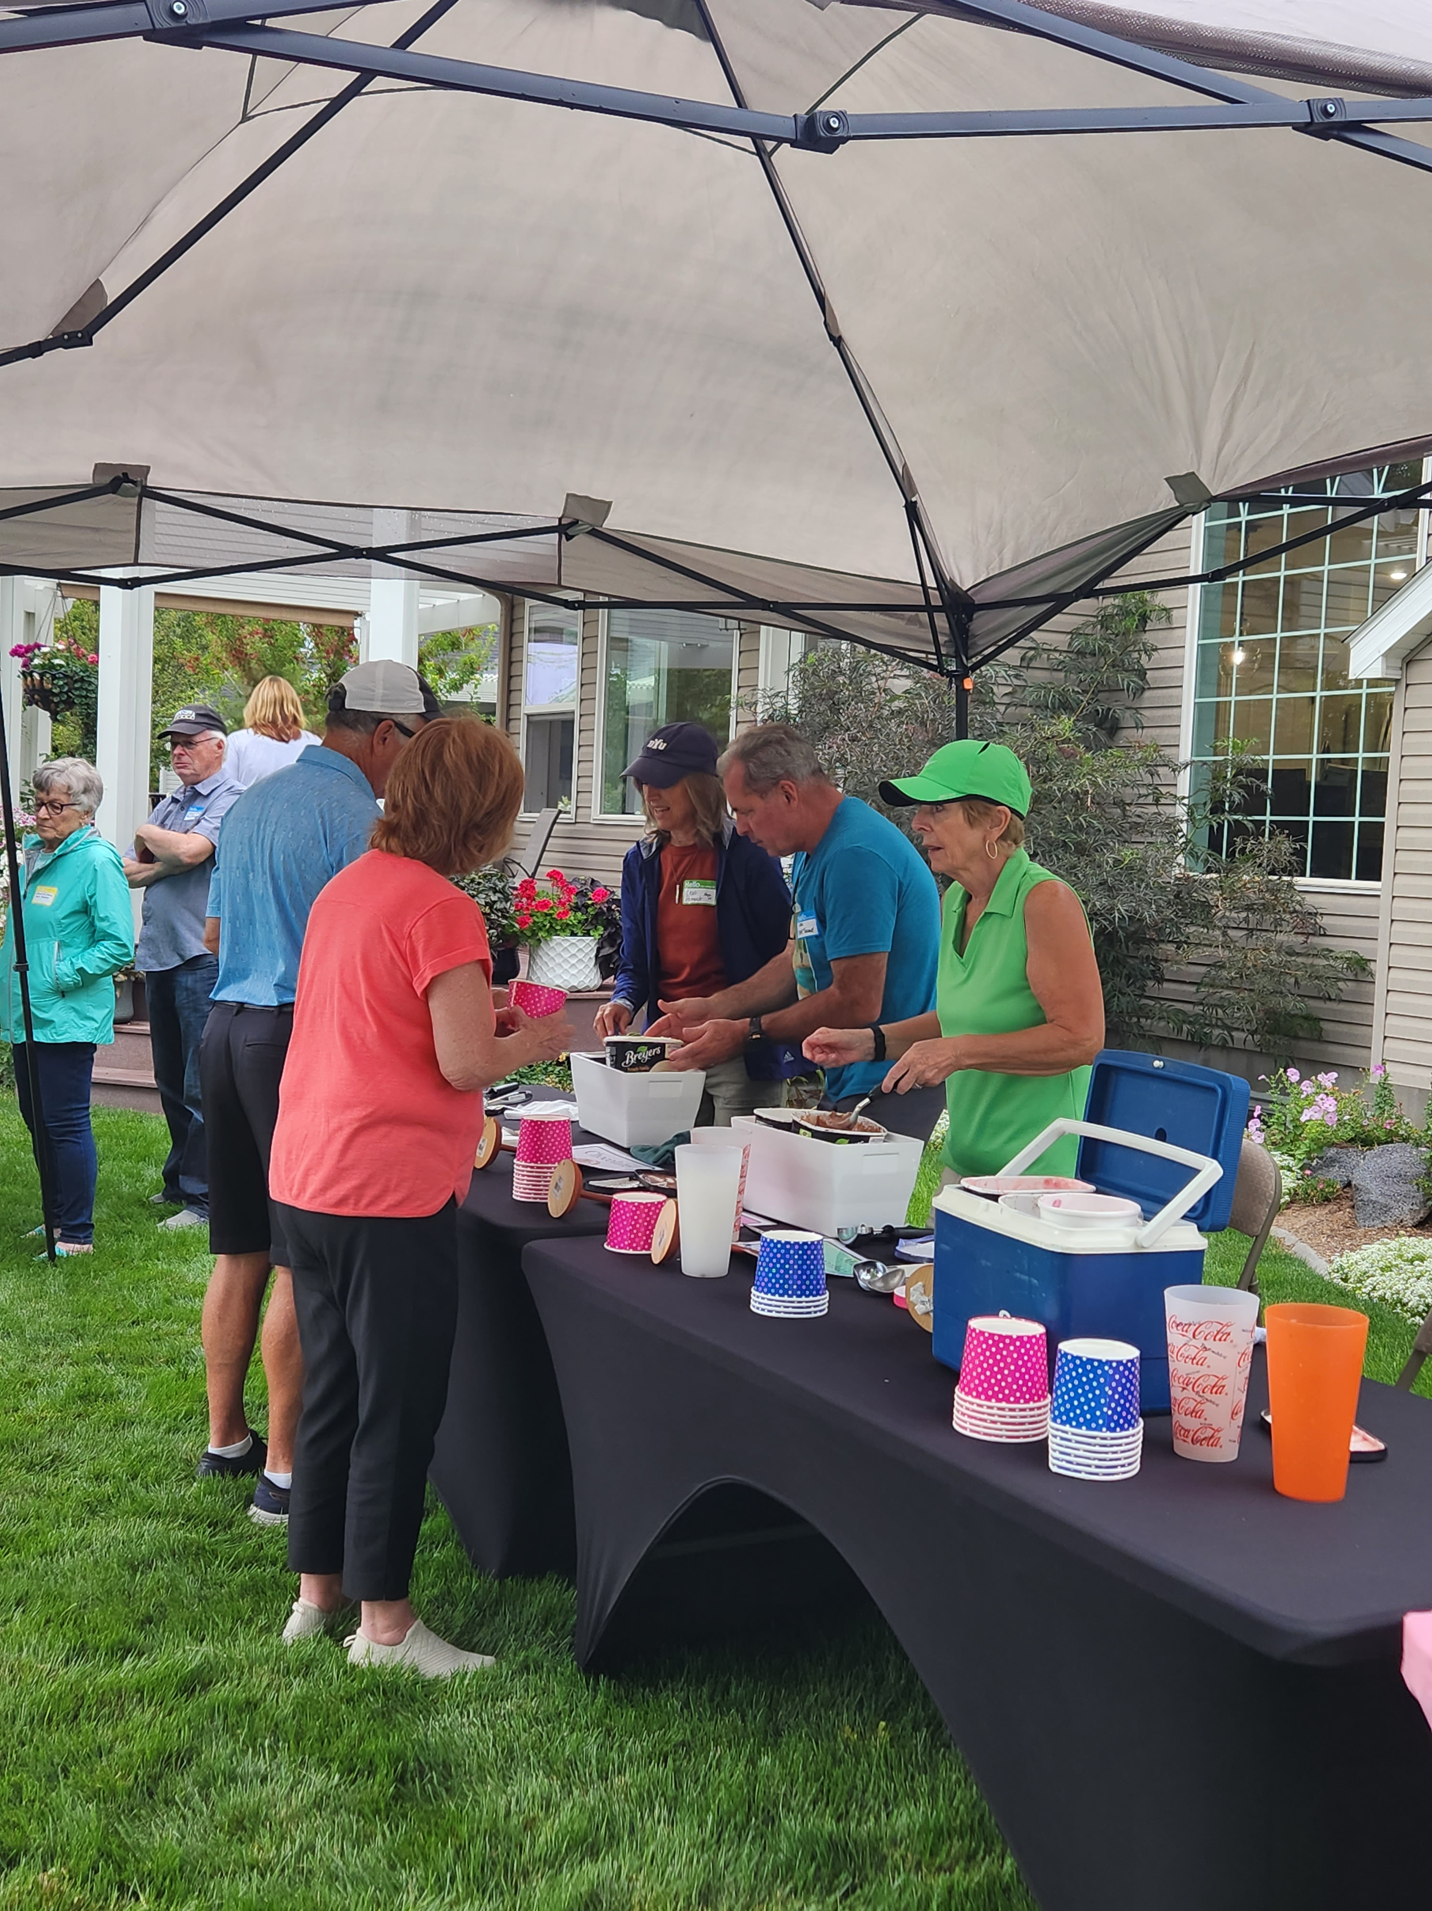
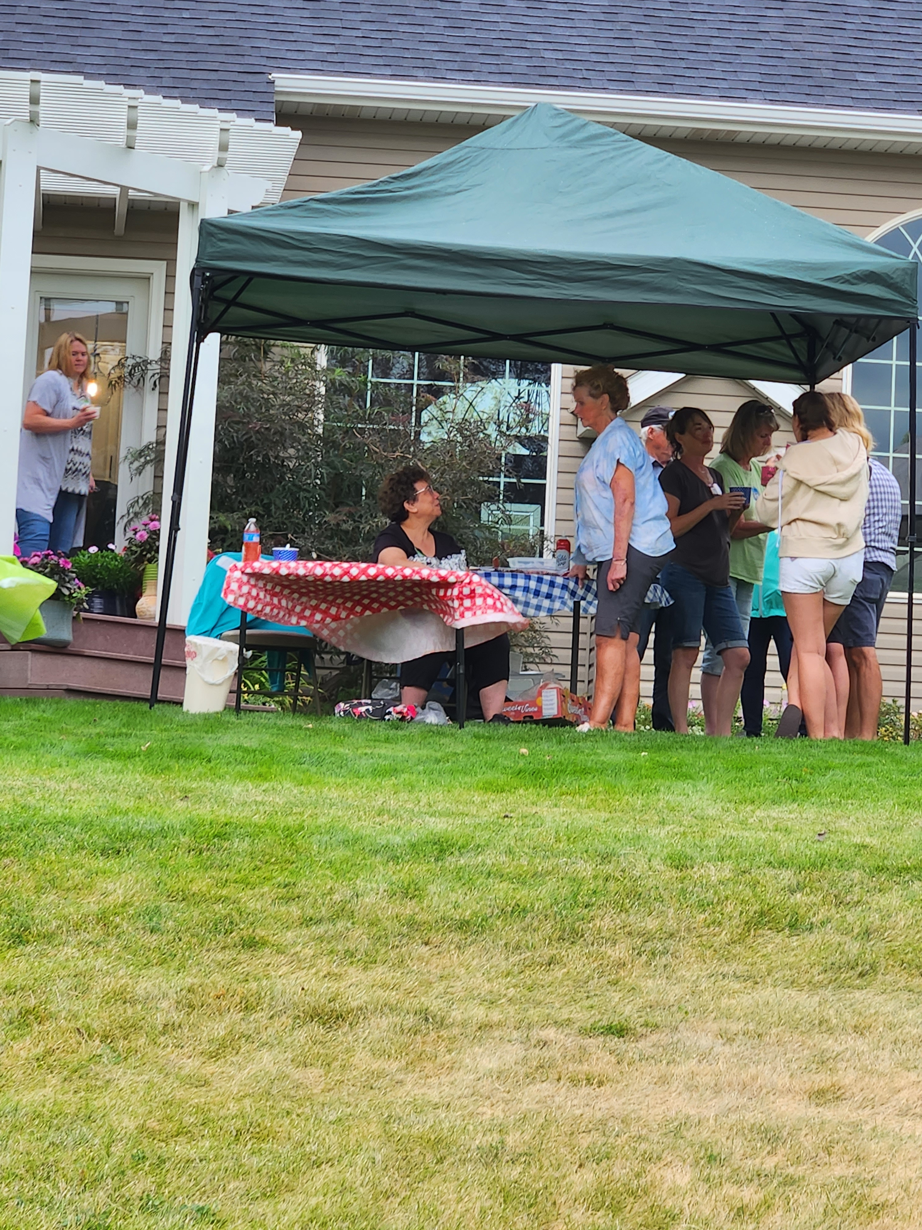
#10 Social Gatherings
Ice Cream Social
Rock Painting
Bocci Ball
Corn Hole
Notes:
Lavinda will report on the Ice Cream Social. Note all the activities we had at the event. Approximately 50 people participated.

Slide 29

#11
Sprinkler Repairs
Notes:
ABE There were 2 significant issues with our sprinkler system, one at each entrance to Waterford. Total cost to repair both was $1,060.00

Slide 30
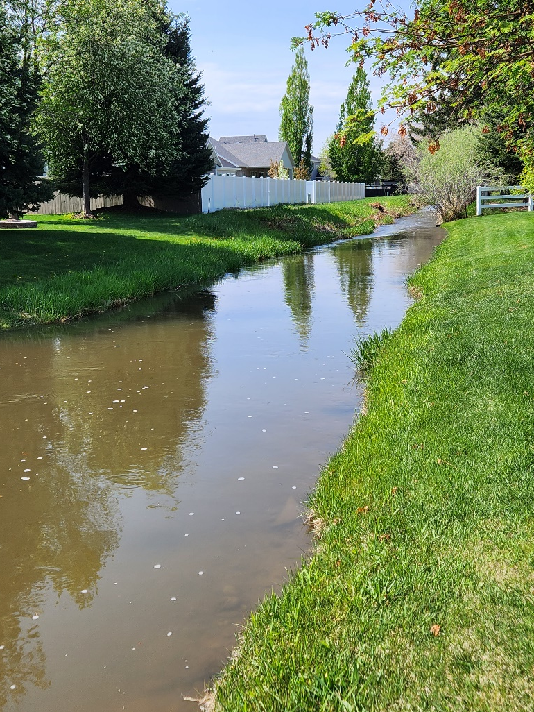
Gustafson Canal
#12
Established a Governing Policy Concerning Homeowners Along the Canal and their Responsibility to Maintain the Area Between their Property Line and the Water’s Edge
PAGE 16 in Handout
Notes:
ABE will report that established a policy for the canal upkeep – a copy is in their handout
See Pages 16-17 in your handouts

Slide 31
#13 Website waterfordhomeowners.org
We have set up a system where minutes, treasurer’s reports, and newsletters can be quickly uploaded to the HOA website so members can see them in a timely manner.
Minutes from Monthly Board Meeting
Treasurer’s Monthly Report
Annual Meeting Minutes
Note: The names of members discussed in a board meeting are redacted prior to publication.
Notes:
SUSAN will explain this

Slide 32
#14
The Board approved the implementation of a Penalty & Fines Policy last October. There were concerns from members that it would create an atmosphere of contention.
During this past year there were two matters that were addressed by this means. The homeowners have worked with the Board and resolved the issues and there were no resulting fines imposed.
Notes:
JOHN will explain this

Slide 33

#14
Transitioned to QuickBooks Online
Notes:
SUSAN will explain this

Slide 34
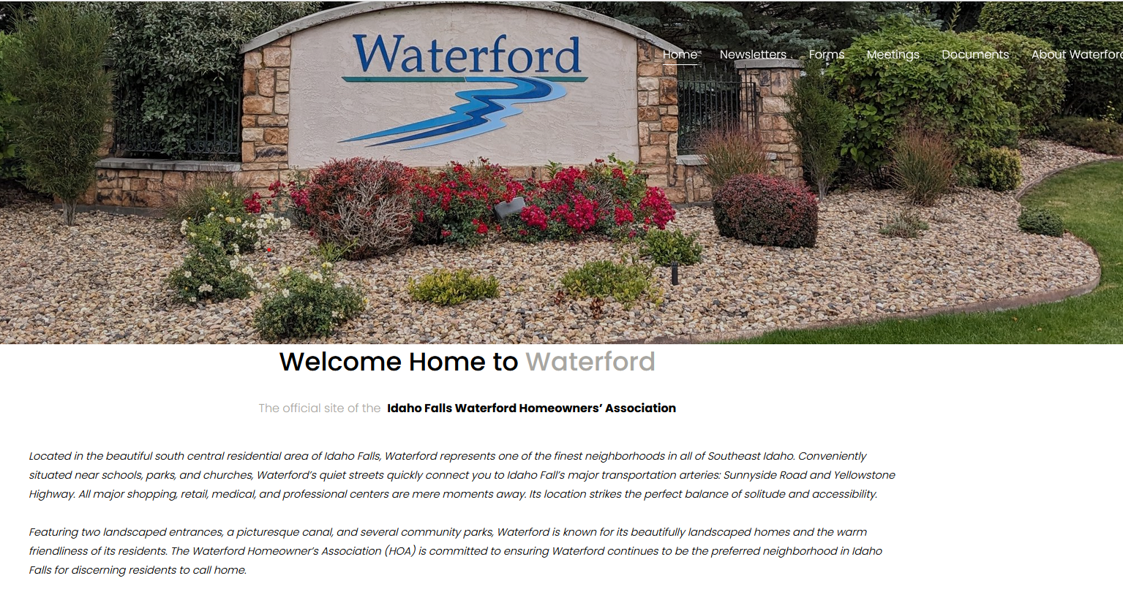
#15
The HOA Website now facilitates
Online Complaints or Violation Submissions
Waterfordhomeowners.org
Notes:
YNETTE will detail the upgrade of the HOA website to accommodate submissions for online complaints

Slide 35
2025 Goals & Plans
Notes:
JOHN will announce members of the Board will present our goals for the coming year

Slide 36
#1 Committees
Diversify and Establish Assignments within the Board and Waterford Homeowners’ Association
Notes:
JOHN will discuss need for more volunteers beside just the board.

Slide 37

#2 Training
Continue Board and Committee Training
Notes:
YNETTE: The board will work towards more training for the Board and ACC and Compliance Committee.

Slide 38
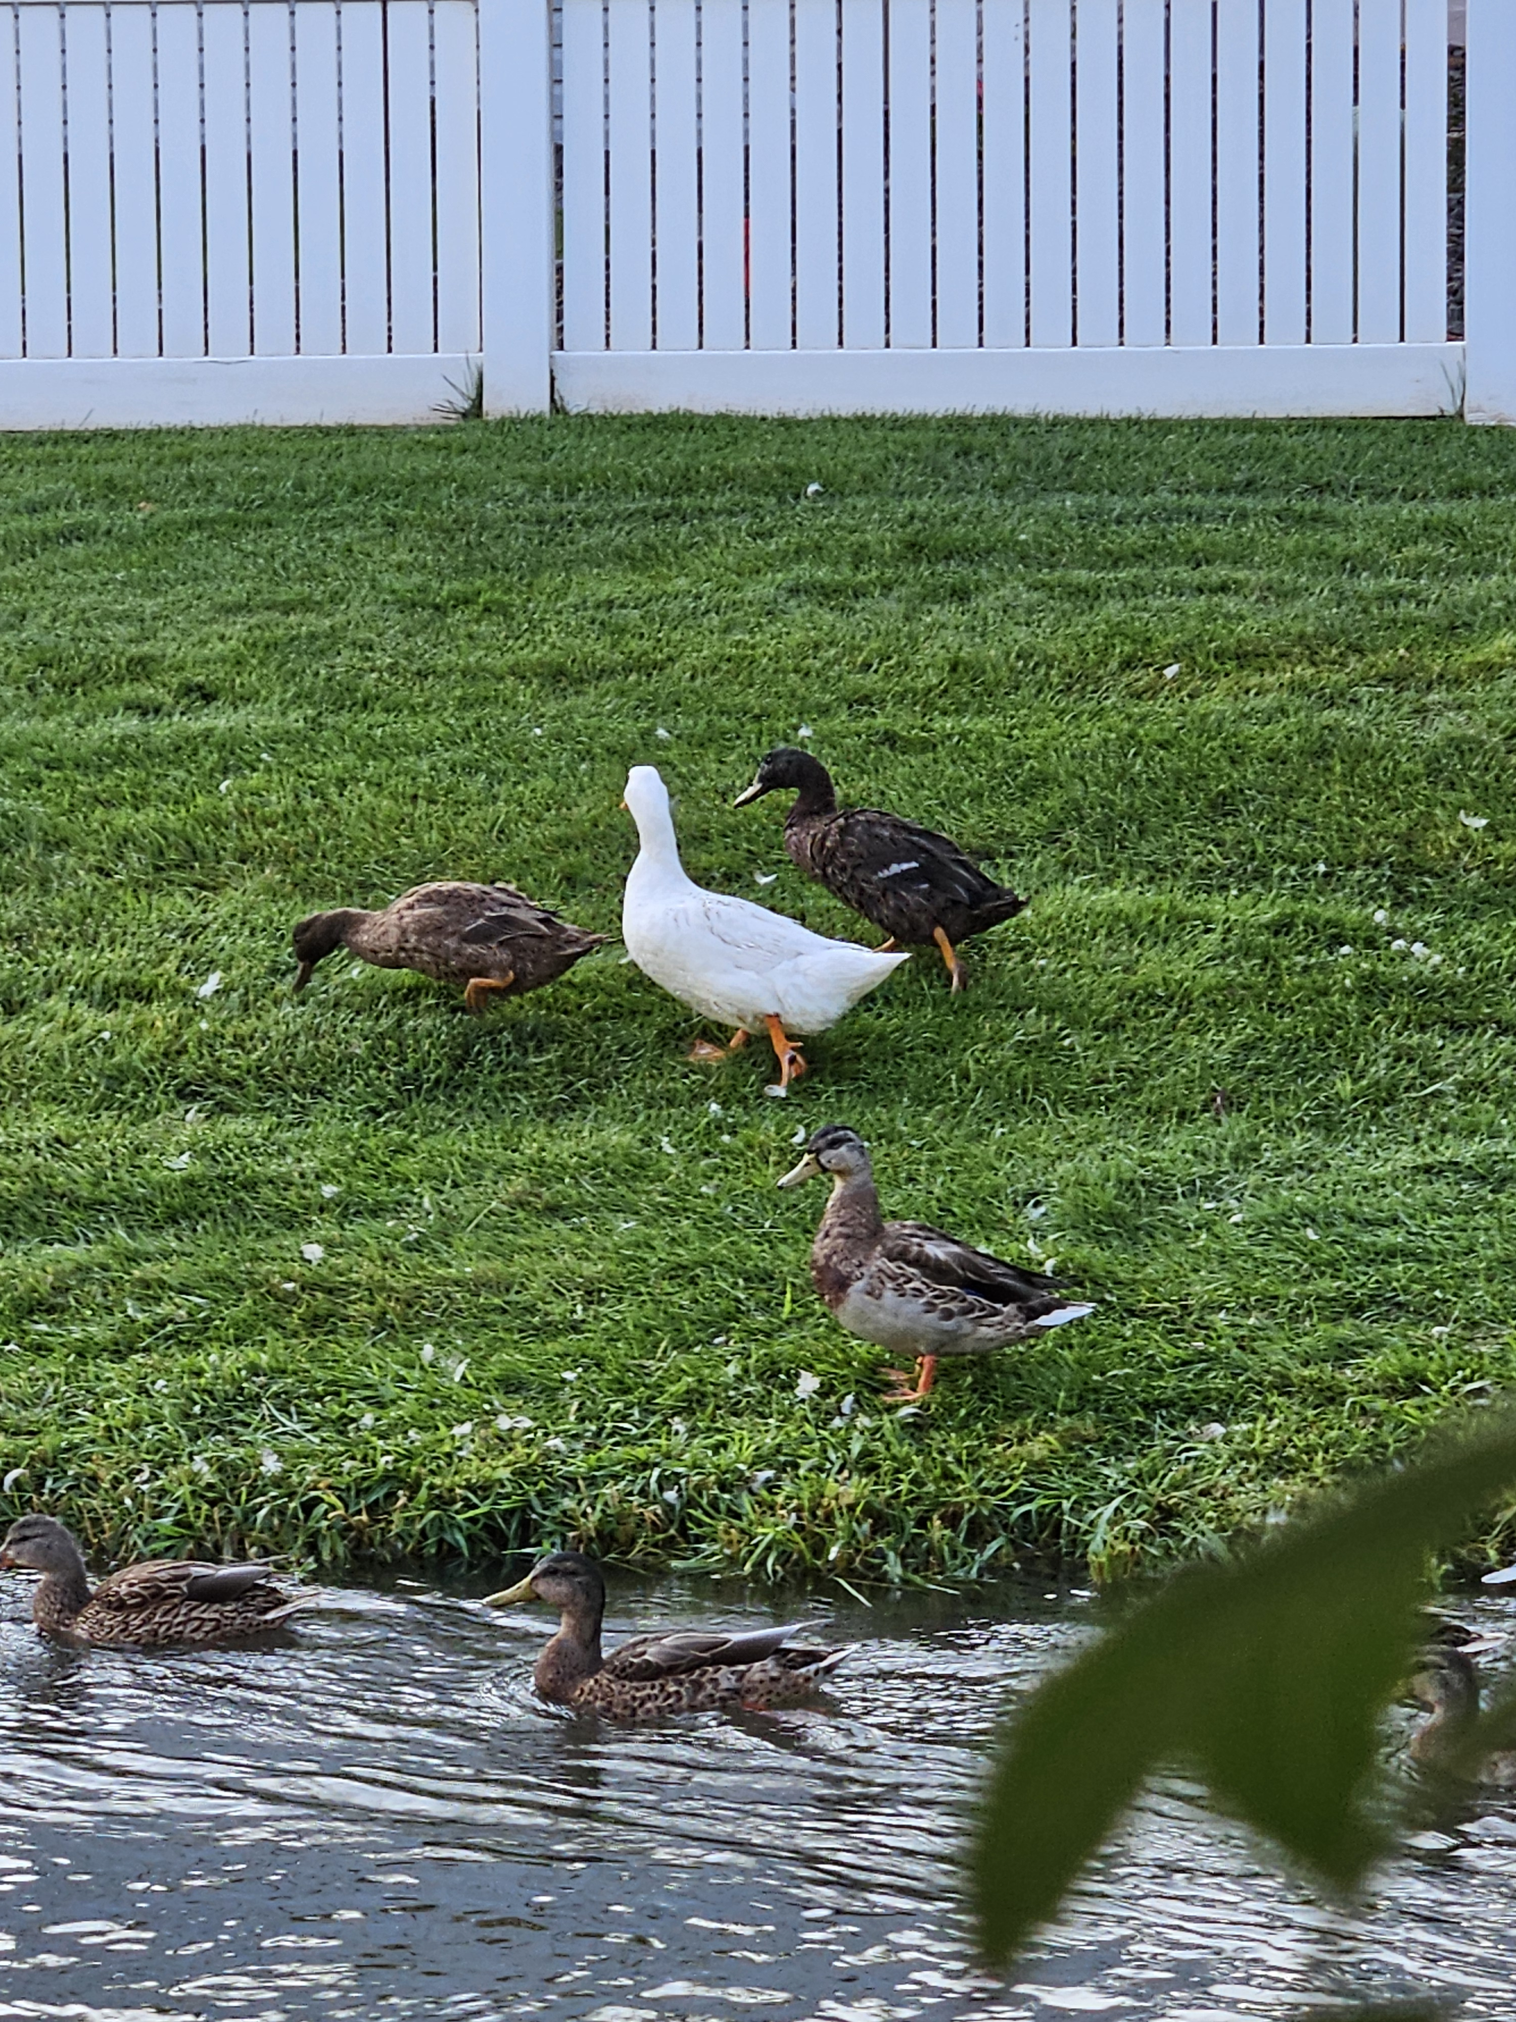
#3
Feeding & Nurturing Ducks along the
Gustavson Canal
Notes:
YNETTE will explain the duck issue and the board’s decision concerning them.

Slide 39
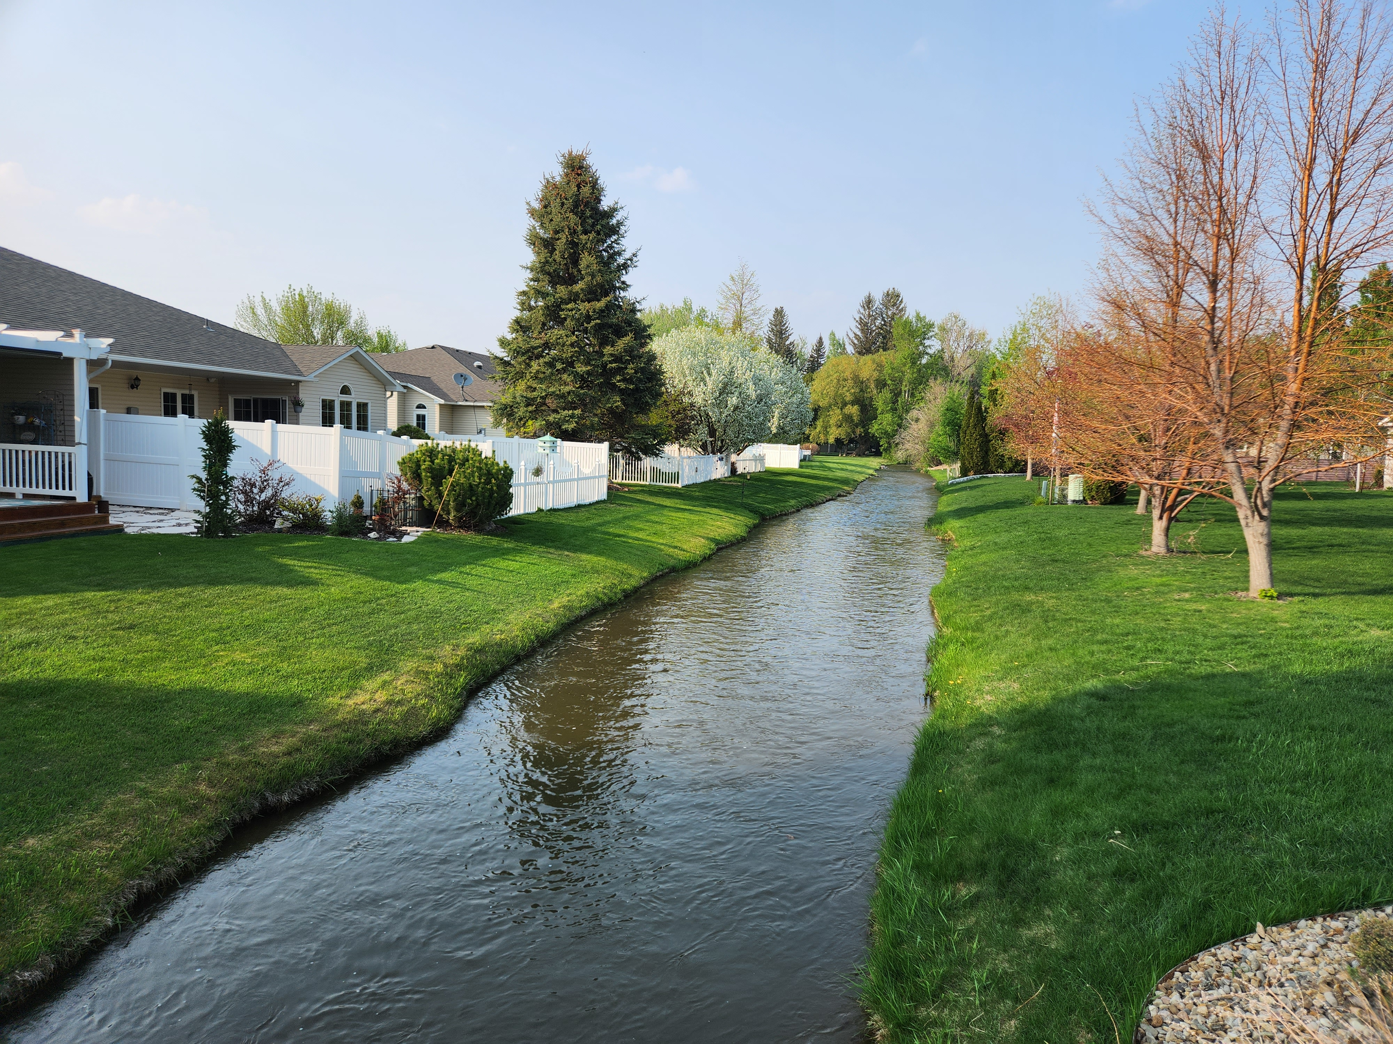
#4
Continue Efforts to Keep Canal Vegetation under Control by working with adjacent homeowners and the Irrigation District
Notes:
ABE will talk about the canal land upkeep.

Slide 40

#5 Yard Signage
Political Signs are allowed six weeks prior to an election but must be down with seven days after the election.
Business Signs are not allowed at the entrances to the Waterford Homeowners’ Association or on home property. This include REALTOR signs.
These business will be notified and asked to take them down.
Notes:
ABE will discuss this

Slide 41
Online ACC Requests
#6
We are continuing the development of the website to facilitate online requests to the Architectural Control Committee Approvals.
We want to be able to let members know exactly what they need to submit to get a project approved.
Notes:
YNETTE will explain this.

Slide 42

#7
Plant more trees at the end of Burgundy on the west side to help muffle noise from Sunnyside
Burgundy Project
Notes:
YNETTE will explain this.

Slide 43

#9
Install a solar power system on the north entrance island to facilitate holiday lights.
Holiday Lights
Notes:
CHRISTOPHER will explain this.

Slide 44
#10
Update and upgrade the signs at both entrances.
Notes:
CHRISTOPHER will discuss the possibility of updating the entrance signs

Slide 45
#11
New plants at Waterford Homeowners’ Association entrances, possibly some large rocks
Notes:
JOHN Possibly install more plants, shrubs, and rocks. The plants have depleted over the years.

Slide 46
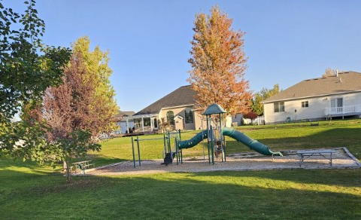
#12
Facilitate with the City of Idaho Falls
an ADA entrance to the playground/picnic area
Notes:
YNETTE Explain the reason for the ADA access, and the agreement we have with the City of Idaho Falls

Slide 47
Homeowner Input
What’s on your mind?
Comments
Suggestions
Notes:
JOHN will ask for comments, questions, and concerns. Ask for some positives, too

Slide 48
Introduction of Candidates
Candidates for Three Year Term
Two Positions Open
J. Doug Hall
Laura Macbeth (Incumbent)
Ynette Marx (Incumbent)
Ron Porter
Nominations from the floor
Notes:
JOHN will explain that there are two positions open. We have four candidates: Laura Macbeth and Ynette Marx are incumbents. Doug Hall and Ron Porter are two new nominations.
Thus far, from mailed in ballots, we have ______ write in candidates.

Slide 49
Voting
Notes:
JOHN will ask for ballots to be turned in. (Anyone that had not voted prior to the meeting was given a ballot when they arrived.)
Votes will be added up and the results turned over to John.

Slide 50
Volunteers Needed
We need your help to make our neighborhood strong. There are currently five standing committees. Some projects or events need temporary committees. We need help with both.
Standing Committees:
Landscaping & Property
Compliance
Activities & Social Events
Architectural Control
Communications
PAGE 19 in Handout
Notes:
JOHN While ballots are being counted all of Board can discuss the need for Volunteers. Review the committees. Note that each committee has at least one board member.
Board members can speak up about the work each committee is responsible for.

Slide 51
One & Done Committees
Special Landscaping Projects
Winter Holiday Decorations
4th of July Decorations
Ice Cream Social
Yard Sale
Newsletter Articles
Other Social Activities
Notes:
JOHN Will explain that there are opportunities to serve on One & Done Committees

Slide 52
Election Results
Notes:
JOHN AND SUSAN will announce voting results and ask for a motion that the ballots be destroyed.
There were _____ write in candidates.
The Ballots have been counted _______________ and ___________________ received the most votes and is therefore elected or re-relected for a three-year terms.
Susan will make a motion to destroy the ballots. John will ask for a second and then a vote is taken. “The motion passed and the ballots will be destroyed.”

Slide 53
Door Prize Drawing
Notes:
LAURA will conduct the drawing. Door Prize Drawing. Thank those that provided our door prizes.

Slide 54
Meeting Adjourned
Thank you for your contribution to our neighborhood!
Notes:
John will thank everyone for their participation and adjourn the meeting. “Meeting is Adjourned until Next October”

